Slide 1
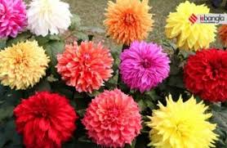
WELCOME

Slide 2
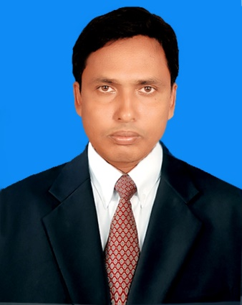
Teacher’s Identification
Md.Zakaria Ibne Mahatab Head Teacher Jagonnathpur Govt.Primary Shcool Chirirbandar,Dinajpur
Mobile No: 01723006285

Slide 3
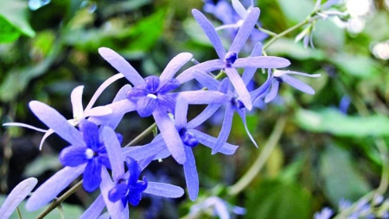
Lession Identification
Class: Three Time: 40 minutes
Subject: English For Today
Unit: 30 (Punctuation and Capital Letters
Lesion: 1-3
Activity: C
Date: 13-02-2021

Slide 4
Learning Outcomes
Student will be able to
Reading:
7.1.1 recognize punctuation marks and read accordingly.
Writing:
5.1.1 use full stop.
5.1.2 use comma.
5.1.3 use question mark.
6.1.1 use capital letters for sentence beginnings.
6.1.2 use capital letters for proper nouns.

Slide 5
Let’s Sing a song
https://youtu.be/gOPm5WA8_OM

Slide 6
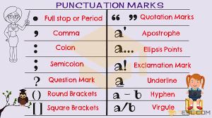
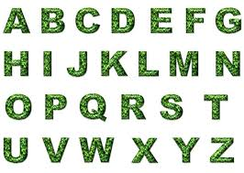
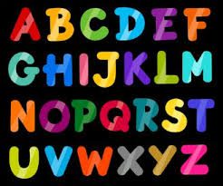
Punctuation and capital Letters

Slide 7
At a glance
The first letter of a sentence write with capital letter.
People name always write with capital letter
Country’s name always write with capital letter
City’s name always write with capital letter
River’s name always write with capital letter
Month’s name always write with capital letter
Full stop (.)-Generally we use full stop at the end of a sentence.
Comma (,)- Used to denote a pause in a sentence.

Slide 8
Punctuation Mark
Punctuation marks are symbols that are used to aid the clarity and comprehension of written language. Some common punctuation marks are the period, comma, question mark, exclamation point, apostrophe, quotation mark and hyphen.
Full stop (.)-Generally we use full stop at the end of a sentence.
Comma (,)- Used to denote a pause in a sentence.

Slide 9
Correct the sentences then write them in your exercise book
*Today is Monday
Answer: Today is Monday.
1. my name is ratul
Answer: My name is Ratul.
2. My sister’s name is smeeta
Answer: my sister’s name is Smeeta.
3. miss salam is our teacher
Answer: Miss Salam is our teacher.

Slide 10
4. i don’t have school tomorrow
Answer: I don’t have school tomorrow.
5. tomorrow is friday
Answer: Tomorrow is Friday.

Slide 11
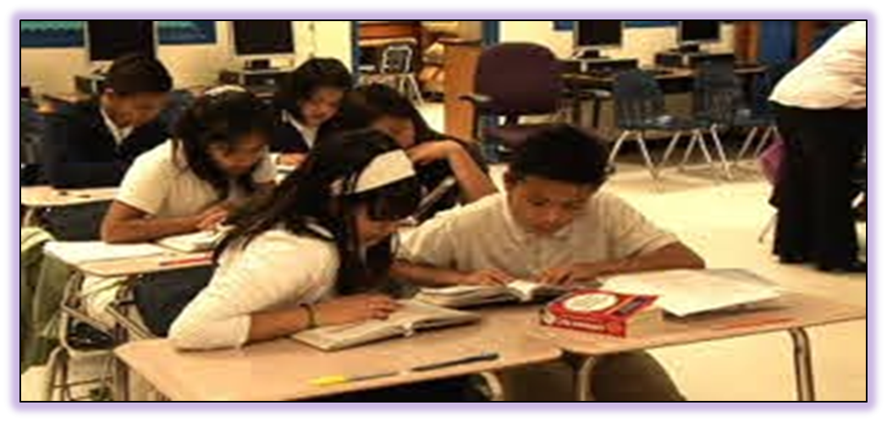
Pair Work
Write 3 sentences about your school with correct punctuation marks and capital letters.

Slide 12
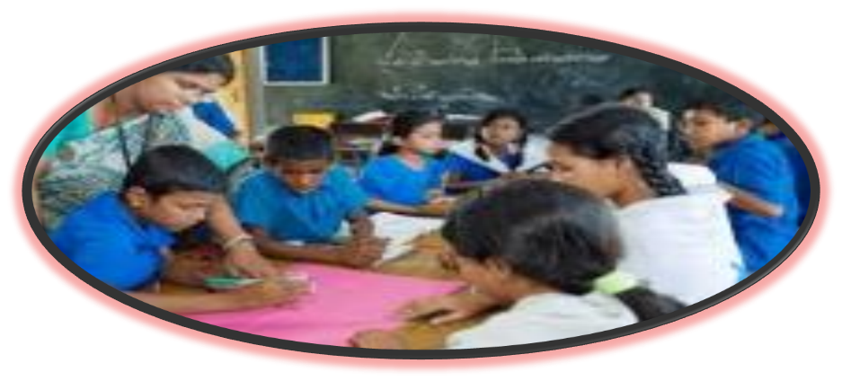
Group Work
Rewrite the sentences with correct punctuaion marks and capital letters
Hello i’m riya islam i’m 8 years old i’m a student i’m in class 3 at rajbari primary school

Slide 13
1. Where does we use capital letter? 2. Where does we use fullstop? 3. Where does we use comma?
Evalution

Slide 14
Home work
Re write the sentences with correct punctuation marks and capital letters
i’m a crow i live in a tree i get up early in the morning i’m active all day i fly in the sky and look for food sometimes i take food from people i’m very quick sometimes i eat dirty food

Slide 15
Thanks

