Slide 1
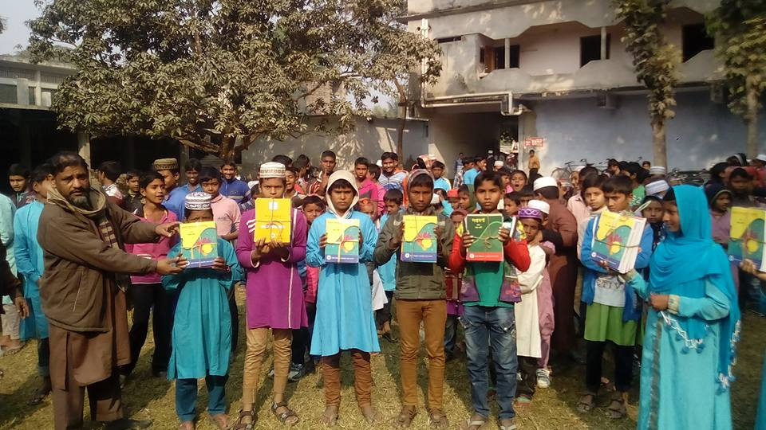
Welcome to
Zoom Online Class
Abul Kalam Azad(Assistant Teacher)
Satrajitpur Fazil Madrasah
Shibganj, Chapainawabganj

Slide 2
Question Tag Practice
Contracted form of Negative Tags
Am not | Aren’t
Is not | Isn't
Are not | Aren’t
Was not | Wasn’t
were not | Weren’t
Have not | Haven’t
Has not | Hasn’t
Had not | Hadn’t
Shall not | Shan’t
Will not | Won’t
Can not | Can’t
Could not | Couldn’t
should not | Shouldn’t
Must not | Mustn’t
might not | Mightn’t
do not | Don’t
does not | Doesn't
did not | Didn't

Slide 3
Question Tag Practice
01. No living being is above death.
02. A boy like you should not do this.
03. Allah may excuse a sinner.
04. Barking dogs seldom bite.
05. Be dignified.
06. Every action has an equal and opposite reaction.
07. Good bye.
08. He’s reading yesterday.
09. Men who live long grow old.
10. Morning shows the day.

Slide 4
Question Tag Practice
01. No living being is above death, are they?
02. A boy like you should not do this, should he?
03. Allah may excuse a sinner, mayn’t He?
04. Barking dogs seldom bite, do they?
05. Be dignified, will you?
06. Every action has an equal and opposite reaction, hasn’t it?
07. Good bye, don’t I?
08. He’s reading yesterday, wasn’t he?
09. Men who live long grow old, don’t they?
10. Morning shows the day, doesn’t it?

Slide 5
Question Tag Practice
11. My friends and I hardly go there.
12. My name and address he took with him.
13. My parents and I are happy.
14. Neither of them is guilty.
15. Study hard to succeed in life.
16. The sooner, the better.
17. Who dares to disobey the law.
18. You and he went there.
19. You and I came to terms.
20. Many a man will come.

Slide 6
Question Tag Practice
11. My friends and I hardly go there, do we?
12. My name and address he took with him, didn’t he?
13. My parents and I are happy, aren’t we?
14. Neither of them is guilty, are they?
15. Study hard to succeed in life, will you?
16. The sooner, the better, isn’t it?
17. Who dares to disobey the law, don’t they?
18. You and he went there, didn’t you?
19. You and I came to terms, didn’t we?
20. Many a man will come, won’t they?

Slide 7
Question Tag Practice
21. The little girl knew a little of the matter.
22. A barking dog seldom bites.
23. The Headmaster and the secretary said many things.
24. The oldest of the men little thinks about death.
25. Some one is crying.
26. What a same.
27. Slow and steady win the race.
28. All that glitters is not gold.
29. Look here he comes.
30. The brother in him rose.

Slide 8
Question Tag Practice
21. The little girl knew a little of the matter, did she?
22. A barking dog seldom bites, does it?
23. The Headmaster and the secretary said many things, didn’t they?
24. The oldest of the men little thinks about death, does he?
25. Some one is crying, aren’t they?
26. What a same, isn’t it?
27. Slow and steady win the race, don’t they?
28. All that glitters is not gold, is it?
29. Look here he comes, doesn’t he?
30. The brother in him rose, didn’t it?

Slide 9
Question Tag Practice
31. He set up a school in his village.
32. You never say what you are thinking.
33. Who cares.
34. Who dares to disobey the law.
35. What a pity.
36. The will of people prevails.
37. One should do one’s duty.
38. The girl in her will surprise you.
39. That he is honest is known to all.
40. The tree has borne fruits.

Slide 10
Question Tag Practice
31. He set up a school in his village, didn’t he?
32. You never say what you are thinking, do you?
33. Who cares, doesn’t he?
34. Who dares to disobey the law, does he?
35. What a pity, isn’t it?
36. The will of people prevails, doesn’t it?
37. One should do one’s duty, shouldn’t they?
38. The girl in her will surprise you, won’t it?
39. That he is honest is known to all, isn’t it?
40. The tree has borne fruits, hasn’t it?

Slide 11
Question Tag Practice
41. The girl in her pleased us all.
42. He spent few hours with us.
43. I think that he is right.
44. The brother in him arose.
45. Everybody desires success.
46. The pupil cut a sorry figure in the exam.
47. Many a rose is born to blush unseen.
48. The prime minister with all the members of the cabinet went to the U.S.A.
49. It ‘s hardly rained at all this summer.
50. Your honesty charmed us.

Slide 12
Question Tag Practice
41. The girl in her pleased us all, didn’t she?
42. He spent few hours with us, didn’t he?
43. I think that he is right, don’t I?
44. The brother in him arose, didn’t it?
45. Everybody desires success, don’t they?
46. The pupil cut a sorry figure in the exam, didn’t they?
47. Many a rose is born to blush unseen, aren’t they?
48. The prime minister with all the members of the cabinet went to the U.S.A, didn’t they?
49. It ‘s hardly rained at all this summer, has it?
50. Your honesty charmed us, didn’t it?

Slide 13
Thank you

