Slide 1
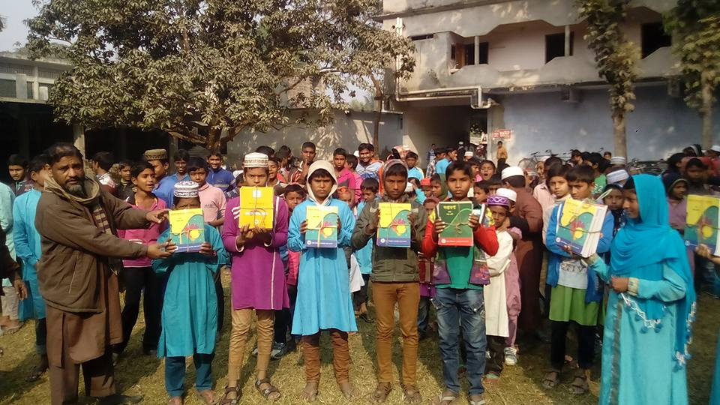
Welcome to
Zoom Online Class
Abul Kalam Azad(Assistant Teacher)
Satrajitpur Fazil Madrasah
Shibganj, Chapainawabganj

Slide 2
Question Tag Practice
Contracted form of Negative Tags
Am not | Aren’t
Is not | Isn't
Are not | Aren’t
Was not | Wasn’t
were not | Weren’t
Have not | Haven’t
Has not | Hasn’t
Had not | Hadn’t
Shall not | Shan’t
Will not | Won’t
Can not | Can’t
Could not | Couldn’t
should not | Shouldn’t
Must not | Mustn’t
might not | Mightn’t
do not | Don’t
does not | Doesn't
did not | Didn't

Slide 3
Question Tag Practice
51. A lie never lies hidden for long.
52. The strong always oppress the weak.
53. This book is rare now.
54. When he came, I was sleeping.
55. Pray to Almighty for me.
56. The teacher as well as the workers may come.
57. How time does fly.
58. Something is better than nothing.
59. That sounds good.
60. An ideal student hardly studies.

Slide 4
Question Tag Practice
51. A lie never lies hidden for long, does it?
52. The strong always oppress the weak, don’t they?
53. This book is rare now, is it?
54. When he came, I was sleeping, wasn’t I?
55. Pray to Almighty for me, won’t you?
56. The teacher as well as the workers may come, mayn’t they?
57. How time does fly, doesn’t it?
58. Something is better than nothing, isn’t it?
59. That sounds good, doesn’t it?
60. An ideal student hardly studies, does he?

Slide 5
Question Tag Practice
61. To err is human.
62. The girl who came to me is my sister.
63. Death knows no time.
64. That sounds great.
65. How awful.
66. Good morning.
67. No, there’s too much work to do.
68. He’d finished the work.
69. His economical policy played a vital role in our economy.
70. Beautiful scenery.

Slide 6
Question Tag Practice
61. To err is human, isn’t it?
62. The girl who came to me is my sister, isn’t she?
63. Death knows no time, does it?
64. That sounds great, doesn’t it?
65. How awful, isn’t it?
66. Good morning, isn’t it?
67. No, there’s too much work to do, is there?
68. He’d finished the work, hadn’t he?
69. His economical policy played a vital role in our economy, didn’t it?
70. Beautiful scenery, isn’t it?

Slide 7
Question Tag Practice
71. It is man who pollutes the environment.
72. A healthy man can reside only in a healthy body.
73. Every action has got an equal and opposite reaction.
74. No one knows what’ll happen next.
75. How odd!
76. The helpless will be helped.
77. Two and two make four.
78. Men should not tell a lie.
79. We live in Bangladesh.
80. The weather was fine yesterday.

Slide 8
Question Tag Practice
71. It is man who pollutes the environment, isn’t it?
72. A healthy man can reside only in a healthy body, can’t it?
73. Every action has got an equal and opposite reaction, hasn’t it?
74. No one knows what’ll happen next, do they?
75. How odd! Isn’t it?
76. The helpless will be helped, won’t they?
77. Two and two make four, don’t they?
78. Men should not tell a lie, should they?
79. We live in Bangladesh, don’t we?
80. The weather was fine yesterday, wasn’t it?

Slide 9
Question Tag Practice
81. This is the right way to do it.
82. Life is very busy in the big cities.
83. We needed a change in thoughts.
84. Let us make them realize it.
85. Man is a social being.
86. He cannot live alone.
87. It is man, who pollutes his environment.
88. Every mother loves her child.
89. Don’t forget me.
90. My father and I are happy.

Slide 10
Question Tag Practice
81. This is the right way to do it, isn’t this?
82. Life is very busy in the big cities, isn’t it?
83. We needed a change in thoughts, didn’t we?
84. Let us make them realize it, shall we?
85. Man is a social being, isn’t he?
86. He cannot live alone, can he?
87. It is man, who pollutes his environment, isn’t it?
88. Every mother loves her child, don’t they?
89. Don’t forget me, will you?
90. My father and I are happy, aren’t we?

Slide 11
Question Tag Practice
91. Let her solve the matter.
92. You had better leave now.
93. We ought to love our motherland.
94. Look at this paper.
95. Let’s phone.
96. It is a beautiful afternoon.
97. Let’s go out for a walk.
98. The police arrested him.
99. Both are responsible.
100. Let’s take an oath today.

Slide 12
Question Tag Practice
33. Let her solve the matter, will you?
34. You had better leave now, hadn’t you?
35. We ought to love our motherland, oughtn’t we?
36. Look at this paper, will you?
37. Let’s phone, shall we?
38. It is a beautiful afternoon, isn’t it?
39. Let’s go out for a walk, shall we?
40. The police arrested him, didn’t they?
41. Both are responsible, aren’t they?
42. Let’s take an oath today, shall we?

Slide 13
Thank you

