Slide 1
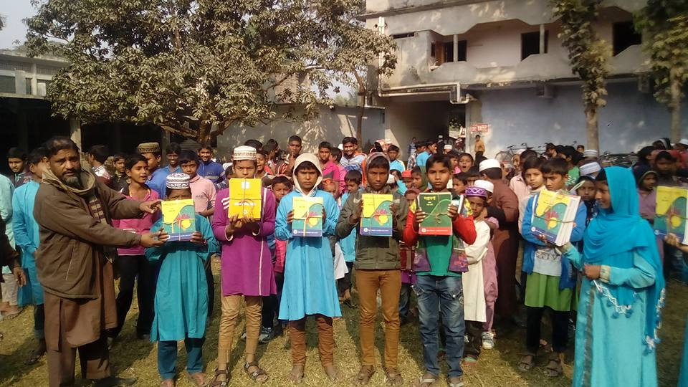
Welcome to
Zoom Online Class
Abul Kalam Azad(Assistant Teacher)
Satrajitpur Fazil Madrasah
Shibganj, Chapainawabganj

Slide 2
Question Tag Practice
Contracted form of Negative Tags
Am not | Aren’t
Is not | Isn't
Are not | Aren’t
Was not | Wasn’t
were not | Weren’t
Have not | Haven’t
Has not | Hasn’t
Had not | Hadn’t
Shall not | Shan’t
Will not | Won’t
Can not | Can’t
Could not | Couldn’t
should not | Shouldn’t
Must not | Mustn’t
might not | Mightn’t
do not | Don’t
does not | Doesn't
did not | Didn't

Slide 3
Question Tag Practice
01. Nothing is impossible.
02. I think everybody knows it.
03. The idle always lag behind.
04. Let’s motivate them.
05. Motivation seldom goes in vain.
06. Congratulations, you have made an excellent result.
07. Thanks. But my parents and teachers also deserve the credit.
08. We ought to remain grateful them.

Slide 4
Question Tag Practice
01. Nothing is impossible, is it?
02. I think everybody knows it, don’t they?
03. The idle always lag behind, don’t they?
04. Let’s motivate them, shall we?
05. Motivation seldom goes in vain, does it?
06. Congratulations, you have made an excellent result, haven’t you?
07. Thanks. But my parents and teachers also deserve the credit, don’t they?
08. We ought to remain grateful them, oughtn’t we?

Slide 5
Question Tag Practice
09. You too studied hard.
10. It is our duty to study in a disciplined way.
11. Let us start our journey.
12. They used to play football in the afternoon.
13. Nobody should laugh at the blind.
14. There is nothing for her to eat.
15. Mina had better to stay at home.
16. You aren’t doing the work.

Slide 6
Question Tag Practice
09. You too studied hard, didn’t you?
10. It is our duty to study in a disciplined way, isn’t it?
11. Let us start our journey, shall we?
12. They used to play football in the afternoon, didn’t they?
13. Nobody should laugh at the blind. Should they?
14. There is nothing for her to eat, is there?
15. Mina had better to stay at home, hadn’t she?
16. You aren’t doing the work, are you?

Slide 7
Question Tag Practice
17. Somebody left their house yesterday.
18. What a beautiful day it is.
19. A cat catches a mouse.
20. Bangladesh is our motherland.
21. Something is burning.
22. Rahim as well as his friends was present.
23. He did it.
24. I know nothing about him.

Slide 8
Question Tag Practice
17. Somebody left their house yesterday, didn’t they?
18. What a beautiful day it is, isn’t it?
19. A cat catches a mouse, doesn’t it?
20. Bangladesh is our motherland, isn’t she?
21. Something is burning, aren’t they?
22. Rahim as well as his friends was present, wasn’t he?
23. He did it, didn’t he?
24. I know nothing about him, do I?

Slide 9
Question Tag Practice
25. Let’s arrange a class party.
26. The moon shines at night.
27. Everybody loves flower.
28. Nothing can satisfy him.
29. He has few reasons for waiting.
30. That was my pen.
31. Nobody believes a liar.
32. We have to study English.

Slide 10
Question Tag Practice
25. Let’s arrange a class party, shall we?
26. The moon shines at night, isn’t it?
27. Everybody loves flower, don’t they?
28. Nothing can satisfy him, can it?
29. He has few reasons for waiting, hasn’t he?
30. That was my pen, wasn’t it/ that?
31. Nobody believes a liar, do they?
32. We have to study English, haven’t we?

Slide 11
Thank you

