Slide 1
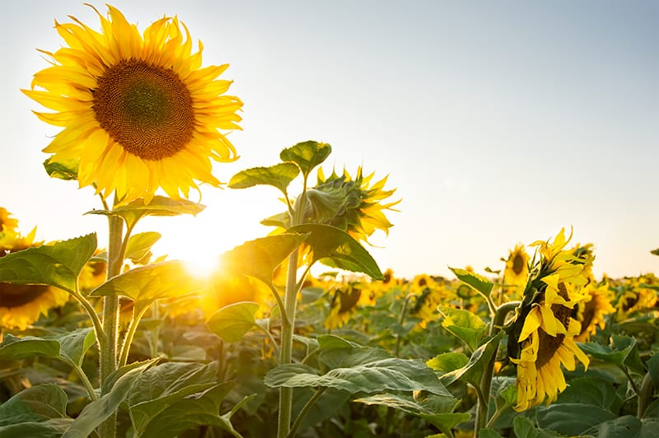
Welcome

Slide 2
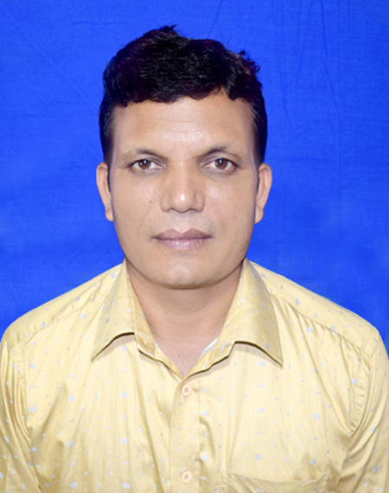
A F M Saiful Islam
Head Teacher
Musrat Madati Govt. Primary School
Kaligonj, Lalmonirhat .

Slide 3
Class : Five
Subject : English
Unit : 4 (Leisure time)
Lesson : 1-2 A
Time : 40 minutes

Slide 4
Learning outcomes
Listening: 2.3.1 comply with request.
Speaking: 2.3.1 ask and answer WH questions.
8.1.8 take part in conversation on appropriate
topics.
Reading: 1.6.1 recognize and read statements, commands,
greetings, questions and answers.
.

Slide 5
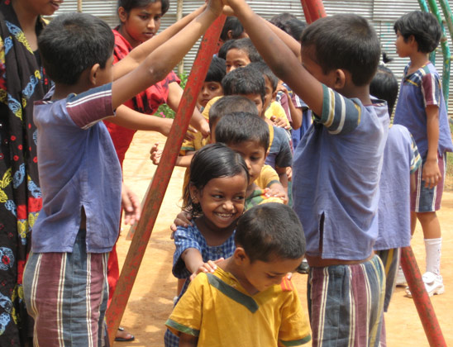
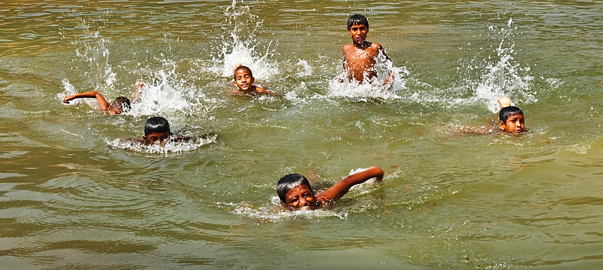
Look at the pictures
What are they doing?
When do you play or swim ?
Free time

Slide 6
Today’s lesson is Leisure time
Open at page 14

Slide 8
New word’s
Leisure:
Free time
Reporter:
A person who reports.
Magazine:
A periodical publication containing
Articles and illustration.

Slide 9
Teacher’s reading
Students, listen and repeat after me.

Slide 10
Student’s silent reading
read the text silently

Slide 11
Act the dialogue
Teacher to student
Student to student

Slide 12
Focus
How do we make request ?
We make requests with Would you/ Could you ……..?

Slide 13
Ask and answer
1. In which class Sima and Biju read ?
2. Where does Sima’s cousin live ?
3. How do Sima spend her leisure time ?
4. Who like sports ?
5. How do you spend your leisure time ?

Slide 14
Assessment
We’ve learnt how to take permission to ask question ?

Slide 15
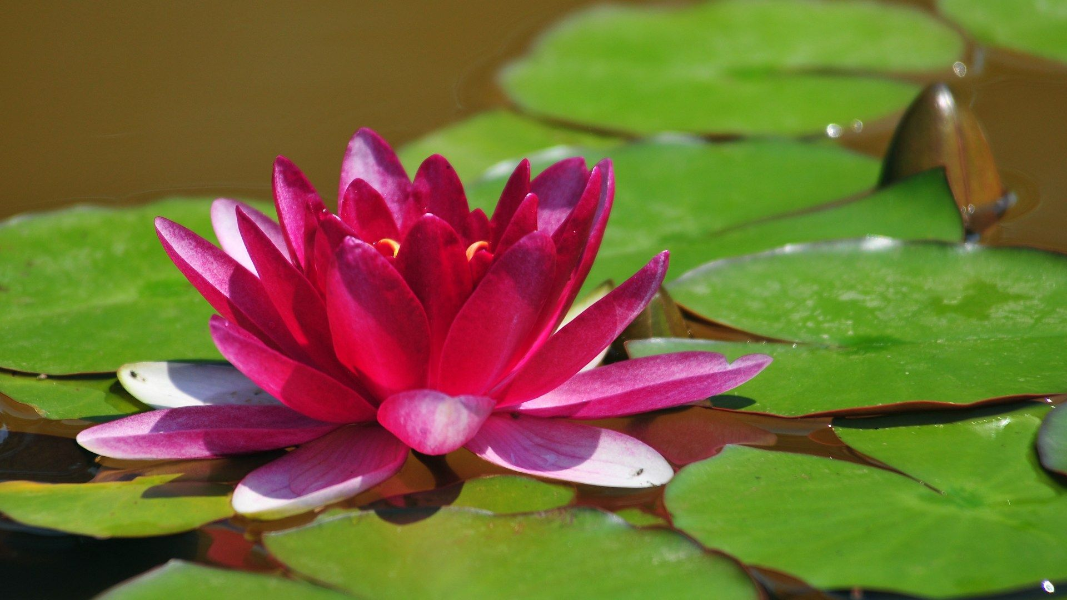
Thanks a lot.

