Slide 1
Welcome to my class

Slide 2
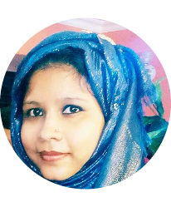
Introduction
Class Introduction
Teacher’s Introduction
English 1st Paper
Class: Nine/ Ten
Unit:10,Lesson:3
Amena Ferdosi (Nizum)
Asistant Teacher (English)
Bhimpur High School
Chatkhil, Noakhali.

Slide 3
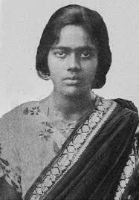
What do you see in the picture?
Do you know her?

Slide 4
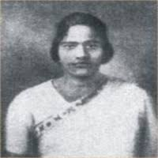
Pritilata Waddedar

Slide 5
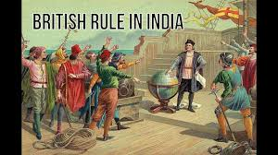
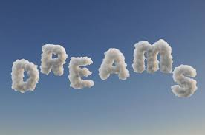
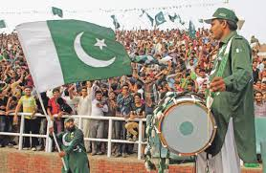
She had dream.

Slide 6
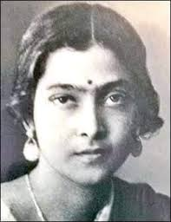
Our lesson topic is……….
They had dreams

Slide 7
Learning Outcomes
After we have studied the unit, students will be able to-
Listen for specific information
Participate in conversations and discussions
Understand and narrate problems
Take and give interviews
Complete a grid

Slide 8
Let us know about Pritilata

Slide 9
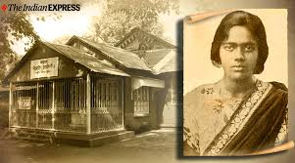
Pritilata was born in Chattogram on 5 May 1911.

Slide 10
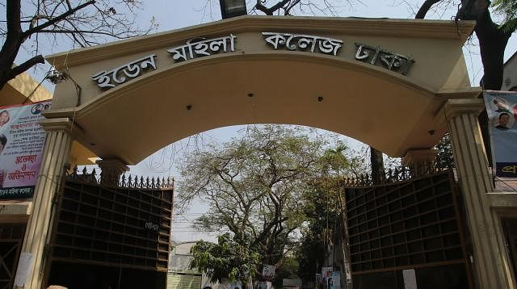
She was a meritorious student at Dr Khastagir Government Girl’s School in Chattogram and Eden College, Dhaka.

Slide 11
She graduated in philosophy with distinction from Bethune College in Kolkata.

Slide 12
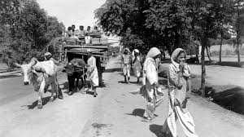
Pritilata was an activist in the anti-British movement.

Slide 13
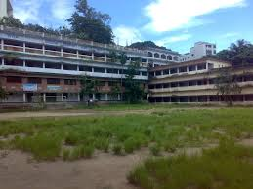
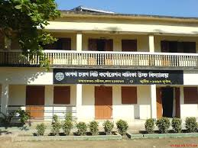
Pritilata became the head teacher of Nandankanon Aparna charan School in Chattogram.

Slide 14
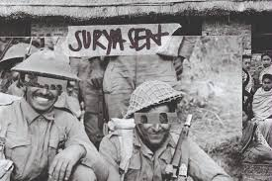
She involved herself in Surja Sen’s armed resistance movement.

Slide 15
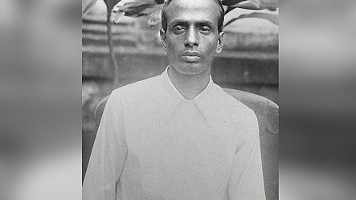
Surja Sen was a famous anti- British movement organizer and revolutionary.

Slide 16
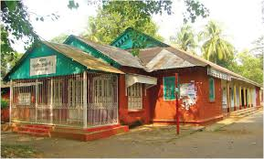
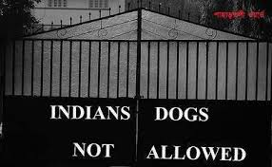
In 1932, Surja Sen planned an attack on the Pahartali European Club. The club was well-known for its notorious sign at its entrance.

Slide 17
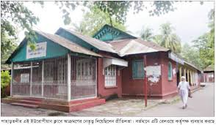
Surja Sen assigned Pritilata to lead a team of 10-12 men to attack the club. The raid was successful but Pritilata dressed as a man, failed to get out of the club.

Slide 18
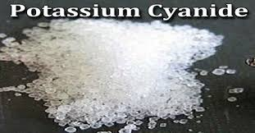
She committed suicide by taking potassium Cyanide to avoid arrest.

Slide 19
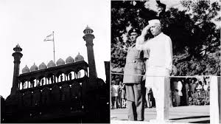
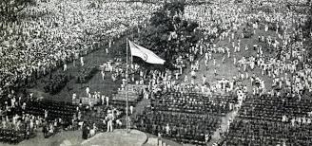
The British rule came to an end in 1947 though she couldn’t see it during her lifetime.

Slide 20
Let us know some keywords
conversation
Discussion

Slide 21
Meritorious
Talented

Slide 22
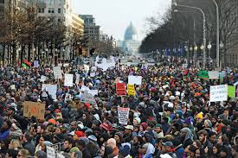
Movement
Agitation

Slide 23
Answer the following questions.
Where did Pritilata fight?
When did she fight?
Why did she fight?
What was pritilata’s profession?
What do you learn from pritilara’s life?

Slide 24
Homework
Write a short notes about a dreamer like Pritilata.

Slide 25
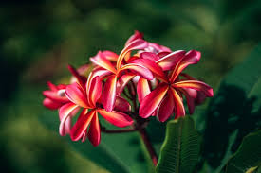
Thank You

