Slide 1
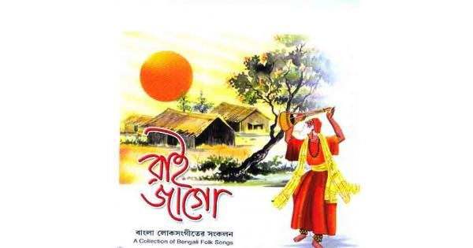
Welcome

Slide 2
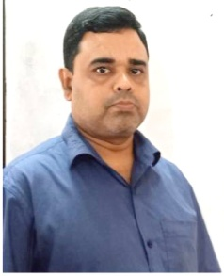
INTRODUCTION
ABDUL AZIZ
B.A(HON’S), M.A(ENGLISH)
Assistant Teacher (English)
MADHAIA BAZAR SADIM HIGH SCHOOL
E-mail: azizabidpur@gmail.com
Class –Eight
English 1st Paper
Unit : 01, Lesson : 01

Slide 3
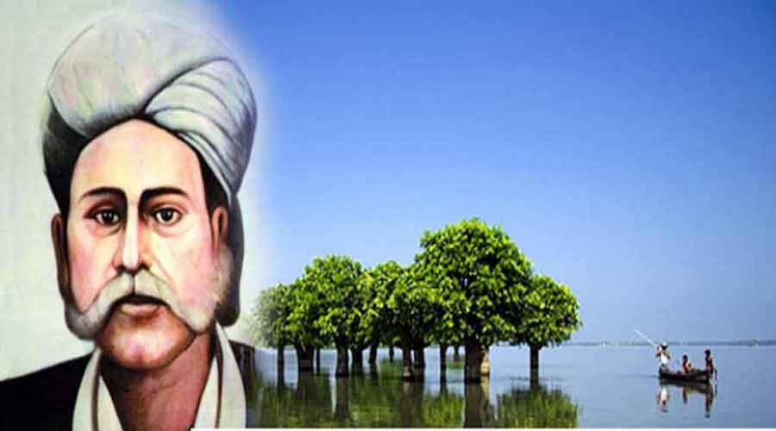
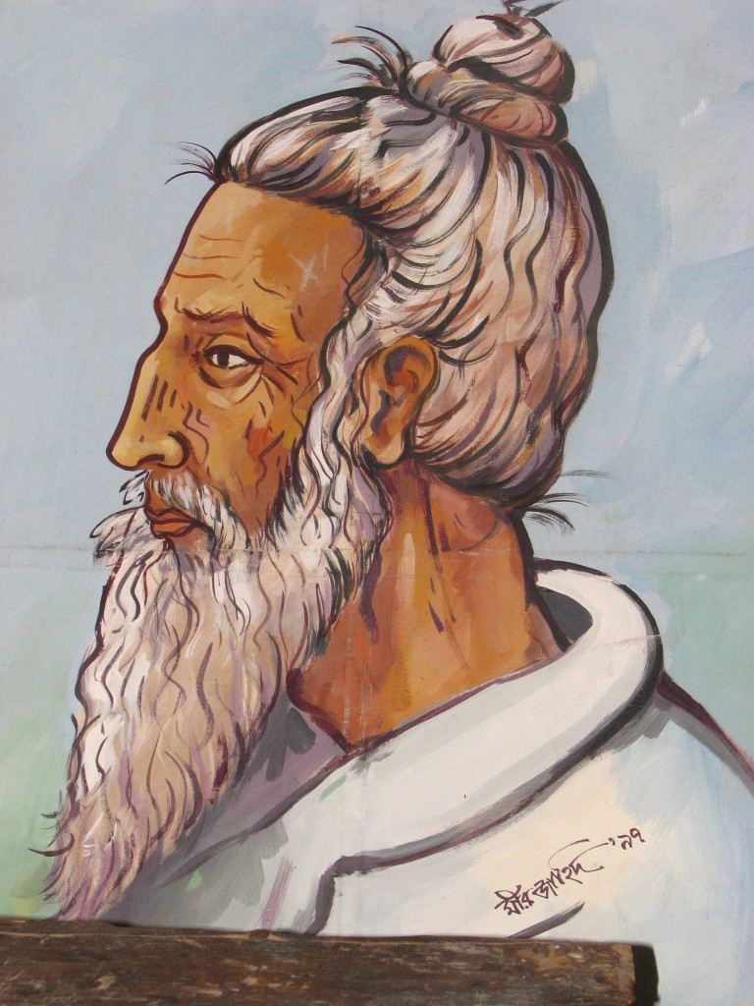
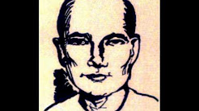
Look at the pictures
5 min
Hason Raja
Lalon Fakir
They are composer and Singer of Folk songs
Radha Romon

Slide 4
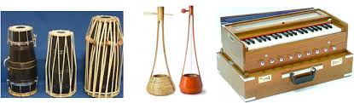
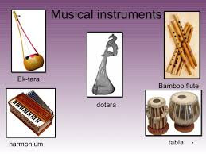
These are the instrument to sing folk songs

Slide 5
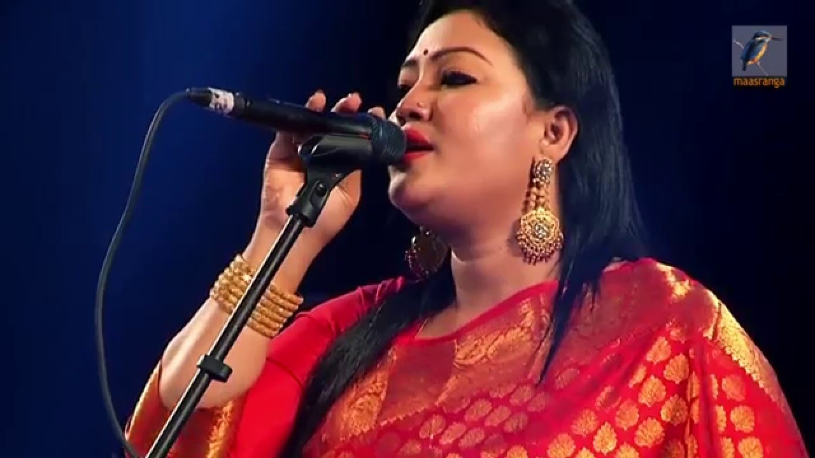
“Our Folk Songs”

Slide 6
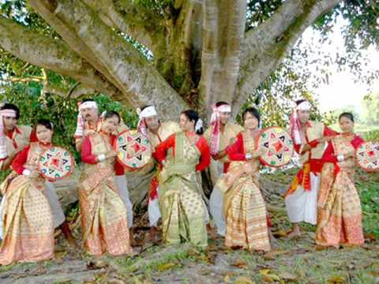
Learning Outcomes
After the end of the lesson ss will be able to-
Explain our folk songs
Tell about our folk songs singers
Participate any debate on folk songs

Slide 7
Read the text (Silent reading)
Folk songs are songs sung in the traditional style of a community or country. Here the traditional style includes the themes, words and tunes of the songs that have existed for a long time among the common people.
We have a rich history and collection of folk songs in Bangladesh. Of them, palligiti, Bhatiali, Bhawaiya, jari, Sari, Gambhira,lalongiti, palagaan and songs of Hasan Raja are very popular. The traditional musical instruments are usally played with these songs.

Slide 8
Word meaning
Traditional means conventional
Community means a group of people living in the same place
tune means melody that characterizes a certain piece of music
Exist means to continue to be or live
Rich means having a lot of something good or useful

Slide 9
Questions and Answers
Who usually likes our folk songs?
Ans: Common people usually likes our folk songs
Can you name some well-known folk singers?
Ans: Yes, I can. Abdul Alim Abbas Uddin, Ferdousi Rahman, Momtaj Begum, Kangalini Sufia are a few well-known folk singers.
Do you like folk songs? if do who is your favorite singer?
Ans: Yes, I like folk songs. My favorite singer is Abdul Alim

Slide 10

Evaluation
5 min
Can you tell some musical instruments name?
Ektara, dotara, bamboo flute, violin, harmonium and sarinda go well
with the folk songs.

Slide 11

Home Work
Write a short paragraph on “Our Folk Songs”
E-mail: azizabidpur@gmail.com

Slide 12


