Slide 1
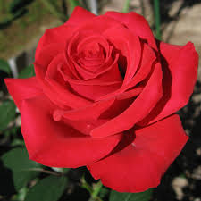
WELCOME

Slide 2
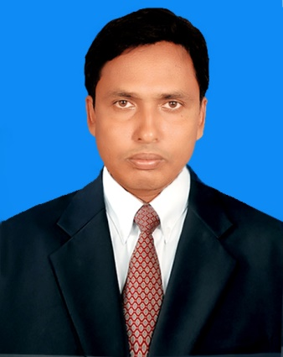
Teacher’s Identification
Md.Zakaria Ibne Mahatab Head Teacher Jagonnathpur Govt.Primary Shcool Chirirbandar,Dinajpur
Mobile No: 01723006285

Slide 3
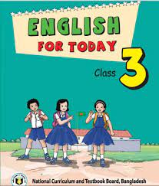
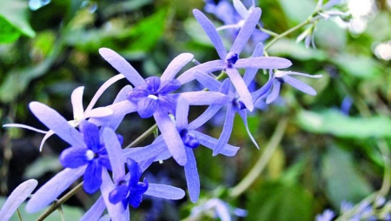
Lession Identification
Class: Three Time: 40 minutes
Subject: English For Today
Unit: 30 (Punctuation and Capital Letters
Lesion: 1-3
Activity: B
Date: 01-02-2021

Slide 4
Learning Outcomes
Student will be able to
Reading:
7.1.1 recognize punctuation marks and read accordingly.
Writing:
5.1.1 use full stop.
5.1.2 use comma.
5.1.3 use question mark.
6.1.1 use capital letters for sentence beginnings.
6.1.2 use capital letters for proper nouns.

Slide 5
Let’s Sing a song
https://www.youtube.com/watch?v=CuI_p7a9VGs

Slide 6
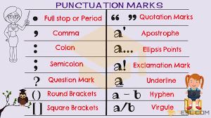
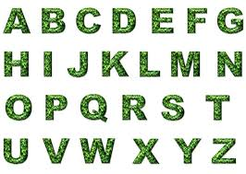
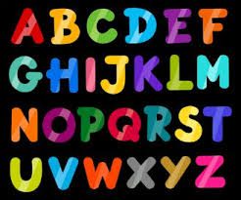
Punctuation and capital Letters

Slide 7
Capital letter
We will know, where we use capital letter
The first letter of a sentence write with capital letter.
It is Sunday morning.
We live in Dinajpur.

Slide 8
People name always write with capital letter
Maliha, Zakaria, Riya, Mashuk
Riya and Mashuk are at school.
Mashuk is a good boy.

Slide 9
Country’s name always write with capital letter
Bangladesh, India, America
Maliha is Bangladeshi.

Slide 10
City’s name always write with capital letter
Dhaka, Dinajpur, Rangpur
Dhaka is the capital of Bangladesh

Slide 11
River’s name always write with capital letter
Buriganga, Padma, Jamuna
Maliha lives near the Buriganga River.
Rajshahi stand on the bank of Padma river.

Slide 12
Month’s name always write with capital letter
January, June, July, August
In June, July and August, there is a lot of rain in Bangladesh.

Slide 13
Day’s name always write with capital letter
Saturday, Sunday, Monday, Tuesday, Wednesday, Thursday, Friday
It is Sunday morning.
Saturday is the first day of a week.

Slide 14
Some one address, title, designation always write with capital letter
Dr. Mr. Mrs.
They are in the school yard with their school teachers, Mr. Mahbub and Mrs. Fareha.
Dr. Murshid is a good man.

Slide 15
Punctuation Mark
Punctuation marks are symbols that are used to aid the clarity and comprehension of written language. Some common punctuation marks are the period, comma, question mark, exclamation point, apostrophe, quotation mark and hyphen.

Slide 16
We will know where we use punctuation mark
Full stop (.)-Generally we use full stop at the end of a sentence.
It is Sunday morning .
Riya and Mashuk are at school .

Slide 17
Comma (,)- Used to denote a pause in a sentence.
They are in the school yard with their school teachers, Mr. Mahbub and Mrs. Fareha.

Slide 18
At a glance
The first letter of a sentence write with capital letter.
People name always write with capital letter
City and Country’s name always write with capital letter
Some one address, title, Designation always write with capital letter.
River’s name always write with capital letter
Day and Month’s name always write with capital letter
Full stop (.)-Generally we use full stop at the end of a sentence.
Comma (,)- Used to denote a pause in a sentence.

Slide 19
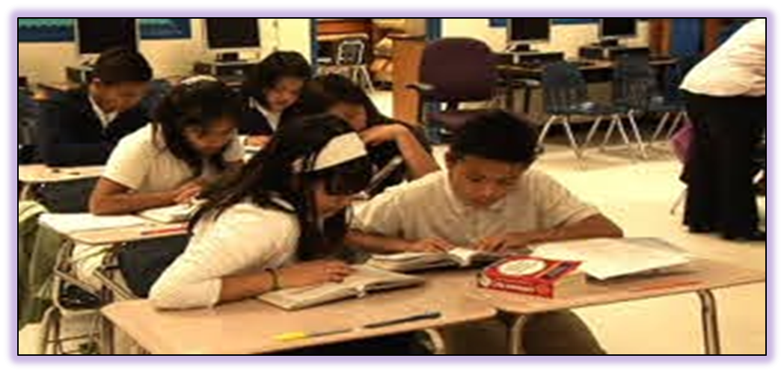
Pair Work
Identify capital letter and underline them
It is Sunday morning. Riya and Mashuk are at school.They are in the school yard with their school teachers, Mr. Mahbub and Mrs. Fareha.

Slide 20
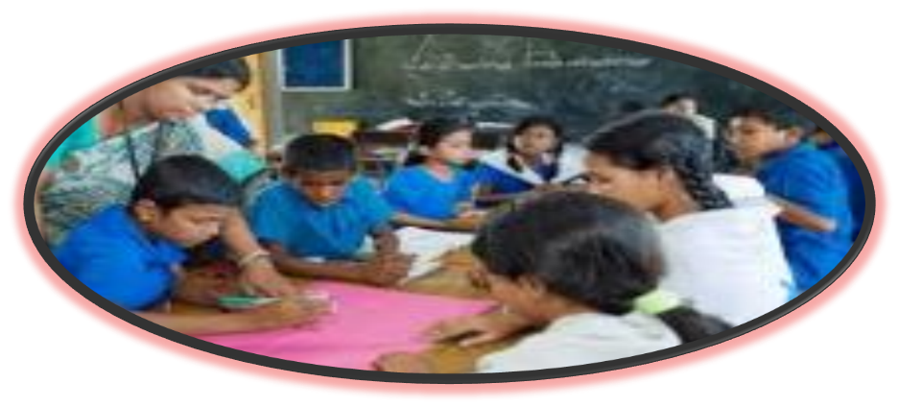
Group Work
Identify punctuation marks and round them.
It is Sunday morning. Riya and Mashuk are at school.They are in the school yard with their school teachers, Mr. Mahbub and Mrs. Fareha.

Slide 21
1. Where does we use capital letter? 2. Where does we use fullstop? 3. Where does we use comma?
Evalution

Slide 22
Home work
*Where does we use capital letter and punctuation marks in activity A follow again again?

Slide 23
Thanks

