Slide 1
Good Morning Everybody
HOW ARE YOU ?
Notes:
Teacher can greet any other process

Slide 3
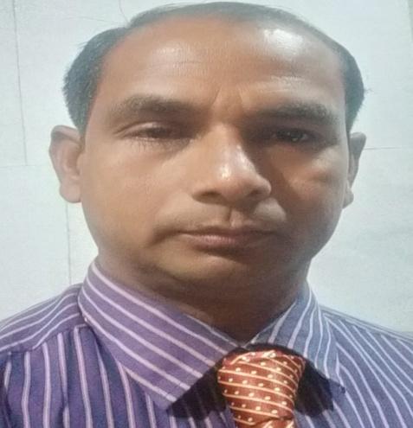
IDENTITY
Md. Moksed Ali,
Assistant Teacher (English),
Bhabanipur Sefatia Kamil Madrasah Online Class
Hatibandha, Lalmanirhat.
Mobile: 01717292475
Email:mmali2023782@gmail.com
English 2nd Paper
Class : 6 – 10.
Notes:
Teacher can hide this slide

Slide 4
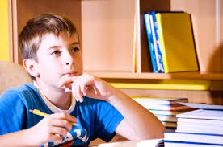
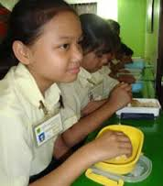
Look at the pictures
He had written a letter.
He had gone to School.
I had eaten rice.
Notes:
At first pictures will be shown. Teacher can try to elicit the answer from the students. Then he/she can give feedback by clicking.

Slide 5
LESSON DICLARATION
PAST PERFECT TENSE

Slide 6
LEARNING OUTCONES
After completing this lesson students will be able to –
say what is Past Perfect Tense.
write the structure of Past Perfect Tense
make correct sentence according to Past Perfect Tense.
re-write in Past Perfect Tense.

Slide 7
Past Perfect Tense
Past Perfect Tense is used when the work had been done but its effect lasts.
অতীতের দুইটি কাজের মধ্যে আগে সম্পন্ন হওয়া কাজটি Past Perfect আর পরে সম্পন্ন হওয়া কাজটি Past Indefinite Tense হয়।
যেমনঃ
আমরা কাজটি করিয়াছিলাম।= We had done the work.
সে স্কুলে যাওয়ার আগে একটি পাখি দেখিল ।
=He had seen a bird before he went to school.
Notes:
Teacher can try to elicit the answer from the students. Then he/she can give feedback by clicking.

Slide 8
Present Perfect Tense
গঠন প্রণালী
Aff : Sub + had +V3 + obj.
I had caught fish.
Neg : Sub + had not+ V3 + obj.
I had not caught fish.
Intre : Had + Sub + V3 + obj ?
Had I caught fish?
Notes:
At first pictures will be shown. Teacher can try to elicit the answer from the students. Then he/she can give feedback by clicking.

Slide 9
Use of had
Person | Singular | Plural
1st | I had | we had
2nd | You had | You had
3rd | He/She had | They had
Notes:
At first pictures will be shown. Teacher can try to elicit the answer from the students. Then he/she can give feedback by clicking.

Slide 10
Affirmative Sentence.
Person | Singular | Plural
1st | I had eaten rice. | We had eaten rice.
2nd | You had eaten rice. | You had eaten rice.
3rd | He/She had eaten rice. | They had eaten rice.
Notes:
At first pictures will be shown. Teacher can try to elicit the answer from the students. Then he/she can give feedback by clicking.

Slide 11
Negative Sentence
Person | Singular | Plural
1st | I had not eaten rice. | We had not eaten rice.
2nd | You had not eaten rice. | You had not eaten rice.
3rd | He/She had not eaten rice. | They had not eaten rice.
Notes:
At first pictures will be shown. Teacher can try to elicit the answer from the students. Then he/she can give feedback by clicking.

Slide 12
Interrogative Sentence
Person | Singular | Plural
1st | Had I eaten rice ? | Had we eaten rice ?
2nd | Had you eaten rice ? | Had you eaten rice ?
3rd | Had s/he eaten rice ? | Had they eaten rice ?
Notes:
At first pictures will be shown. Teacher can try to elicit the answer from the students. Then he/she can give feedback by clicking.

Slide 13
INDEVETUAL WORK
Fill in the gaps with the right form of verbs (according to Past Perfect Tense) that given in the box.
Play | Make | Have/has
Catch | Do | go
We (a) ----------------- a box. He has (b) ---------------- a bird.
Had you (c) ---------------- the work ? They (d) ----------not
gone to school. Suda had not (e) ------------------ football.
Had made
had caught
done
had
played
Notes:
At first pictures will be shown. Teacher can try to elicit the answer from the students. Then he/she can give feedback by clicking.

Slide 14
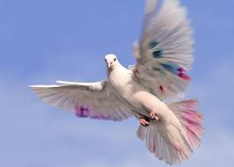
Pair Works
Write three sentences (affirmative, negative and Interrogative) about the above picture according to the rules of Past Perfect Tense.
Notes:
At first pictures will be shown. Teacher can try to elicit the answer from the students. Then he/she can give feedback by clicking.

Slide 15
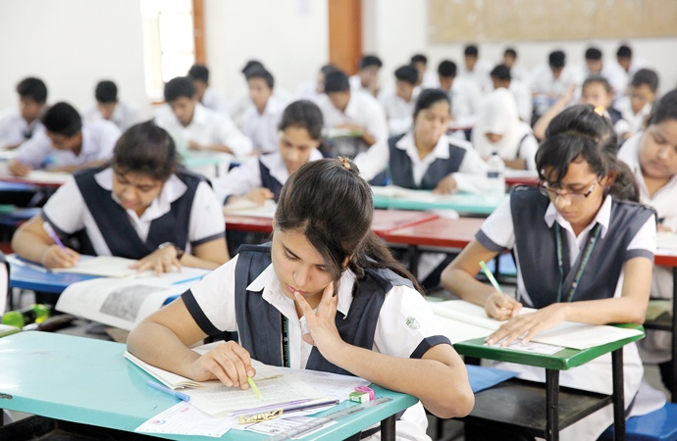
Group Work
Read the passage and rewrite it in the Past Perfect Tense.
Sima had read English. He had liked English very much . He had thougt. He had gone to school. He had written a Poem.
Notes:
At first pictures will be shown. Teacher can try to elicit the answer from the students. Then he/she can give feedback by clicking.

Slide 16
Home Work
Write down five sentences that you and your brother do at your house.
Notes:
Teacher can give some instructions to do the home task.

Slide 17
THE END.
Notes:
Teacher can use another language

