Slide 1
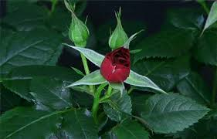
Good morning

Slide 2
Presented by
Sarup Das
Head Teacher
Azompur Govt. Primay school
Damurhuda,Chuadanga.

Slide 3
Class: Five
Subject: English
Unit: 3
Lesson: 1-2

Slide 4
Learning outcomes
Students will be able to:
Understand questions about family and friends of students.
Say words, phrases and sentences with proper sounds and stress.
Say sentences with proper intonation.
Read words, phrases and sentences in the text with proper pronunciation, stress and intonation.
Make sentences using words, phrases given in the text.

Slide 5
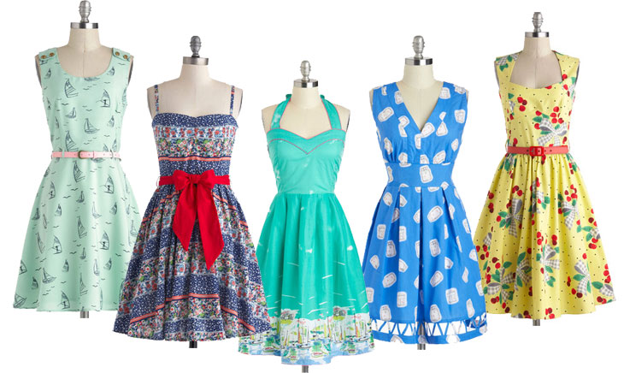
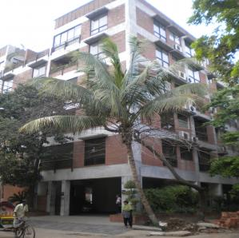
What is this?
Apartment
Dresses

Slide 6
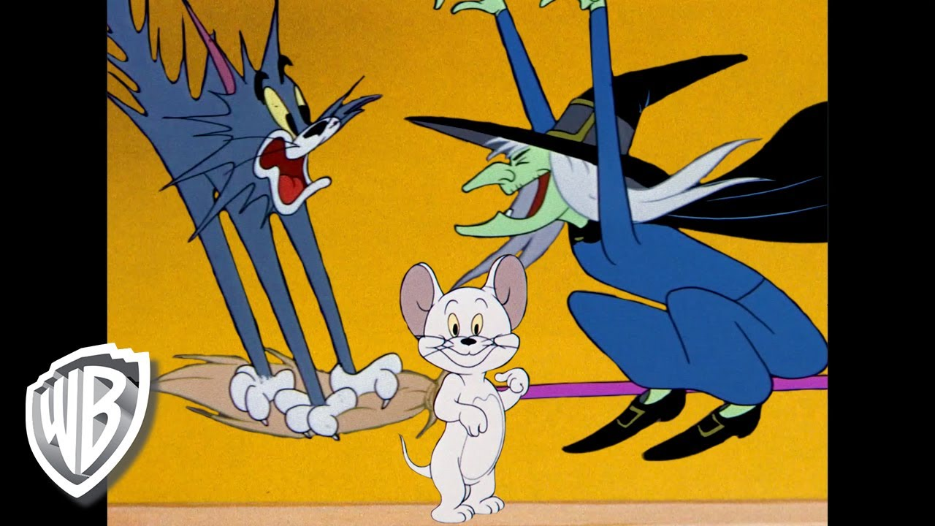
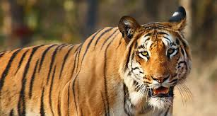
What is this?
Cartoons
Tiger

Slide 7
Today’s lesson
Saikot’s family

Slide 8
Review of previous lessons
What title do we use to address a man?
What title do we use to address a married woman?
Mr
Mrs

Slide 9
New words and meaning.
1.Parents = father and mother
2.Banker = the person who works in bank
3.Neighbours = the people who lives near
4.Student = learner
5.Flat = apartment
6.Make = prepare
7.Often = always
8.Improve = develop
9.Tiger = one of the animals who lives in forest
10.Listen = hear

Slide 10
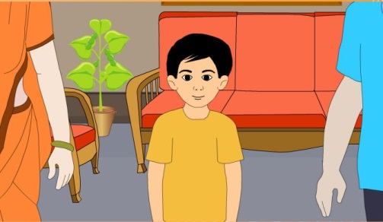
He lives with his parents in a flat in Bogra .He is in class 5.He is a good student. He wants to improve his English, so he watches cartoons on TV everyday. He also reads English books. He likes books about animals, especially tigers and lions.
This is Saikat.

Slide 11
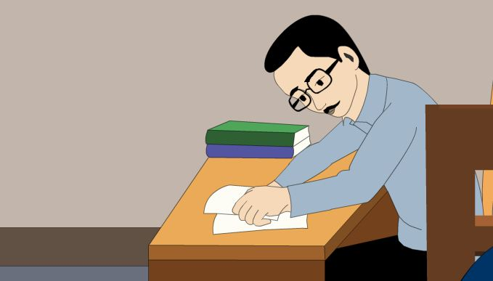
Mr.Rashidul Islam is a banker. But in his free time Mr.Islam writes stories and listens to music.
This is Saikat’s father.

Slide 12
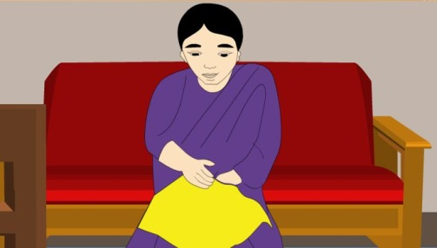
Saikat’s mother is Mrs.Monwara Islam .She is a housewife. In her free time she enjoys sewing. She makes dresses. She often gets orders from her friends and neighbours.
This is Saikat’s mother.

Slide 13
Teacher’s Reading
Dear students, open your book .

Slide 14
1. Match similar words or phrases in column A with column B.
Column A | Column B
a. improve | 1.a school pupil
b. apartment | 2.put on one’s clothes
c. cartoons | 3.a flat
d. dresses | 4.a drawing usually humorous
e.student | 5.develop

Slide 15
GW
Group-1
Where does Saikat live?
What does he wants to improve?
Group-2
What is Mr. Islam?
What does he do in his free time?
Group-3
What is Monwara Begum?
What does she do in his free time?

Slide 16
IW
Read the passage about ‘Saikot’s family’ from the text book and write the answer of the following questions.
1. What is Saikot’s father do?
Ans: Saikots father is a banker .
2. What is Saikot’s mother’s name?
Ans: Saikots father name is Monowara Begum.
3. What kind of books does Saikot like?
Ans: Saikot likes books about animals specially Tigers & Lions.
Notes:
The teacher can ask SS to go to the textbook. After reading the passage student will find out the answer from the passage. 10 minutes can be given for the task. Then the teacher can elicit answer from 4/5 students. Then the teacher can show the answer.

Slide 17
Write true or false.
1. Saikat lives in Dhaka.
2. Saikat’s mother is a teacher.
True
3. Saikat reads English story book everyday.
False
False

Slide 18
Fill in the gaps.
1.Sakat islam wants to improve …………
2. He is in class …………...
3. Saikat Isalm is a ………….students.
4. He likes book about………

Slide 19
Make sentence
Home work
1.Housewife
2.Music
3. Cartoons

Slide 20

Thank you

