Slide 1
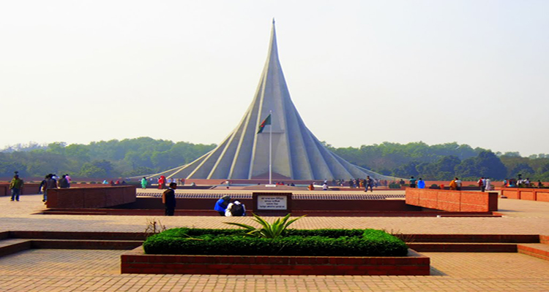

Slide 2
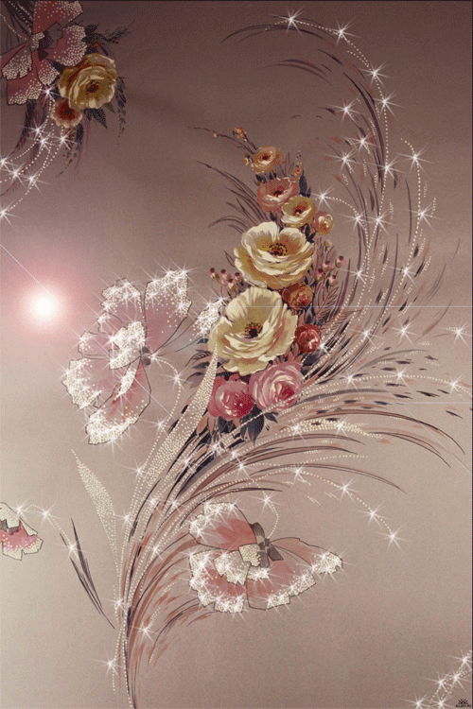
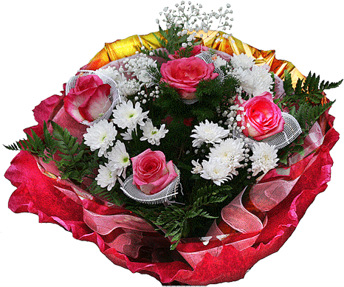
You are welcome.

Slide 3
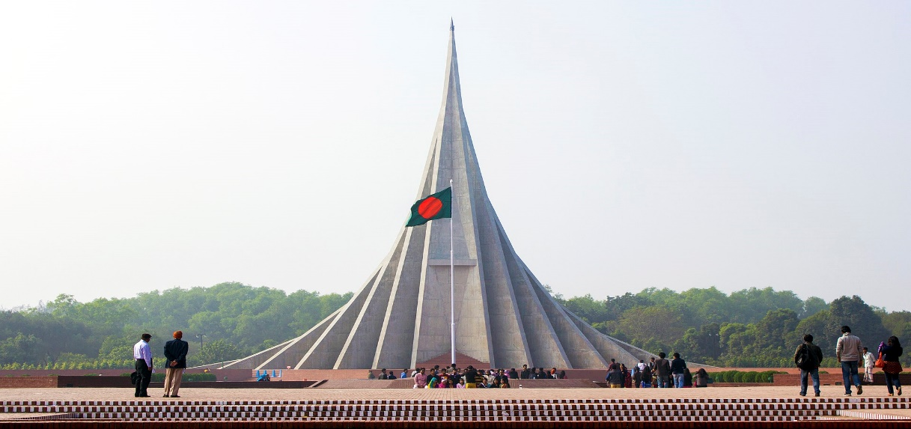
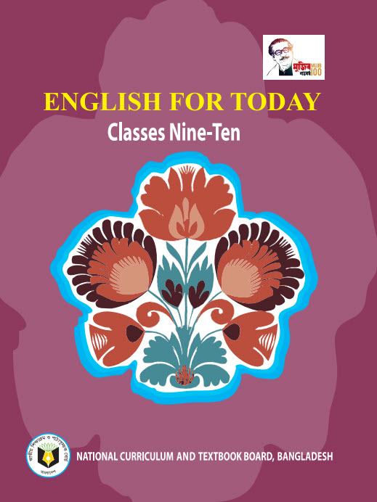
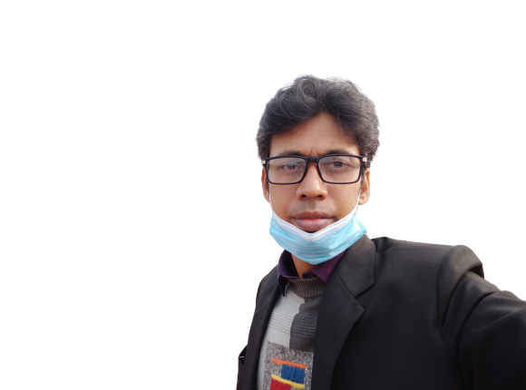
Introduction
Swandip Banerjee
Asst. Teacher (English)
Pallimangal Secondary School
Sonadanga, Khulna.
Mobile: 01718503573
E-mail: swandipb1@gmail.com

Slide 4
A: Look at the picture and ask and answer the questions about it.
What can you see in the picture?
Where is it?
Why was it built?

Slide 5
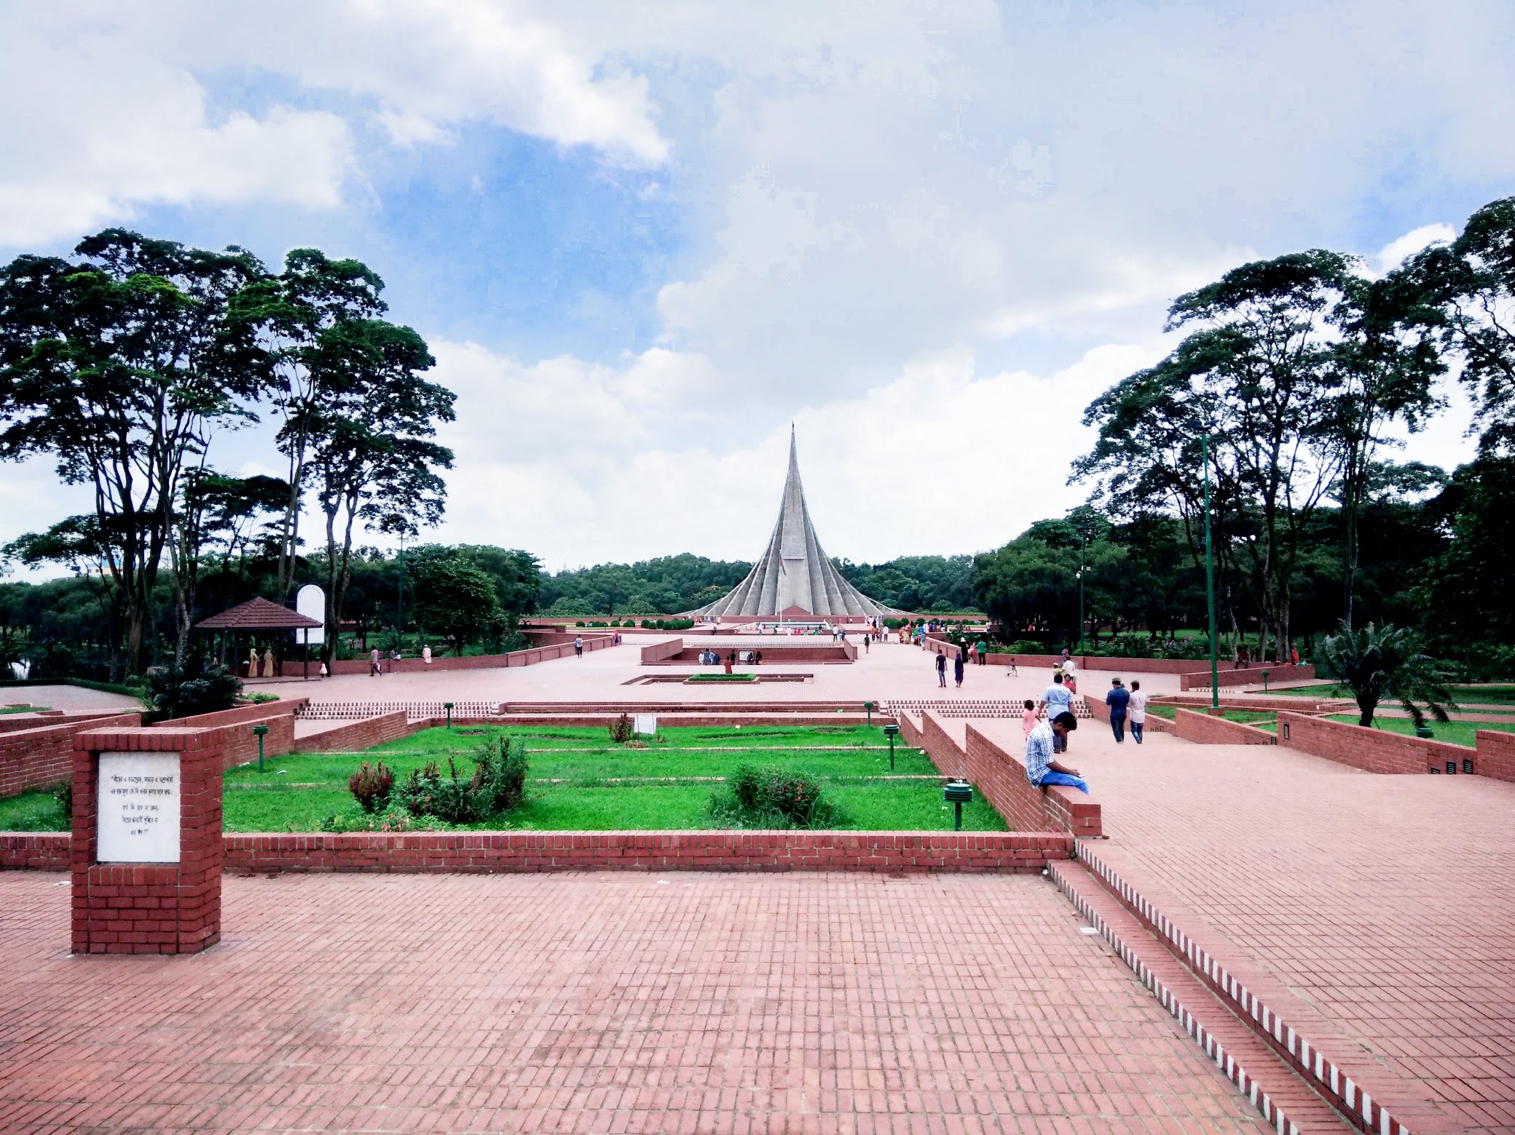

Slide 6
Independence Day
Today our lesson is………….
Unit : 03
[Events and Festivals]
Lesson : 05

Slide 7
Learning outcomes
After the students have studied the lesson, they will be able to …..
talk about events and festivals,
infer meanings from the context,
ask and answer questions and give opinions in a logical sequence.

Slide 8
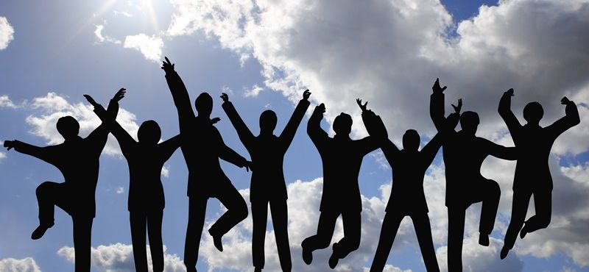
New word
Enthusiasm
a strong feeling of excitement and interest in something and a desire to become involved in it
Synonym: passion, interest

Slide 9
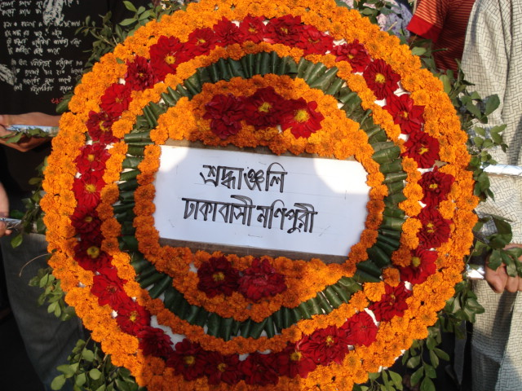
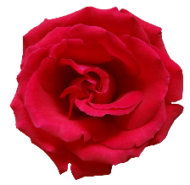
New word
Wreath
an arrangement of flowers and leaves, especially in the shape of a circle, placed on graves, pedestal etc. as a sign of respect for somebody who has died.
Synonym: bouquet, garland

Slide 10
Read the text.
26 March, our Independence Day, is one of the most state festivals. The day is celebrated every year in the country with great enthusiasm and fervour. It is a national holiday. All offices, educational institutions, shops and factories remain closed on this day. The day begins with a 31 gun salute.
Early in the morning the President and the Prime Minister, on behalf of the nation place floral wreaths at the National Mausoleum at Savar. Then other leaders, political parties, diplomats, social and cultural organisations and freedom fighters pay homage to the martyrs. People from all walks of life also go there in rallies and processions. There are many cultural programmes throughout the day, highlighting the heroic struggle and sacrifice in 1971.

Slide 11
In Bangabandhu National Stadium, school children, scouts and girl guides take part in various displays to entertain thousands of spectators. Educational institutions also organise their individual programmes. Sports meets and tournaments are also organised on the day including the exciting boat race in the river Buriganga.
In the evening, all major public buildings are illuminated with colourful lights. Bangla Academy, Bangladesh Shilpakala Academy and other socio-cultural organisations hold cultural functions. Similar functions are also arranged in other places in the country.

Slide 12
C: Match the words with their meanings.
Words | Meanings
fervour | acts of performing skills
alike | to decorate a building with bright lights
spectator | in a similar way
displays | a strong feeling of excitement
illuminate | a person who is watching an event
a strong feeling of excitement.
in a similar way.
a person who is watching an event.
acts of performing skills.
to decorate a building with bright lights.

Slide 13
D: Choose the best answer.
1. Our biggest state festival is
a) Victory Day. b) Shaheed Dibosh.
c) Pahela Baishakh. d) Independence Day.
2. The celebration of Independence Day begins with
a) processions. b) gun salute.
c) placing wreaths at the National Memorial.
d) the display of parades by defence forces.

Slide 14
3. The National Musolium is
a) on Dhaka University campus. b) at Ramna Park.
c) at Savar. d) near Dhaka Medical College.
4. On Independence Day the National Parade is held
a) at the National Parade ground. b) in the streets.
c) in the decorated vehicles. d) in Bangabandhu Stadium.

Slide 15
Evaluation
What are the main features of the day?
Why do people from all walks of life go to the National Mausoleum according to the text?
What are the most spectacular events of the day?
Describe why the cultural programs are arranged on 26th march.

Slide 16
Home work
Write a letter to your foreign friend how the independence day of Bangladesh is celebrated in your school.

Slide 17
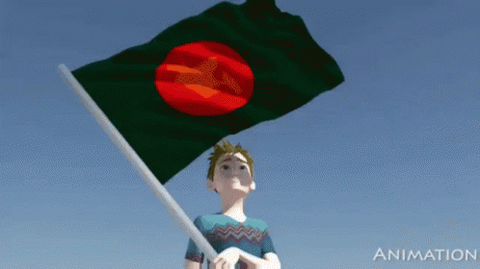
THANK YOU ALL.

