Slide 2
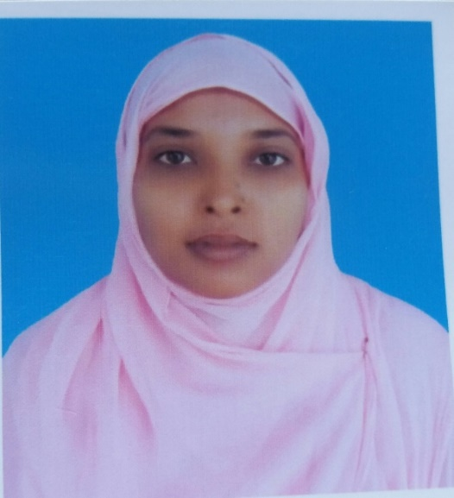
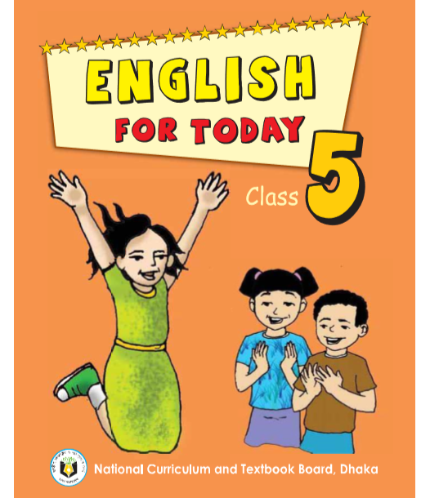
Identity
Mst.Forida Yeasmin
Assistant Teacher
Guthoil Model govt.Primary School
Nachoil, Chapainawabgonj
Email:foridapti1982@gmail.com
Class: Five
Sub:English For Today
Unit:10
Lesson: 3-5
Time: 45 Minute
Date: 13-09-2020

Slide 3
Dear student’s do you know these three famoss people?

Slide 4
Lesson Declaration
My home district

Slide 5
Learning outcomes
By the end of the lesson students will be able to
Listening :
1.2.1 recognize which words in a sentence are stressed.
3.1.1 understand statements made by the teacher and student
Speaking:
1.1.1 Say words, phrases and sentences with propersounds and stress.
Reading:
1.5.1 read words, phrases and sentences in the text with proper pronunciation,stress and intonation.
1.6.1 recognize and read statements, commands, greetings, questions and answer.

Slide 6
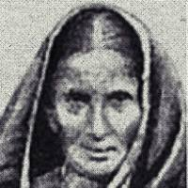
Dear students,do you know?
What is the meaning of the words?
Famous
Literature
Familiar
বিখ্যাত
Knowledge
সাহিত্য

Slide 7
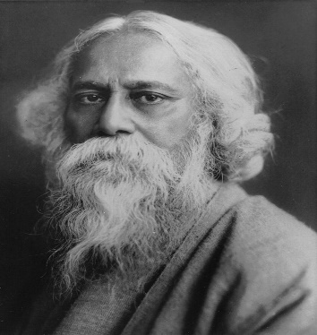
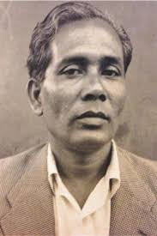
Dear students,do you know?
What is the meaning of the words?
Writer
Painter
Auther
লেখক
Artist
চিত্রশিল্পী

Slide 8
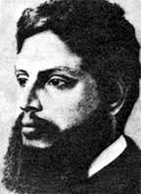
Upendrakishore Roy Chowdhury
Writers of children’s literature.

Slide 9
The great painter Zainul Abedin comes from kishoregonj,too.
Zainul Abedin

Slide 10
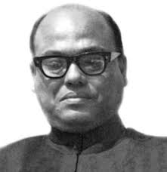
Syed Nazrul Islam, the first acting President of Bangladesh,is also from here.
Syed Nazrul Islam

Slide 11
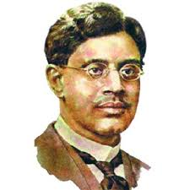
Sukumar Roy
Writers of children’s literature.

Slide 12
Chandrabati
The first woman poet of Bangla literature was born here.

Slide 13
Chandrabati
Upendrakishore Roy Chowdhury
Syed Nazrul Islam
Famous people of Kishoreganj
Sukumar Roy
Zainul Abedin

Slide 14
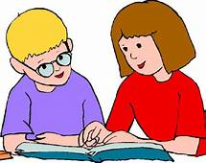
Dear students, make pair and read the text with pair.

Slide 15
Tell the name of some famous people from Kishoreganj.
The names of some fomous people from Kishoreganj are Chandrabati,Upendra Kishore Roy Chowdhury, Sukumar Roy, Zainul Abedin and Syed Nazrul Islam.

Slide 16
What is the name of the first woman poet of Bangla literature?
Chandrabati is the name of the first woman poet of Bangla literature.

Slide 17
Who are the writers of the children’s literature from Kishoreganj ?
Upendra-Kishore Roy Chowdhury and Sukumar Roy are the writers of the children’s literature from Kishoreganj.

Slide 18
What is the name of the first acting president of Bangladesh?
Syed Nazrul Islam is the name of the first acting president of Bangladesh.

Slide 19
What is the name of the great painter from Kishoregonj?
Zainul Abedin is the name of the great painter from Kishoregonj.

Slide 20
Group work
Make a list famous people of kishoreganj discuss with your groupmates.

Slide 21
Home work
Write five sentences about your home district.

