Slide 2
What do you see in the picture?
Map of Bangladesh
Which place are star marked?
Kishoregonj

Slide 3
Lesson Declaration
My home district

Slide 4
Learning outcomes
By the end of the lesson students will be able to
Listening :
1.2.1 recognize which words in a sentence are stressed.
3.1.1 understand statements made by the teacher and student
Speaking:
1.1.1 Say words, phrases and sentences with propersounds and stress.
Reading:
1.5.1 read words, phrases and sentences in the text with proper pronunciation,stress and intonation.
1.6.1 recognize and read statements, commands, greetings, questions and answer.

Slide 5
Dear students,do you know?
What is the meaning of the words?
Word English Meaning Bengali Meaning
Town City শহর
Important Significant গুরুত্বপূর্ণ
Place Location জায়গা/স্থান
Around On all sides আশেপাশে
Fort Castle দুর্গ
Celebrate Perform উদযাপন করা
Visit Look Over দর্শন

Slide 6
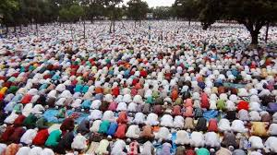
The largest Eid fairgrounds

Slide 7
Government Gurudayal College

Slide 9
The fort of Isah Khan at Jangal Bari.

Slide 11
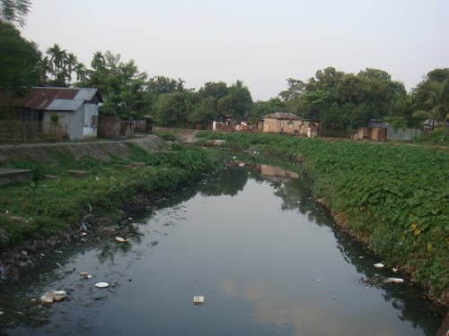
Fuleshwari River

Slide 12
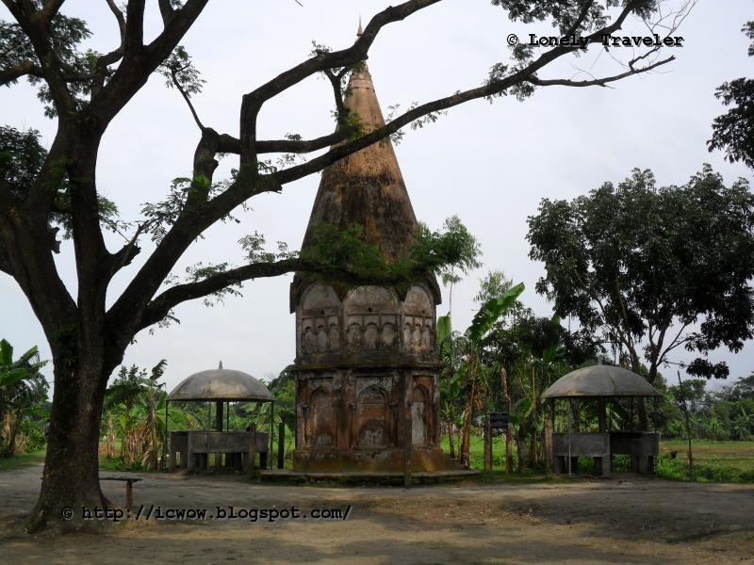
Shiva Temple of Chandrabati

Slide 13
Solakia Eid ground.
Shiva Temple of Chandrabati
Government Gurudayal College
Famous places of Kishoreganj
Shah Muhammad Mosque
Pagla Mosque
Isah Khan at Jangal Bari

Slide 14
Dear students, make pair and read the text with pair.

Slide 15
Group work
Make a list of the important places in kishoreganj.Which place do you think is the most interesting? Why? Discuss with your groupmates.

Slide 16
Evaluation
What is the name of the largest Eid ground?
Where is the fort of Isah Khan?
Where is the Shah Muhammad Mosque?
What is there on the bank of the Fuleshwari River?

