Slide 1
Welcome to all

Slide 2
Teacher Identity
Md Manir Hossain
Assistant teacher
Vhaggha karbari para govt primary school.
Matiranga, Khagrachari.

Slide 3
Introducing of Lesson
Unit – 3
Lesson- 2
Lesson’s name- Saikot’s family
( Saikot is in …….lions)

Slide 4
Learning Outcomes-
By the end of this lesson students will be able-
Listening-
1.3- to recognize which words in a sentence are stressed.
Speaking-
3.1 – to ask answer WH and Yes/ No questions.
Reading –
6.1 , to say what the speaker is doing and what others are doing.
Writing-
8.1 to make sentences using words and phrases , following instructions.

Slide 5
Creating safty environment-
Through greetings.

Slide 6
Showing picture

Slide 7
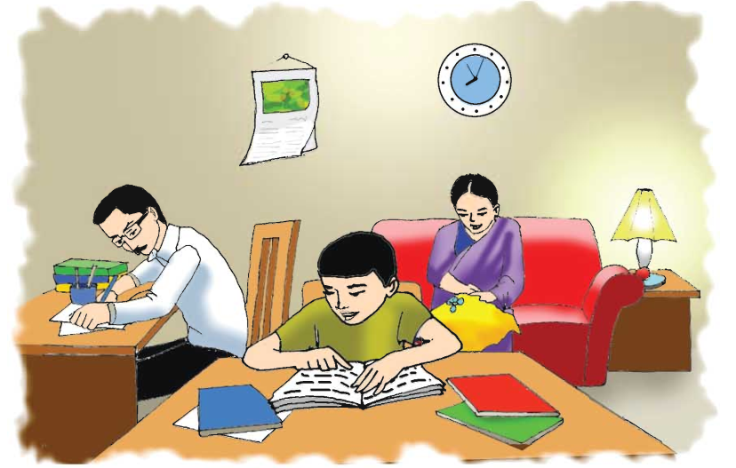
What are they doing?

Slide 8
What can you see in the picture?
How many people there?

Slide 9
New words.
Improve, everyday , animal , especially, lion, watch

Slide 10
Students reading with groups-
( Teacher should be monitor and mentor)

Slide 11
Students silent reading for answer the following the questions-

Slide 12
Whole class work

Slide 13
Home work
Write a paragraph within ten sentences with your’s family!

Slide 14
Goodbye

