Slide 2
Welcome

Slide 3
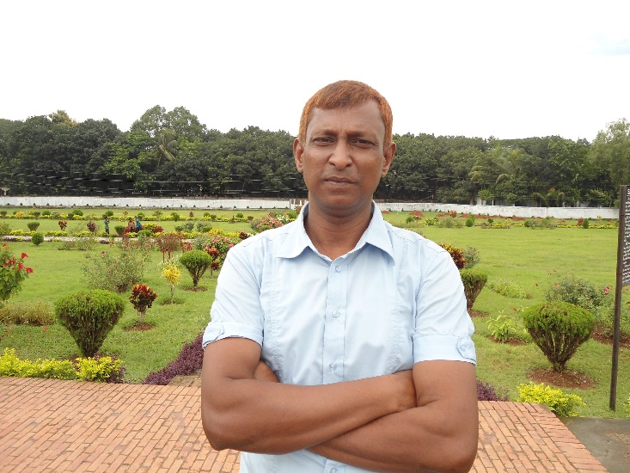
INTRODUCING
Class–Eight.
Subject - English First paper
Unit:- One, Lesson:- Five
Bangladeshi cuisine.
Time - 40 minutes
Date – 24/02/2021
Md. Abdul Baset
Sr. Assistant Teacher (ICT)
Satmora High School
Cell- 01710998333

Slide 4
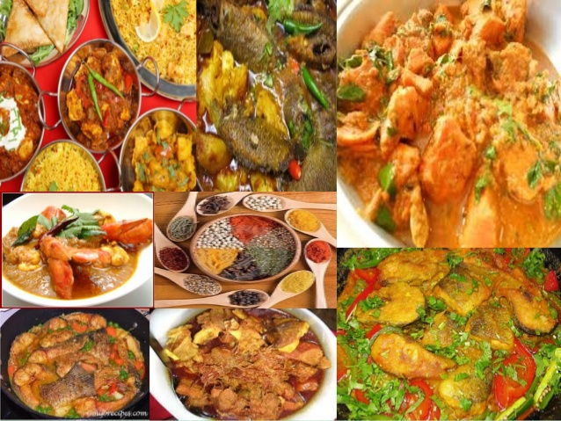
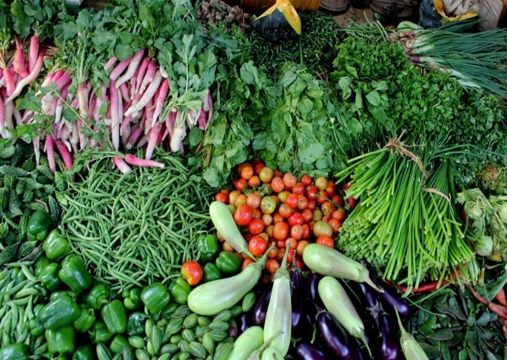
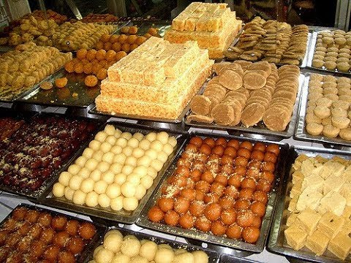
Say something about these pictures
Various kinds of curries.
Various kinds of vegetables.
Various kinds of sweets and cakes.

Slide 5
Our today’s lesson is -
A glimpse of our culture
“Bangladeshi cuisine”

Slide 6
After we have studied this lesson, we will be able to
Read and understand the text through silent reading
Infer meaning from context
Ask and answer questions
Write answer to questions
Write short composition

Slide 7
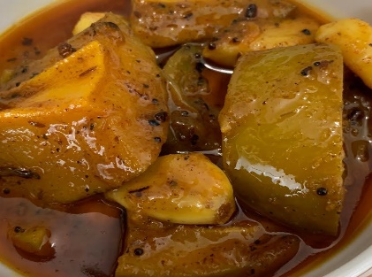
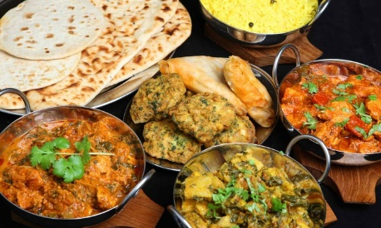
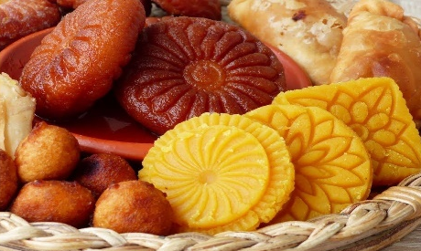
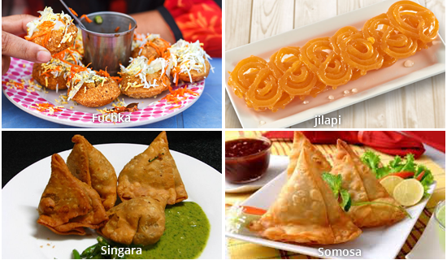
Let’s know about some word meaning-
Pickles
Rite
Cuisine
Cooking
Appetizing
Tasty
Snacks
Meal/Food

Slide 8
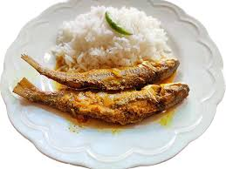
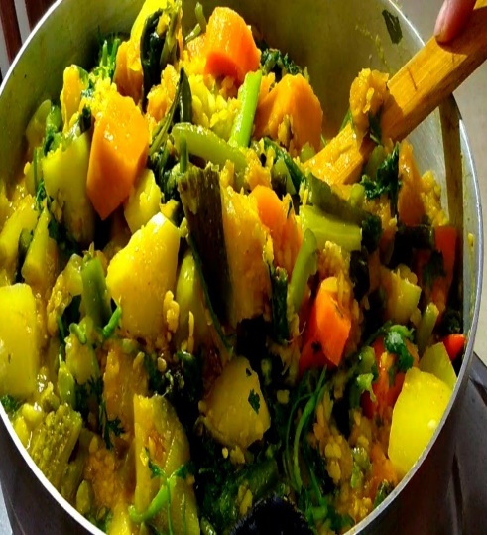
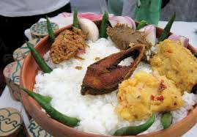
What do you see in these pictures?
Rice with fry fish and cooked vegetable
Various kinds of sweets and pithas
Panta ilish

Slide 9
Bangladeshi cuisine is rich and varied with the use of many spices.
We have delicious and appetizing food , snacks and sweets.

Slide 10
Individual work
Time : 5 Munities
What is Bangladeshi cuisine ?

Slide 11
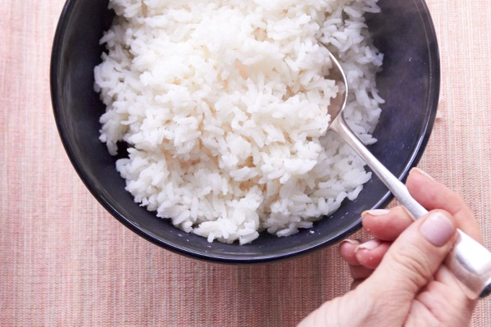
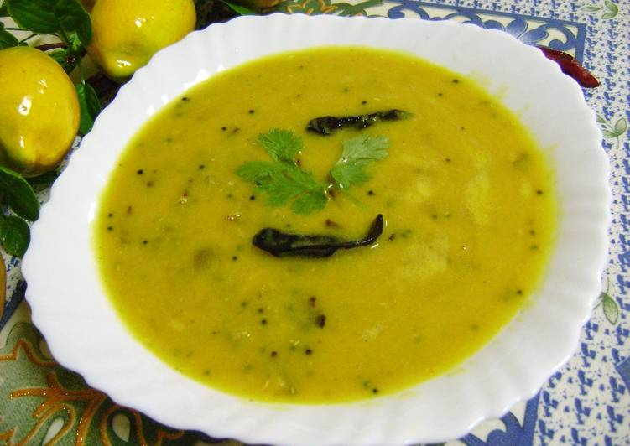
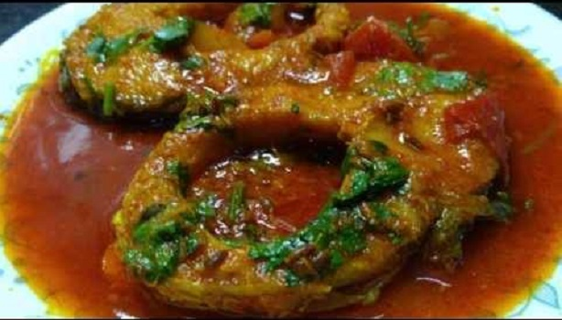
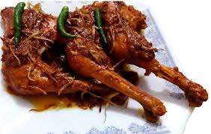
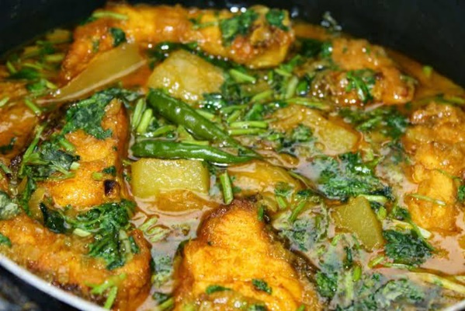
Boiled rice
Lentil soup
Fish fry
Cooked vegetable
Meat
Curry
Boiled rice is our staple food. It is served with a variety of vegetables, curry, lentil soups, fish and meat.

Slide 12
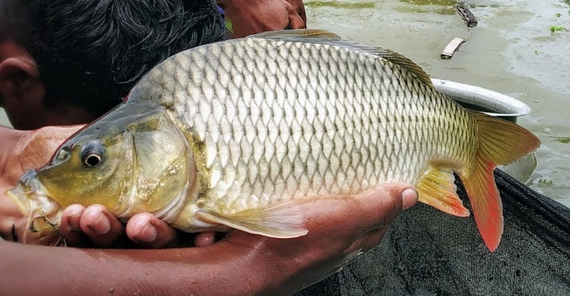
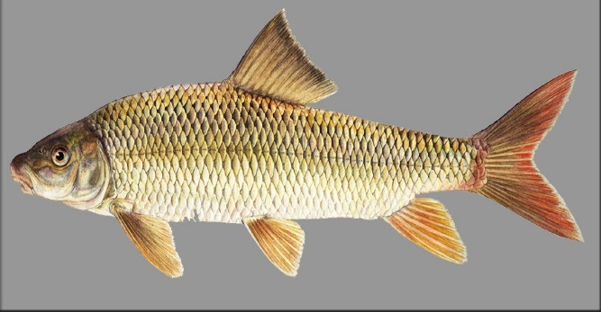
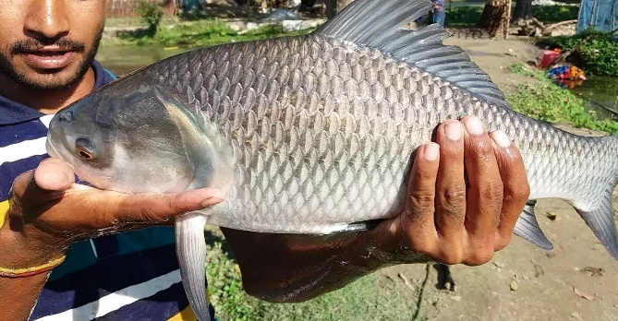
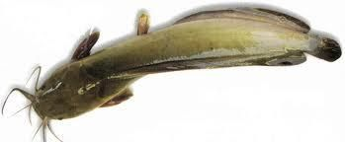
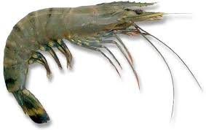
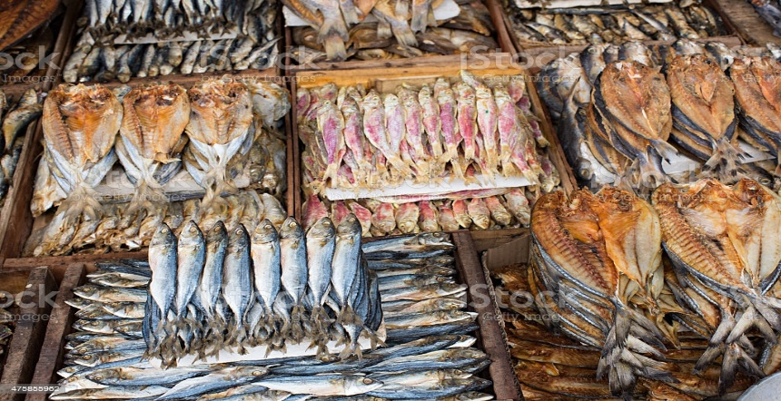
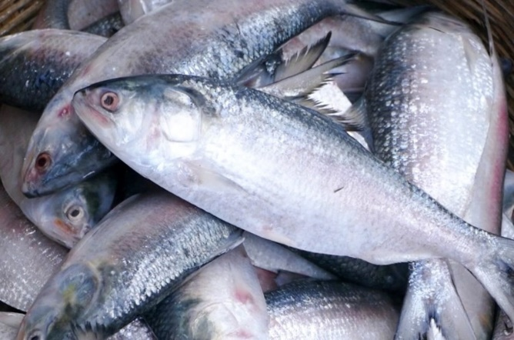
Carp
Rui
Katla
Magur (Catfish)
Chingri ( Prawn or Shrimp)
Shutki or dried fish
Hilsha
Fish are main source of protein. Fishes are now cultivated in ponds. Also we have fresh-water fishes in the lakes and rivers. More than 40 type of fishes are common . Some of them are Carp, Rui, Katla, Magur ( Catfish), Chingri (Prawn or Shrimp). Shutki or dried fishes are popular. Hilsha is very popular among the people of Bangladesh.

Slide 13
Panta Ilish
Lentil soup
Fried fish
onion
Dried fish
Green chilies
Pickles
Panta ilish is a traditional platter of panta bath. It is steamed rich soaked in water and served with a dried hilsha slice, often togather with dried fish, pickles, lentil soup, green chilies and onion. It is a popular dish on the Pohela Boishakh.

Slide 14
Sweet (Pitha)
Rice flour
Syrup
Molasses
Milk
The people of Bangladesh are very fond of sweets. Almost all Bangladeshi women prepare some traditional sweets. Pitha, a type of sweets made from rice flour, sugar, syrup, molasses, and sometimes milk, is traditional food loved by the entire population.

Slide 15
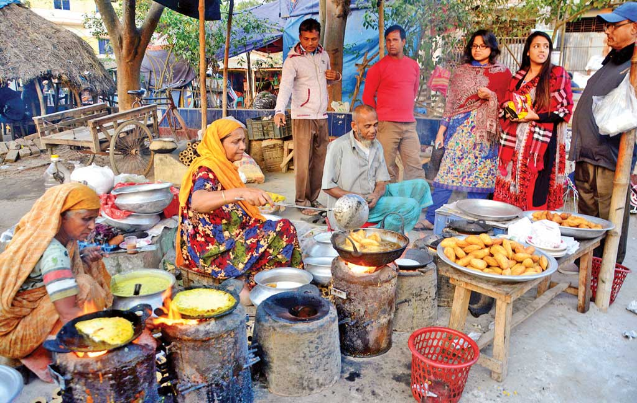
Pitha (Sweet)
Sweet
What do the pictures indicate?
Sweets are distributed among close relatives when there is good
news like births, wedding, promotions, etc.

Slide 16
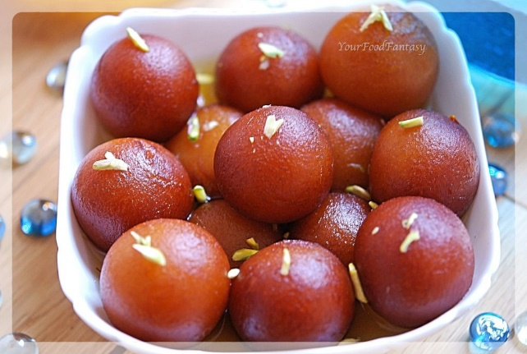
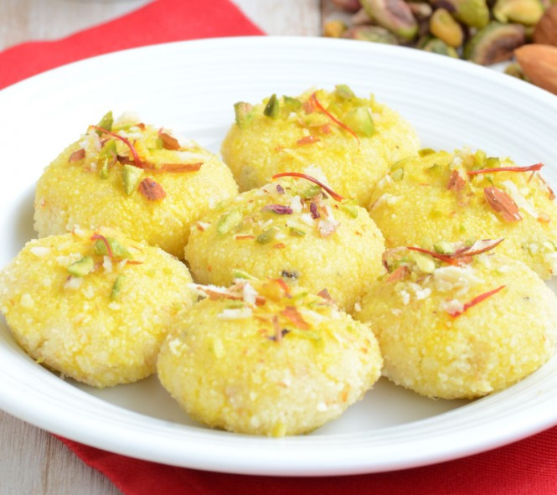
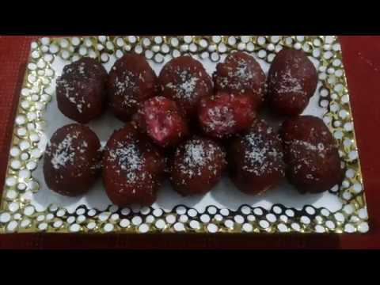
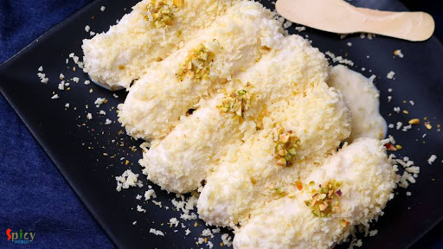
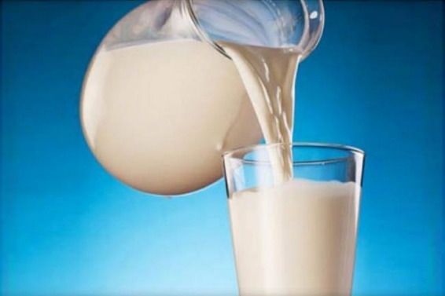
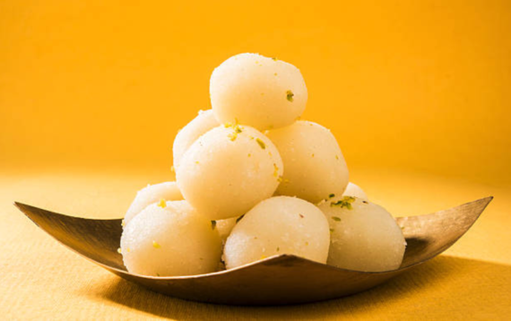
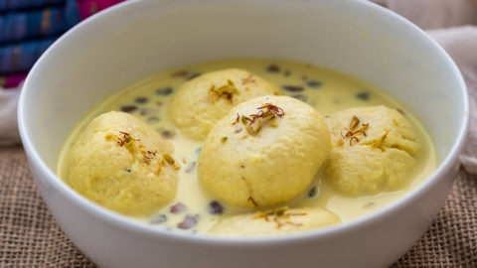
Gulap jamun
Sandesh
Kalo jamun
Chom-Chom
Roshgolla
Rasmalai
Milk
Sweets of Bangladesh are mostly milk-based. The common ones are roshgolla, sandesh, rasmalai, gulap jamun, kalo jamun and chom-chom. There are hundreds of different varieties of sweet preparations. Sweets are therefore an important of the day-to-day life of Bangladeshi people.

Slide 17
Pair work
Describe a Bangladeshi Food that you like best.

Slide 18
True or false? If false, write the correct information.
1. Our foods are rich because they have a lot of oil in them.
Ans. : False. Our foods are rich because they have the use of many spices in them.
2. We get protein from fish.
Ans. : True.
3. On Pohela Boishakh, the traditional food is steamed rice and fried hilsha.
Ans. : False. On Pohela Boishakh, the traditional food is steamed rice soaked in water and
it is served with a fried hisha slice, often with dried fish, pickles, lentil soup, green chilies
and onion.
4. Panta Uthsab takes place almost all the year round in Bangladesh.
Ans. : False. Panta Uthshab only takes place in Pohela Boishakh.
5. Sweets are not much appreciated by the people of Bangladesh.
Ans. : False. The people of Bangladesh are very fond of sweets.

Slide 19
Evaluation
What has made Bangladeshi food so special?
Where do we get the fishes from?
Apart from fish what other foods do we eat with rice?
Why are sweets are important part of our life?

Slide 20
Home Work
Write a paragraph about ‘Bangladeshi cuisine’.

Slide 21
Thanks

