Slide 1
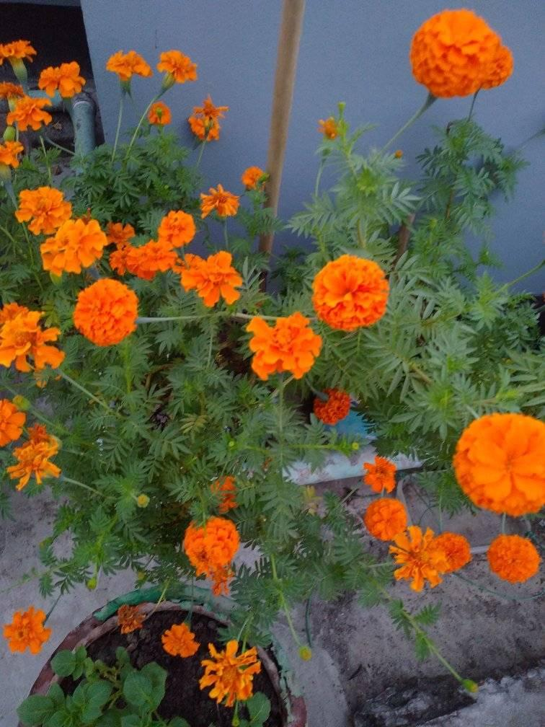
My Dear Students
Good Morning

Slide 2
INTRODUCTION
MD.SOHIDULLAH
Assistant Teacher
Shahabajpur Alim Madrasha.
Sapahar, Naogaon.
Class: Nine and Ten
Sub: English 2nd paper
Time:40 minutes

Slide 3
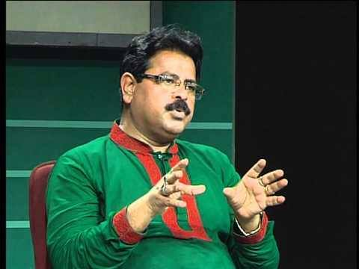
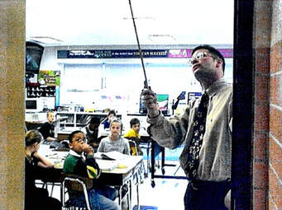
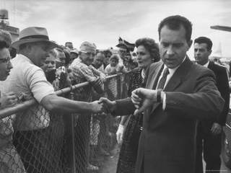
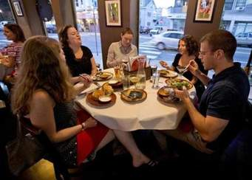
“Do it”.
“Honesty is the best policy.”
“Education is the Most Powerful Weapon which you can use to change the World”
The teacher said to me, “Don’t waste time.”
He said to me, “We are eating.”
He said, “ The teacher teaches the students.”

Slide 4
Narration

Slide 5
Learning outcomes
By the end of this lesson students will be able to transform of the direct to indirect.
He said to me, “I did the work.”
He told me that he had done the work.
Liza said to Tanushre, “I was ill yesterday.”
Liza told Tanushre that she had been ill the previous day.

Slide 6
Kinds of Narration
NARRATION
DIRECT
INDIRECT
Anika said to Setu, “ You are my best friend.”(direct)
Anika told Setu that she(s) was her best friend.(indirect)

Slide 7
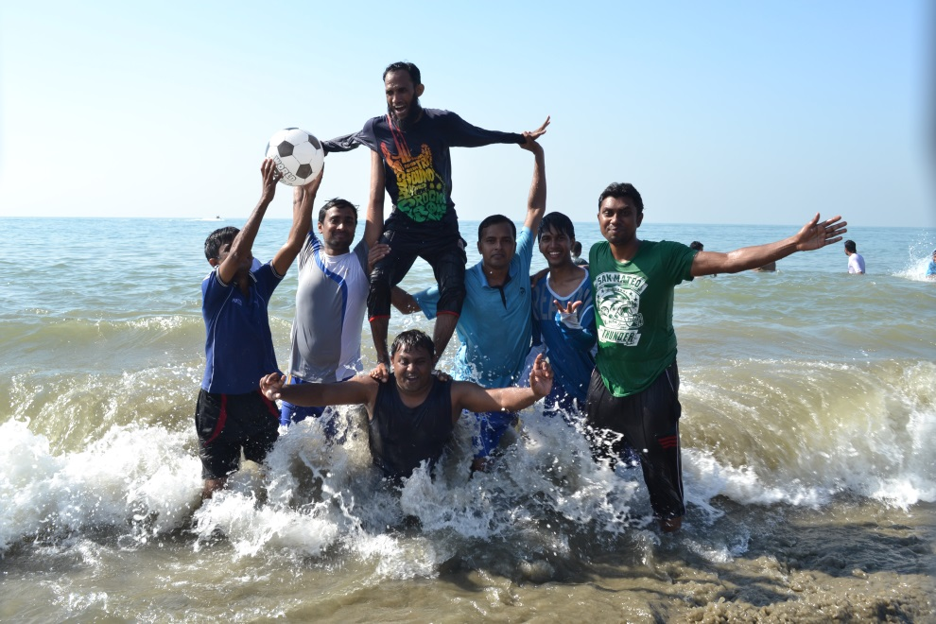
He said, “How beautiful the scenery is!”
He exclaimed with joy that the scenery was very beautiful.
My friend said, “We enjoyed very much.”
My friend said that they had enjoyed very much.

Slide 8
“Why did you not attend in the class yesterday?” said the teacher. The student said, “I was ill, sir.” “How are you today?” the teacher said.
The teacher asked the student why he had not attended the class the previous day . The student respectfully replied that he had been ill. The teacher again asked how he was that day.

Slide 9
Some important words for changing in narration
Main Words | Changing words
This | That
Today | That day
Yesterday | The previous day
Here | There
Now | Then
Tomorrow | The next day
Come | Go
Must | Had to
Sir | respectfully

Slide 10
The girl said, “I am well.”(direct)
The girl said that she was well.(indirect)
The boy said to the man, “ You sent me with this letter.” (direct)
The boy told the man that he (m) had sent him (b) with that letter. (indirect)
In this way we can change the subject and verb of speech
I, WE---Speaker
You---Listener (as sub)
V1__V2
V2__had V3

Slide 11
He said, “ The teacher teaches the students.”
He said that the teacher taught the students.
The girl said, “I am well.”
The girl said that she was well
He said to me, “I did the work.”
He told me that he had done the work.
“How are you today?” the teacher said. The teacher asked how he was that day.

Slide 12
Assertive- that +s+v+obj.
Wh-wh+s+v+obj.
Aux-if+s+v+obj.
V1+obj-to+v1+obj.

Slide 13
He said, “I am ill.”
My father said, “Do it.”
The teacher said to the students, “Why are you making noise?”
The students said, “Sorry, sir.”
He said, “What a bird it is!”

Slide 14
HOME WORK
Mina said, “ I went to school.”
Ripa said to Amit, “ Good morning.”
The teacher said, “I will teach you narration.”
The boy said, “ He played cricket well.”
He said, “ They were eating.”

Slide 15
Thanks a lot to Everybody

