Slide 1
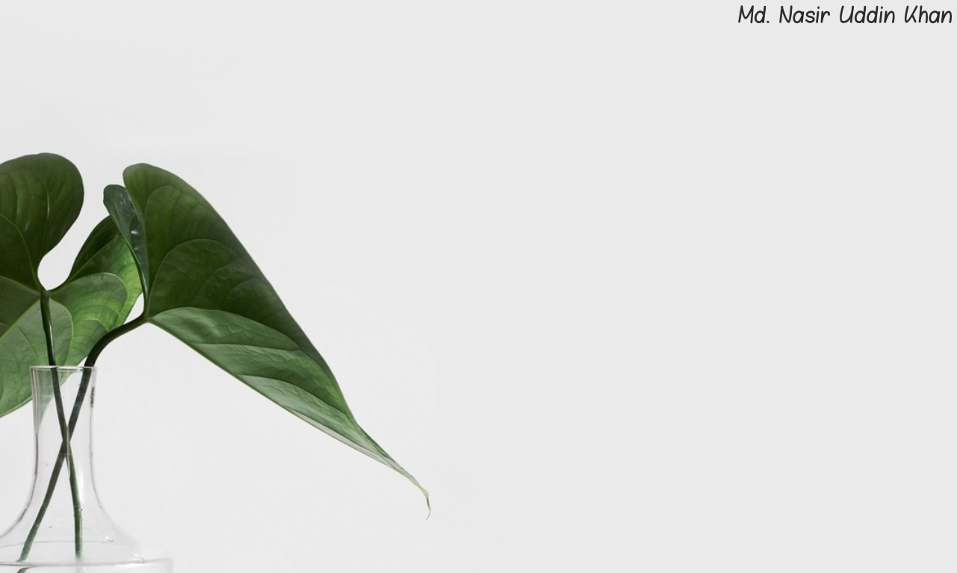
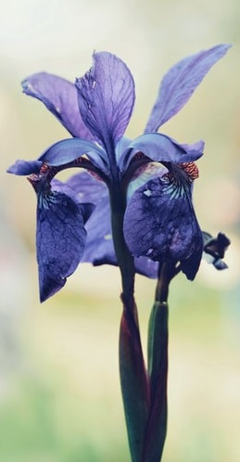
Welcome
To
English Class

Slide 2
পরিচিতি
Md. Nasir Uddin Khan
Assistant Teacher
Gridakalindia GPS
Faridgonj, Chandpur
01687422109
nu01687@gmail.com
Class: Five
Sub: English For Today
Unit: 06

Slide 3
Good morning song song

Slide 4
Lesson Declaration:
Food Pyramid
Lesson : Eat Healthy
Part of Lesson: What food is good food? …… we need to make good choices .
Page: 24.

Slide 5
Learning outcomes:-
4.2.1: Students will be able to understand and enjoy simple stories.
3.1.1: Students will be able to ask and answer WH questions.
1.5.1 : Students will be able to read words, phrase and sentences in the text with proper pronunciation, stress and intonation.
8.1.1 : Make sentences using words and phrases given in the textbook .
.

Slide 6
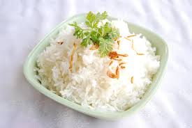
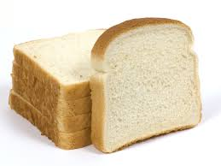
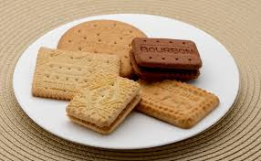
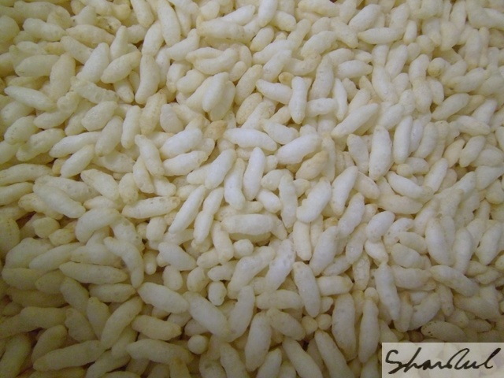
Rice
Bread
Biscuit
Muri
We should eat plenty of these foods.
We found the foods base of the pyramid.

Slide 7
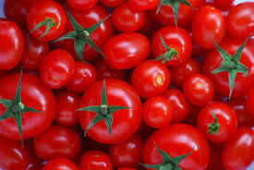
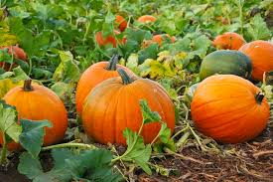
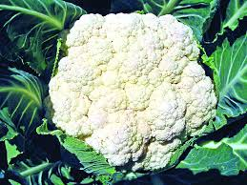
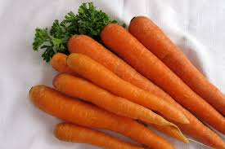
Tomato
Pumpkin
Fulkopy
Carrot
These foods are some fresh vegetables
We found these second group of the pyramid.
We must eat these foods item regularly.

Slide 8
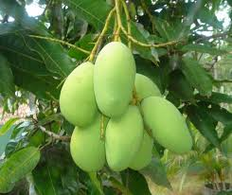
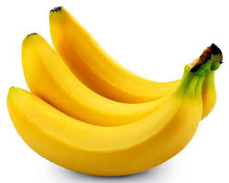
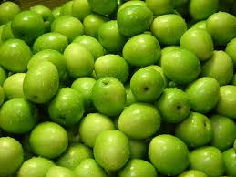
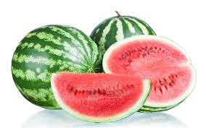
Mango
Banana
Plum
Water melon
These foods are some fresh fruits.

Slide 9
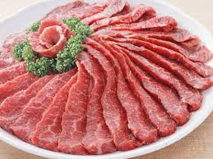
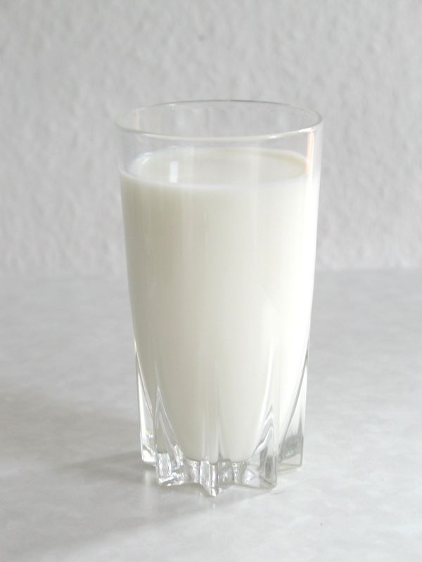
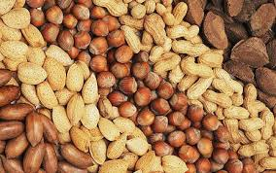
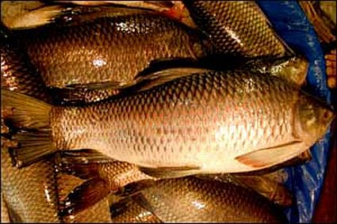
Meat
Milk
Nut
Fish
Milk , Cheese, Yogurt, Meat, Fish, Nuts, Eggs. We found go up the pyramid.
We should eat these food moderately.

Slide 10
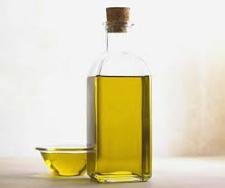
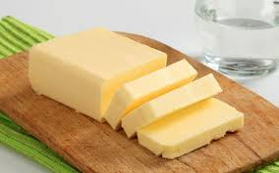
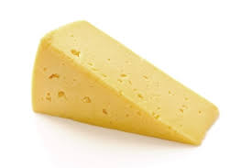
Oil
Butter
Chese
Nut
These foods are fat food .
We found at the top of the Food Pyramid.

Slide 11
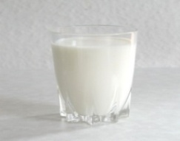
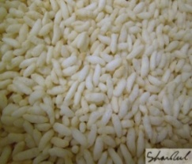
Food Pyramid

Slide 12
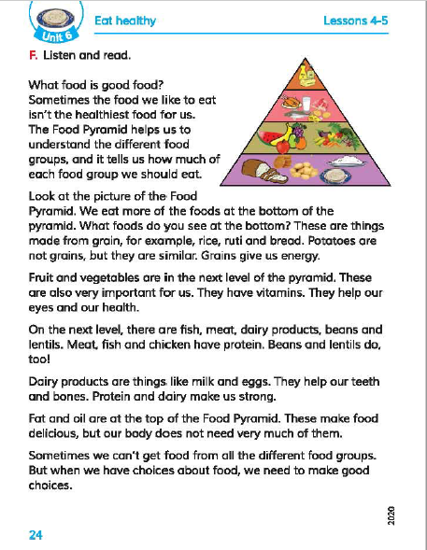
Loud Reading from Textbook

Slide 13
New words:
Grains-
Important-
Energy-
Different-

Slide 14
Group work
Apple
Banana
Which foods at the top of the pyramid?
Which foods you should eat most of the time?
Some fresh fruits and vegetables.
Fats ,oils , sweets , etc .

Slide 15
Evaluation:-
1. Which foods do you see at the bottom of the Pyramid?
Ans : Breads , Cereals , Rice , Noodles etc.
2. What is Food Pyramid?
Ans : Food Pyramid is a chart to show the five groups of foods.

Slide 16
Home work:-
Write a five sentences about the Food Pyramid.

Slide 17
Thanks All

