Slide 1
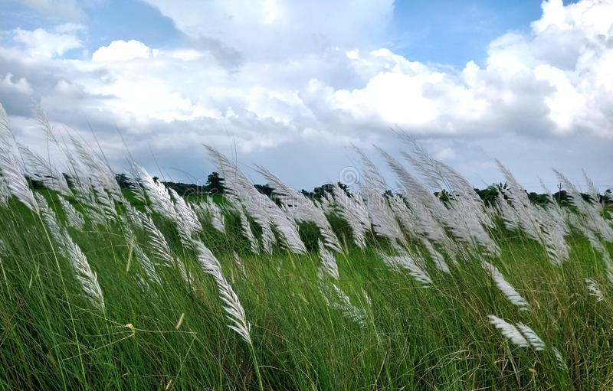
Well-come every one
to
my class

Slide 2
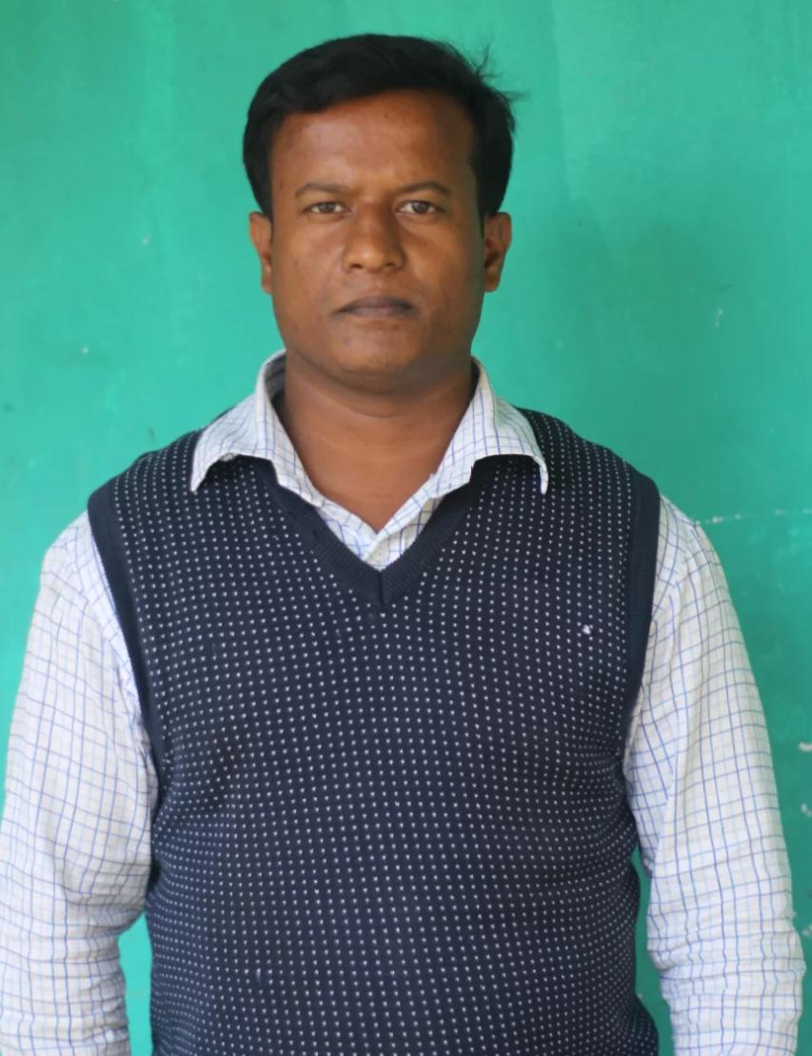
Identity
Md. Zahid Hasan
Assistant Teacher ( English)
Hat Barobazar Secondary School
mdzahidhasan926@gmail.com
AFFIRMATIVE ____ NEGATIVE
(VICE-VERSA)
UNIT-11

Slide 3
Look at the sentence.
He is too weak to walk.
Affirmative sentence : Subject + verb + too + adjective + to + verb + extension.
Negative sentence : Subject + verb + so + adjective + that ( to) + subject ( pronoun) + can / could + not + verb + extension.
Such as
He is so weak that he cannot walk.

Slide 4
Exercise:
1. He was too dull to understand it.
2. They are too small to touch the roof.
3. You are too lazy to succeed.
Answer:
1. He was so dull that he could not understand it.
2. They are so small that they cannot touch the roof.
3. You are so lazy that you cannot succeed.

Slide 5
Look at the sentence.
The load is too heavy for him to carry.
Affirmative sentence : subject + verb + too + adjective + for + Noun / pronoun + to + verb + extension.
Negative sentence : Subject + verb + so (too)+ adjective +that (for)+ Noun / pronoun as subject + can / could + not + verb + extension.
Such as __
The load is so heavy that he cannot carry.

Slide 6
Exercise:
1. The weather is too bad for us to go out.
2. The sum was too hard for them to solve.
3. The road was too narrow for the driver to drive.
Answer:
1. The weather is so bad that we cannot go out.
2. The sum was so hard that they could not solve.
3. The road was so narrow that the driver could not drive.

Slide 7
Look at the sentences.
Kamal is a farmer.
Affirmative sentence : Subject (except the name of Quality) + verb + Noun /Pronoun(except the name of Quality) + Extension.
Negative sentence : Auxiliary verb / do / does / did +not + Subject + verb + Noun / Pronoun + Extension + ?
N:B:- If we use Do / Does / Did , the verb will take its base form ( v – 1).
Example:
Isn’t kamal a farmer?

Slide 8
Exercise.
Answer:
Don’t they work in the field?
Didn’t Hasan go to market?
Doesn't he play football?
Haven’t we done it?
1. They work in the field.
2. Hasan went to market.
3. He plays football.
4. We have done it.

Slide 9
Home work
Change the sentences as directed.
1. Dhaka is the capital of Bangladesh. ( Neg)
2. He is too late to catch the bus. (Neg)
3. The field was so hard that the farmer could not cultivate. (Aff)
4. Do not I read in class seven? (Aff)
5. The load is too heavy for me to carry. (Neg)

