Slide 1
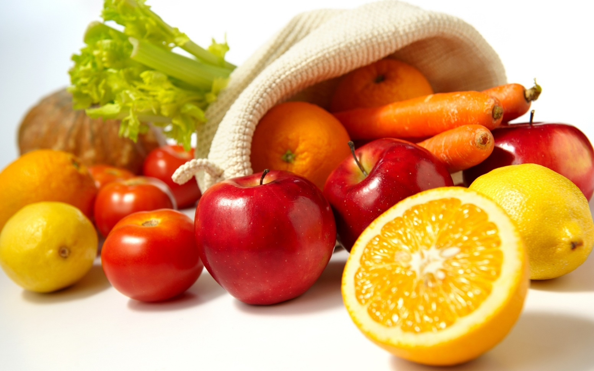
Welcome

Slide 2
Introduction of the teacher:
Name: Hasibur Rahman
Designation :Assistant teacher
School name :Madhya dhadda govt. primary school

Slide 3
Introduction of the lesson:
Class : Five
Unit : 7
Lesson : 7.1
Lesson Title : Eat Healthy Live Healthy
Total Time : 35 minutes

Slide 4
Learning outcomes:
3.1.1Uderstand questions asked by the teacher about them.
8. 1.1 .Take part in conversations appropriate topics.

Slide 5
Let us enjoy a song
Good morning song.

Slide 6
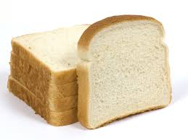
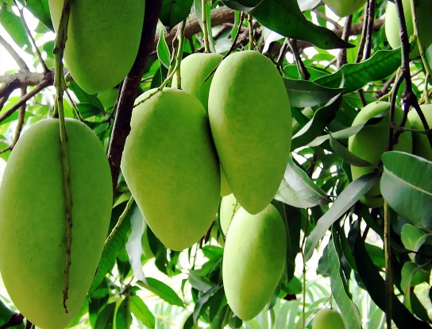
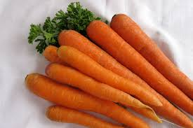
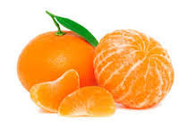
Look at the pictures and say
mango
carrot
orange
bread
What is the name of the pictures?
Now try to answer to the picture name.

Slide 7
Evaluation
a. Are all the foods you like good for health?
b. Which foods can keep you healthy?

Slide 8
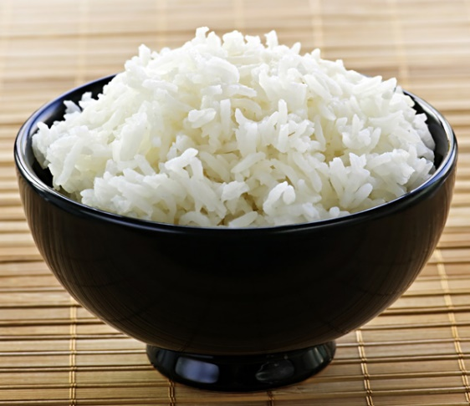
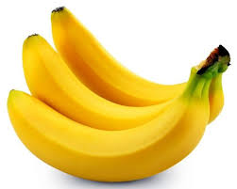
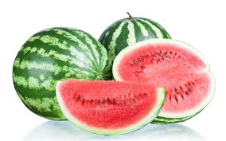
Home Task
What is the name of the picture?

Slide 9
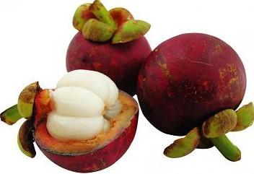
Thanks

