Slide 1
W
E
L
C
O
M
E
W
E
L
C
O
M
E

Slide 2
TEACHETR INTRUDUCTION
DIDAR HOSSAIN
ASSISTANT TEACHER
PURBORAKHI GOVT. PRIMARY SCHOOL.
SADAR,MUNSHIGANJ.

Slide 3
LESSON OVERVIEW
Class: Two
Subject: English
Lesson Title:Sizes
Lesson unit :1-3

Slide 4
Learning outcomes
Students will be able to -
Listening
1.1.1 -Become familiar with English sounds by listening to common words
Speaking
1.1.1 – repeat after the teacher simple words and phrases with proper sounds and stress .
1.1.2 –say simple words and phrases with proper sounds and stress.

Slide 5
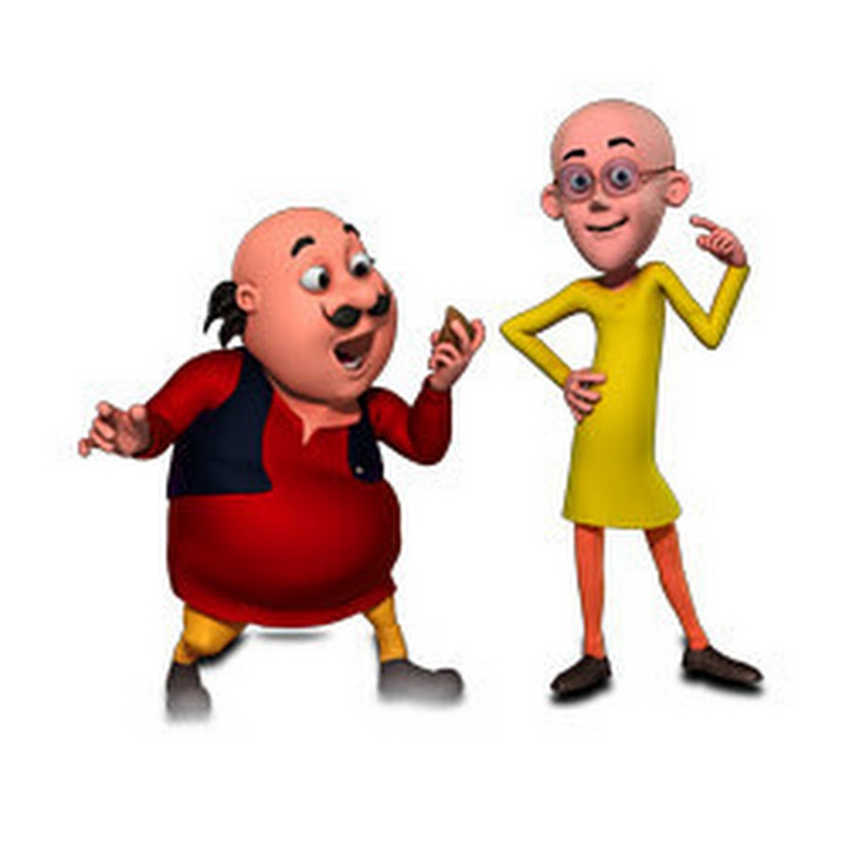

Slide 6
LESSON DECLARATION
SIZES

Slide 7
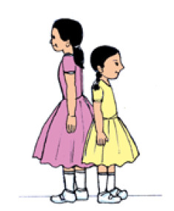
TALL
SHORT

Slide 8
BIG
SMALL

Slide 9
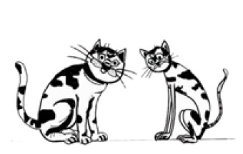
FAT
THIN

Slide 10
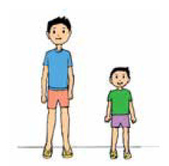

Slide 12
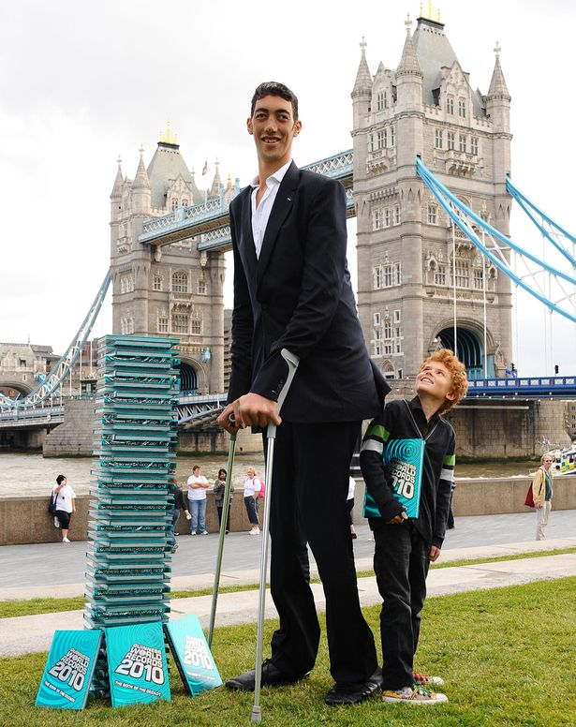

Slide 13
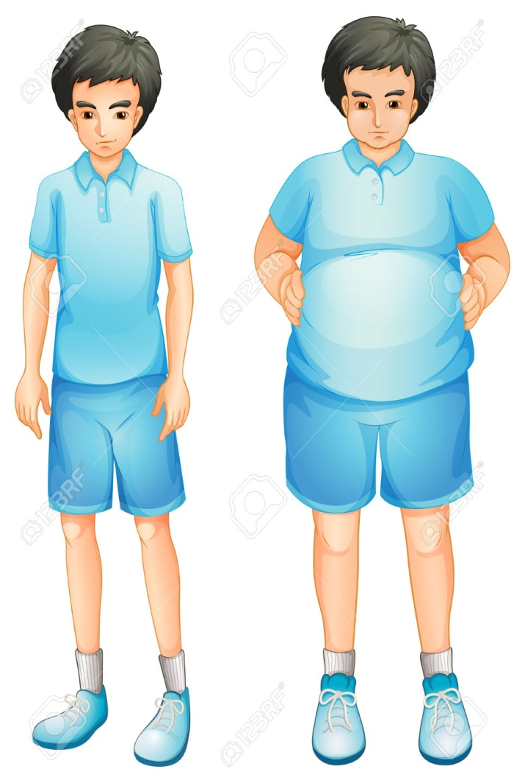

Slide 14
T
H
A
N
K
S

