Slide 1
Welcome everybody

Slide 2
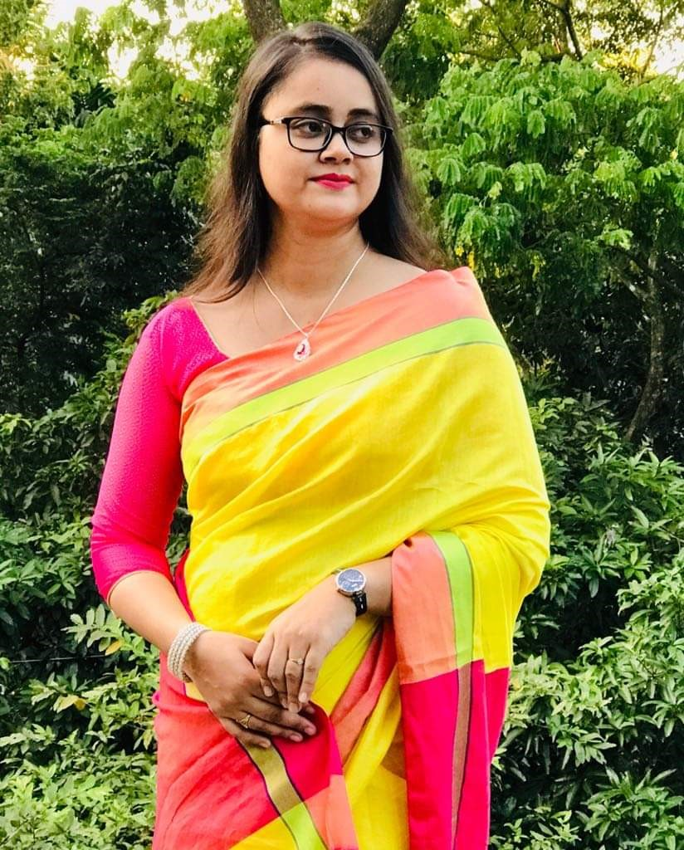
Presented by
Farzana chowdhury
Assistant teacher
Norpati Government primary school
Laksam,cumilla.
E-mail:sorna67m@gmail.com
English
class-5
Unit-1-( Hello)
Lesson-1,2-3

Slide 3
Learning outcomes:
L-3.2.1 understand questions about family and friends of students.
S-2.1.2 make introductions.
R-1.5.1 read words, phrases, and sentencesin the text with proper pronunciation,stress and intonation.

Slide 5
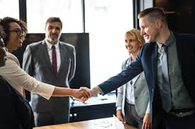
New words
Introduce
To make known by name.
পরিচয় প্রদান করা
Holiday
A time of rest time from work, school,etc.
ছুটি বা অবকাশ

Slide 6
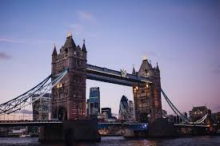
United
Joined together as a group
যুক্ত
kingdom
A country ruled by a king or queen.
রাজ্য

Slide 7
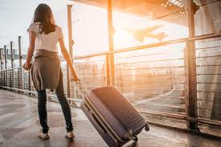
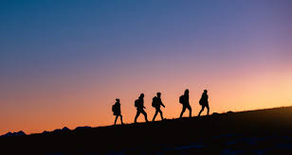
Leave
To go away from somewhere.
ত্যাগ করা
Journey
Travelling from one place to another.
ভ্রমন

Slide 8
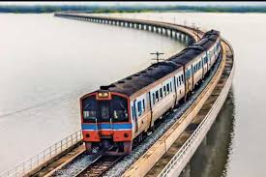
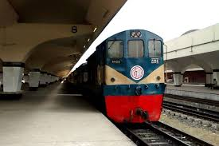
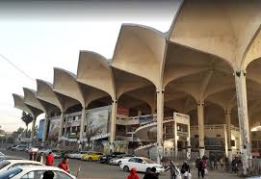
Train
Railway station

Slide 9
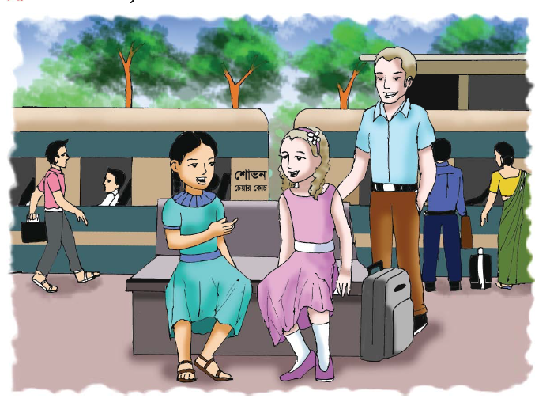

Slide 10
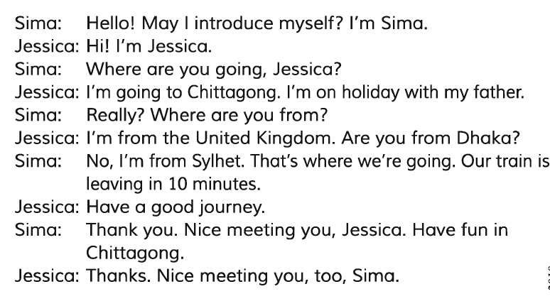

Slide 11
Write ‘True’ for correct statement and ‘false’ for incorrect statement.
Sima lives in Sylhet.
Jesicca hails from the united Kingdom.
Sima is pleased to meet Jessica.
Jessica is with her mother.
Jessica started the conversation.
Sima is Bangladesi.
True
true
true
false
false
true.

Slide 12
Match the words of the coloumn A with their meaning in column B .
Column A | Column B
a. introduce | i) Name of a country.
b. Myself | ii) Joined together for a common purpose.
c. United | iii) To tell someone name and whereabouts.
d. Journey | iv) Travelling from one place to another.
e. Holiday | v) The speaker himself for herself.
 | vi) The person spoken to.
 | vii) A period of time when people do not work.

Slide 13
Ask and answer the questions.
1. Where is Jessica going?
Ans: Jessica is going to Chattogram.
2. Why is Jessica going there?
Ans: Jessica is going there to spend her holiday with her father.

Slide 14
3. Where is Jessica from?
Ans: Jessica is from the united kingdom
4. Is Sima from Dhaka?
Ans: No, Sima is from Sylhet.

Slide 16
Home work
Write at least five sentences about your Last holiday by answering the following questions.
When did you get your holiday?
Where did you go then?
How did you go there?
Whom did you go with?
How did you enjoy your days?

Slide 17
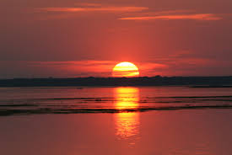
Goodbye
See you again

