Slide 1
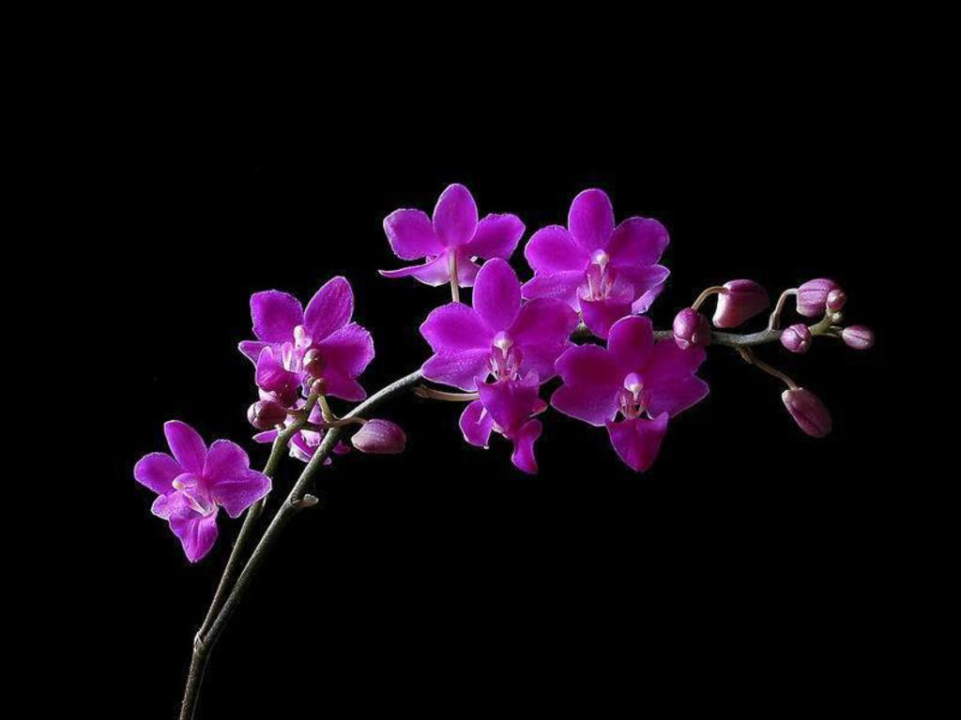
Dear Learners
welcome
From Shahid Arju Moni Govt. Secondary School

Slide 2
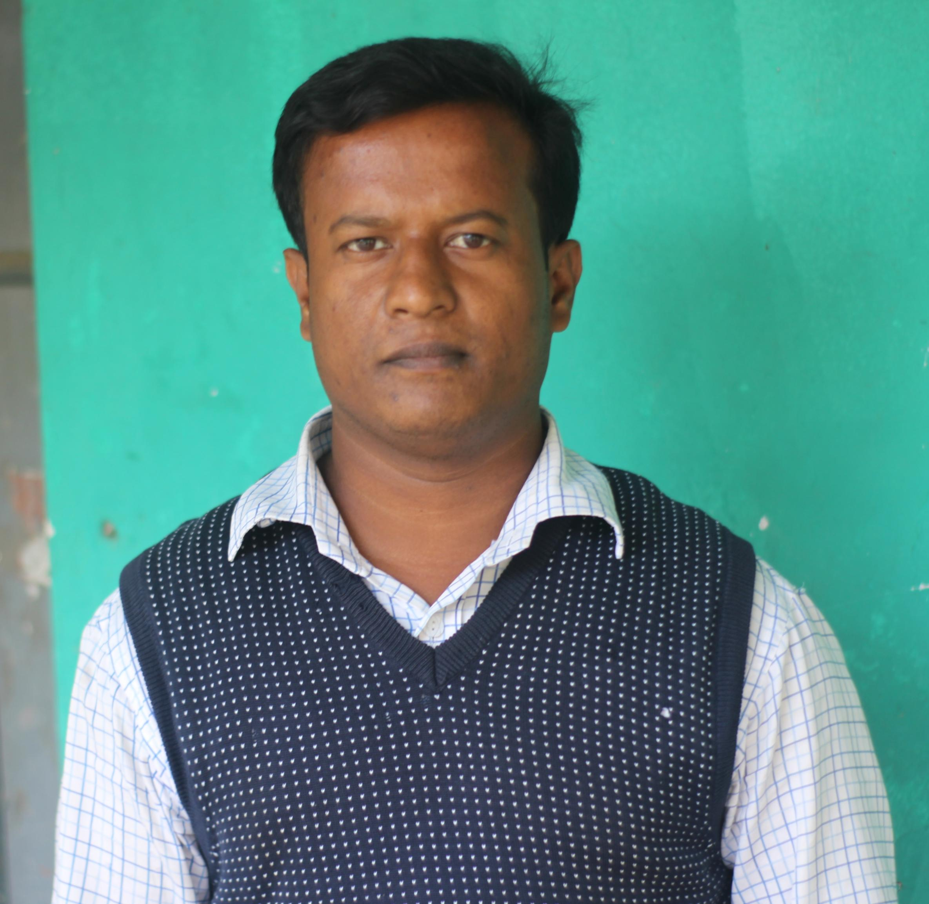
Introduction
Md. Zahid Hasan
Assistant Teacher (English)
Hat Barobazar Secondary School, Jhenaidah
Mob: 01778401886
Emai:mdzahidhasan926@gmail.com
Class-6/7
Subject: English 2nd Paper
Notes:
Introduction of the teacher and the class.

Slide 3
Read and say-
What are they?
Read the following three sentences attentively:
1. He is good.
2. He is better.
3. He is the best.
When we say-
Good => The rate of goodness is normal.
Better => The rate of goodness is high.
Best => The rate of goodness is totally high.
So, these words show the grade or rate of an adjective ‘Good’. In other word, this rate or grade is Degree.
Most Adjectives of Quality, and four Adjectives of Number and
Quantity (much, little, many, few) have degrees of comparison.

Slide 4
Today’s Lesson
Today we will learn
‘Degree’
-the Degrees of Comparison.
Specifically, we will learn -
1. What is degree?
2. Its classifications.
3. 8 Rules of conversion of adjectives
4. 5 types of Superlative sentences
5. 8 Rules of transforming sentences from Superlative to Positive
6. Easy techniques to hold these rules in mind

Slide 5
Definition
The different forms of Adjectives are called Degree.
Degrees of comparison mean how much grade or rate of quality is applied.

Slide 6
Degrees are of three kinds-
1. Positive degree
2. Comparative degree
3. Superlative degree
Kinds of Degree

Slide 7
Definitions of Different Degrees
Positive degree:
The form of an adjective which depicts a noun or pronoun’s quality, flaw or state is called Positive degree.
For example:
He is a tall boy.
No other boy is as tall as he.
Comparative degree:
The form of adjective which compares two nouns’ or pronouns’ quality, flaw or state is called Comparative degree.
For example, He is taller than Rabby.
Superlative degree:
The form of an adjective which is used to compare among many is called Superlative Degree.
For example,
He is the tallest boy in the class.

Slide 8
Rules of conversion of adjectives
Rule-01 Gi D`vniY
SL | Positive | Comparative | Superlative
01 | Poor | Poorer | Poorest
02 | Dear | Dearer | Dearest
03 | Tall | Taller | Tallest
04 | Bright | Brighter | Brightest
Rule-02 Gi D`vniY
SL | Positive | Comparative | Superlative
01 | Red | Redder | Reddest
02 | Hot | Hotter | Hottest
03 | Thin | Thinner | Thinnest
04 | Fat | Fatter | Fattest

Slide 9
Rules of conversion of adjectives
SL | Positive | Comparative | Superlative
01 | Large | Larger | Largest
02 | Humble | Humbler | Humblest
SL | Positive | Comparative | Superlative
01 | Happy | Happier | Happiest
02 | Lazy | Lazier | Laziest
SL | Positive | Comparative | Superlative
01 | Coy | Coyer | Coyest
02 | Gay | Gayer | Gayest

Slide 10
Rules of conversion of adjectives
SL | Positive | Comparative | Superlative
01 | Precious | More precious | Most precious
02 | Important | More important | Most important
03 | Careful | More careful | Most careful
SL | Positive | Comparative | Superlative
01 | Good/well | Better | Best
02 | Bad/evil/ill | Worse | Worst
03 | Late | Latter/later | Last/latest
04 | Many | More | Most
05 | Old | Older/elder | Oldest/eldest
06 | Fore | Former | Foremost
07 | Far | Farther/further | Farthest/furthest
08 | In | Inner | Innermost/inmost
09 | Out | Outer | Uttermost/utmost
10 | Up | Upper | uppermost

Slide 11
Rules of transforming from Superlative to Positive
Superlative sentences are of five types-
a) Shakib is the best of all players in Bangladesh team. => Of all hy³ Superlative
b) Shakib is one of the best players in Bangladesh team. =>One of hy³ Superlative
c) Shakib plays the best of any player in Bangladesh team. => Of any hy³ Superlative
d) Shakib gives the best performance for Bangladesh team. => Plain Superlative
e) Shakib is the best. => Superlative

Slide 12
Rules of transforming from
Superlative to Positive
Rule-03
Of all hy³ Superlative Degree to Positive Degree:
Superlative Sentence: Sushmita is the most intelligent of all girls in the class.
No other+ Singular form of the after-portion of ‘Of all’+ Verb + so/as + Positive Form of Superlative degree + as+ Subject.
Positive structure: No other + girl in the class+ is + so/as + intelligent + as + Sushmita.
Positive: No other girl in the class is so/as intelligent as Sushmita.
Rule-02
One Of hy³ Superlative Degree to Positive Degree:
Superlative Sentence: Hrishita is one of the most talented students in the class.
Very few + After-portion of Superlative degree+ Plural form of Verb + so/as + Positive Form of Superlative degree + as+ Subject.
Positive structure: Very few + students in the class+ are + so/as + talented + as + Hrishita.
Positive: Very few students in the class are so/as talented as Hrishita.
Rule-01
Plain Superlative Degree to Positive Degree:
Superlative Sentence: Epshita is the sweetest girl in the class.
No other + After-portion of Superlative degree+ Verb + so/as + Positive Form of Superlative degree + as+ Subject.
Positive structure: No other + girl in the class + is + so/as + sweet + as+ Epshita.
Positive: No other girl in the class is so/as sweet as Epshita.

Slide 13
Rules of transforming from
Superlative to Positive
Rule-04
Of any hy³ Superlative Degree to Positive Degree:
Superlative Sentence: Shakib plays the best of any player in Bangladesh team.
No other + After-portion of ‘Of any’+ Verb + so/as + Positive Form of Superlative degree + as + Subject.
Positive structure: No other+player in Bangladesh team + plays + so/as + good + as + Shakib.
Positive: No other player in Bangladesh team plays so/as good as Shakib.
Rule-05
Complement wenxb Superlative Degree ‡_‡K Positive Degree:
Superlative Sentence: Shakib plays the best.
No one else / Nothing else + verb + as + Positive Form of Superlative degree + as+ Subject.
Positive structure: No one else + plays + so + good + as+ Shakib.
Positive: No one else plays as good as Shakib.
Rule-06
Of all hy³ Negative Superlative Degree to Positive Degree:
Superlative Sentence: Joy is not the tallest of all boys in the class.
Some other + After-portion of ‘Of all’+ Plural form of Verb + the least + as + Positive Form of Superlative degree + as+ Subject.
Positive structure: Some other + boys in the class+ are + the least + as + tall + as + Joy.
Positive: Some other boys in the class are the least as tall as Joy.

Slide 14
Rules of transforming from
Superlative to Positive
Rule-08
Negative Plain Superlative Degree to Positive Degree:
Superlative Sentence: Orjan is not the smallest boy in the class.
Some other + Plural form of after-portion of Superlative degree + Plural form of Verb + the least + as + Positive Form of Superlative degree + as+ Subject.
Positive structure: Some other + boys in the class+ are + the least + as + small + as + Orjan.
Positive: Some other boys in the class are the least as small as Orjan.
Rule-07
One of hy³ Negative Superlative Degree to Positive Degree:
Superlative Sentence: Ornab is not one of the cleverest boys in the group.
Subject + Negative form of Verb + so + Positive Form of Superlative degree + as + some other + After-portion of Superlative degree.
Positive structure: Ornab+ is not + so/as+ clever + as+ some other boys in the group.
Positive: Ornab is not so/as clever as some other boys in the group.

Slide 15
Rules of transforming from Superlative to Positive
SL | Superlative | Positive
01 | Plain Superlative | No other-----as/so-----as
02 | Of all hy³ Superlative | No other-----as/so-----as
03 | Of any hy³ Superlative | No other-----as/so-----as
04 | One Of hy³ Superlative | Very few-----as/so-----as
05 | Complement wenxb Superlative | Nothing/None else-----as/so-----as
06 | Negative Plain Superlative | Some other-----the least as/so-----as
07 | Of all hy³ Negative Superlative | Some other-----the least as/so-----as
08 | One of hy³ Negative Superlative | Not as/so-----as + some other
Note: 1. No other, of any Gi c‡i mvavibZ Singular word e‡m|
2. One of, Of all, Very few Ges some other Gi c‡i me©`v Plural word e‡m|

Slide 16
Class work
Open your writing pad and do the exercise:
1. Abdul is the strongest boy in the team.
2. Chattogram is one of the richest towns in Bangladesh.
3. Iron is the most useful of all metals.
4. It burns the prettiest of any wood.
5. Truthfulness is the greatest.
6. Barisal is not the largest of all towns in Bangladesh.
7. Rana is not one of the smartest boys in the class.
8. January is not the coldest month in Bangladesh.
Answers
01. No other boy in the team is as strong as Abdul.
02. Very few towns in Bangladesh are as rich as Chattogram.
03. No other metal is as useful as iron.
04. No other wood burns as pretty as it.
05. Nothing else is as great as truthfulness.
06. Some other towns in Bangladesh are the least as large as Barisal.
07. Rana is not so smart as some other boys in the class.
08. Some other months in Bangladesh are the least as cold as January.

Slide 17
Thanks all

