Slide 1
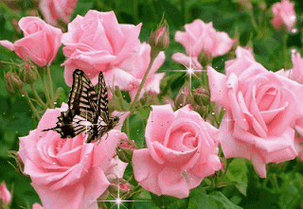
Welcome to English 2nd Paper Class

Slide 2
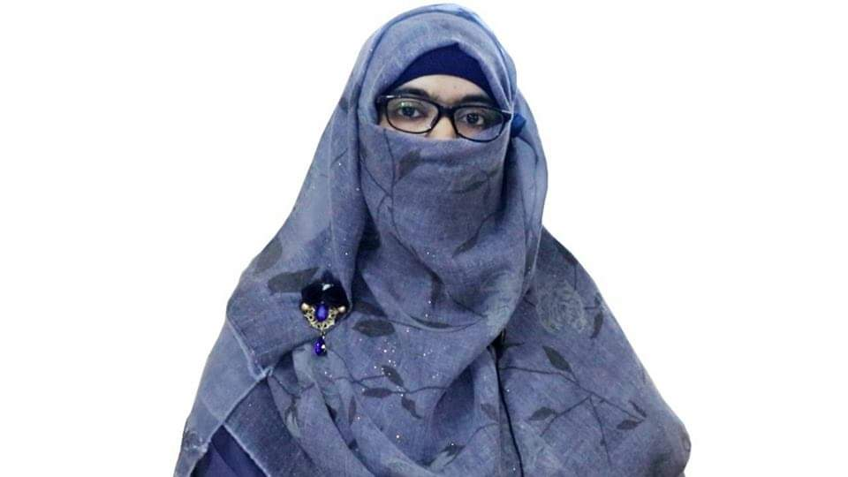
Identity
Sabina Yeasmin
Lecturer in English
Baridhara Nazmul Ulum Alim Madrasah
Badda, Dhaka

Slide 3
Degree Part-2

Slide 4
Learning outcome
At the end of the lesson, students will be able to-
Exercise from Positive to Comparative and Superlative and vise versa spontaneously.

Slide 5
1.Plain Positive: Sub + verb + a/an + adj + noun/pronoun Viz: Sazzad is a good boy. | 2.Comparative : Sub + verb +adj (comparative form) + than/than any other +noun/pronoun Viz: Sazzad is good than any other boy. | 3.Superlative: Sub + verb + the +adj (superlative form) Viz: Sazzad is the best boy.

Slide 6
2.No other (singular) #.No other +obj + verb +as +positive form + as + sub. Viz: No other student in the class is as good as Rahim. | 2.Than any other #. Sub + verb + comparative form+ than any other +extension. Viz: Rahim is better than any other student in the class. | 2.The #. Sub + verb + the +superlative form +extension. Viz: Rahim is the best student in the class.

Slide 7
3. Very few (plural) #. Very few +obj +verb + as+ positive degree +as +sub #. Viz: Very few poets in the world are as great as Shakespeare. | 3. Than most other #.Sub+ verb +comparative form +than most other +extension. #. Viz: Shakespeare is greater than most other poets in the world. | 3. one of the #. Sub+ verb +one of the + superlative form+ extension. #. Viz: Shakespeare is one of the greatest poets in the world.

Slide 8
4. As -----as---- #. Sub +verb +as +Positive form +as +Sub #. He is as wise as Karim. N.B. not as …… as …. Viz: Sohan is not as stupid as he. | 4. Not less------ than ------ #. Last sub +verb +not less ----- than +first sub Viz: Karim is not less wise than he. N.B. Less ……. Than #. Viz: Sohan is less stupid than he. | 4. No Superlative

Slide 9
5. As soon as ----- Viz: As soon as we reached the madrasah, the Principal left out. | 5. No sooner had ------ than--- #. Viz: No sooner had we reached the madrasah than the Principal left out. | 5. No Superlative

Slide 10
A frugal man is happier than a prodigal man. (Positive)
Ans: A prodigal man is not so happy as a frugal man.
2.It is evident that industry is one of the greatest virtues. (Positive)
Ans: It is evident that very few virtues are as great as industry.
3.Anger is one of the most inhuman vices. (Positive)
Ans: Very few vices are as inhuman as anger.

Slide 11
4. Mobile phone is one of the greatest inventions. (Positive)
Ans: Very few inventions are so great as mobile phones.
5. Deforestation is one of the greatest problems of our environment. (Comparative)
Ans: Deforestation is greater than most other problems of our environment.

Slide 12
6. At present cricket is the most popular game in our country (Positive)
Ans: At present no other game in our country is as popular as cricket.
7. A healthy poor man is happier than a sick moneyed man. (Positive)
Ans: A sick moneyed man is not as happy as a healthy poor man.

Slide 13
8. It is one of the largest parliament buildings. ( Positive)
Ans: Very few parliament buildings are as large as it.
Very few insects are as busy as a bee. (Comparative)
Ans: A bee is busier than most other insects.

Slide 14
Water is one of the most important elements of all living beings. (Positive)
Ans: Very few elements of all living beings are so/as important as it.
11. Honesty is the best policy in life. (Positive)
Ans: No other policy in life is as good as honesty.

Slide 15
Pahela Baishakh is one of the most interesting days of the year. (Positive)
Ans: Very few days of the year are so interesting as Pahela Baishakh.
13. Books are man’s best friends in life. (Positive) .
Ans: No other friends in man’s life is so good as books.

Slide 16
14. Bayazid Bostami was one of the greatest saints of Islam. (Positive)
Ans: Very few saints of Islam were as great as Bayazid Bostami.
15. Some poets are at least as great as Tennyson. (Superlative)
Ans: Tennyson is the greatest of some poets.

Slide 17
Very few cricket team in the world are as unpredictable as Pakistan. (Superlative)
Ans: Pakistan is one of the most unpredictable cricket teams.
17. Dowry is one of the major problems of Bangladesh. (Positive)
Ans: Very few problems of Bangladesh as major as dowry.

Slide 18
18. Tea is the most popular drink. (Comparative)
Ans: Tea is more popular than any other drink.
19. And it suddenly occurred to Tania that her husband was the strongest man she had ever met. (positive)
Ans: And it suddenly occurred to Tania that no other man is as strong as her husband she had ever met.

Slide 19
20.The Jamuna is one of the biggest rivers in Bangladesh. (Comparative)
Ans: The Jamuna is bigger than most other rivers in Bangladesh.
21.Traffic jam is one of the most serious problems in the city of Dhaka. (Comparative)
Ans: Traffic jam is more serious than most other problems in the city of Dhaka.

Slide 20
22. Actually at that time he (king) was the wisest of all. (Comparative)
Ans: Actually at that time he was wiser than any other king.
23. Jim was one of the sincerest husbands that we have ever known. (Positive)
Ans: Very few husbands were so sincere as Jim that we have ever known.

Slide 21
24. It is the most significant event in the history of Bangladesh. (Comparative)
Ans: It is more significant than any other event in the history of Bangladesh.
25. They are the most courageous sons of our nation. (Positive)
Ans: No other sons of our nation are as courageous as they.

Slide 22
26. They are more patriotic and industrious. (Positive)
Ans: They are very patriotic and industrious.
27. The Tajmahal is one of the most beautiful buildings in the world. (Positive)
Ans: Very few buildings in the world are as beautiful as the Tajmahal.

Slide 23
28.Very few animals are as ferocious as lion. (Superlative)
Ans: Lion is one of the most ferocious animals.
29. No other student of our class is so meritorious as Tuhin. (Superlative)
Ans: Tuhin is the most meritorious student of our class.
30.As soon as he reached the station, the train left. (Comparative)
Ans: No sooner had he reached the student than the train left.

Slide 24
Thank you so much
For watching

