Slide 1
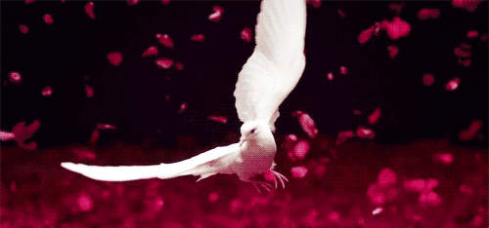
GOOD MORNING

Slide 2
Identity
Md shafiqul islam
Assistant Teacher
Sonatan Darussannat Dakhil Madrasha
Kawnia, Rangpur.
Mail:shafiqulislam42347@gmail.com
English 1st Paper
Class: Eight
Unit: Ten
Lesson: 1& 2
Date: 04/02/2021

Slide 3
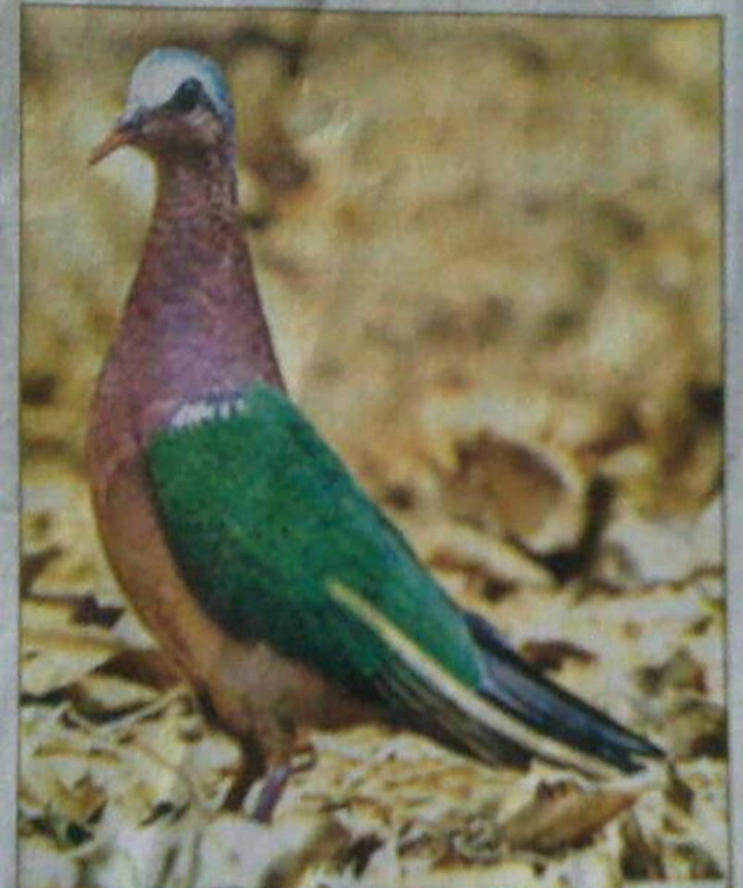
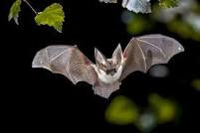
LOOK AT THE PICTURE

Slide 5
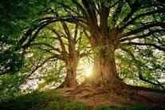

Slide 6
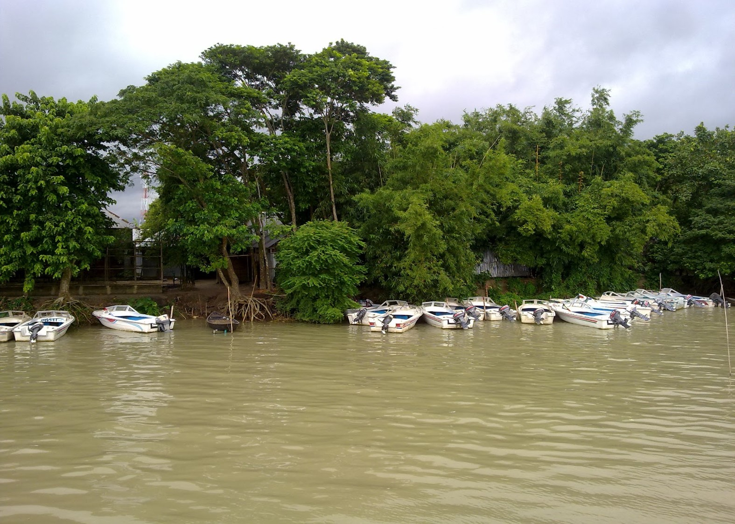

Slide 7
TODAYS LESSON IS-
The Truthful Dove

Slide 8
Learning Outcome
After we have studied these lesson, we will be able to-----
Describe picture.
Read and understand texts through silent reading.
Word meaning from the text.
Ask and answer question.
Take part in discussions.
Choose the correct answer from the alternative.
Fill each gaps with suitable words from the text..

Slide 9
Word meaning
Shelter ---------------আশ্রয় wondering----------------বিস্ময়কর
Grumpy --------------রুক্ষমেজাজি insincere----------------আন্তরিকতাহীন
Unwillingly -----------অনিচ্ছুক praise-------------------প্রশংসা
Generous -------------উদার প্রকৃতি grateful--------------কৃতজ্ঞ
Flattery ----------------চাটুকার ashamed--------------লজ্জিত
Selfish ------------------স্বার্থপর quiet------------------শান্ত
Greed -------------------অতিরিক্ত লোভ urged------------------পীড়াপীড়ি করা
Powerful ----------------শক্তিবান
Heavily ------------------মুষলধারে
Around -------------------চারিদিক
Knocked ------------------আঘাত করা
Requested ---------------অনুরোধ করল
Hungry --------------------ক্ষুধা
Puffed ---------------------ফুৎকার
Ruffled --------------------বিক্ষুদ্ধ করা

Slide 10
Describing lesson-
Once upon a time, a dove and a bat were very good friends. One day the two friends decided to set out on a journey.

Slide 11
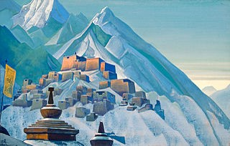
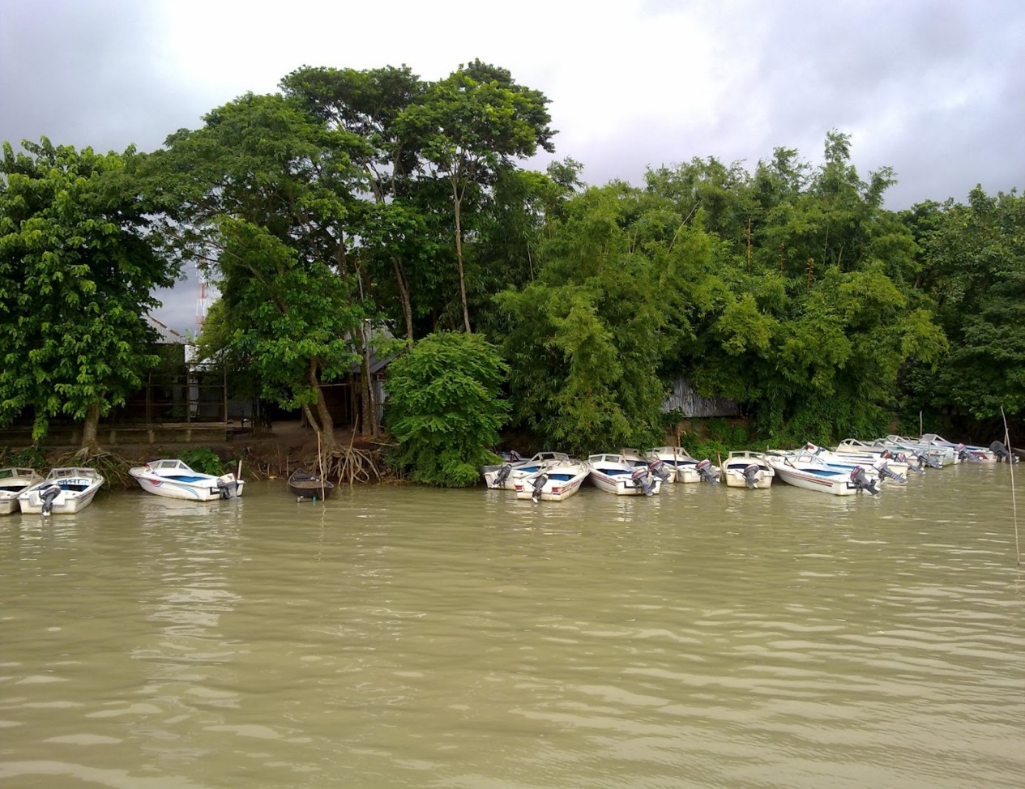
They flew over the rivers and hills and came to a big jungle. Both the friends were very tired, they needed to sit down and take a rest.

Slide 12
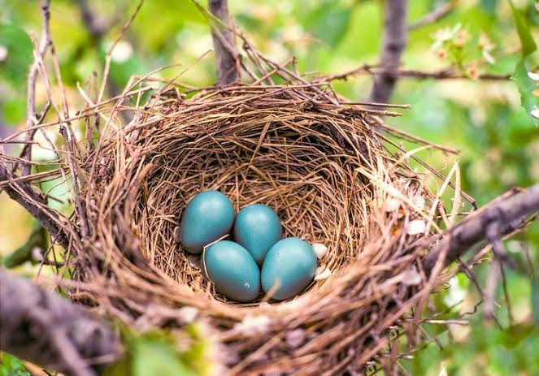
They came upon a century –old rain tree. An owl had his nest in that tree. The dove and the bat knocked t the owl’s door.

Slide 13
The old grumpy owl opened the door. The dove and the bat requested him to give them shelter. The owl unwillingly let them in. The two birds were hungry too. They begged for some food.

Slide 14
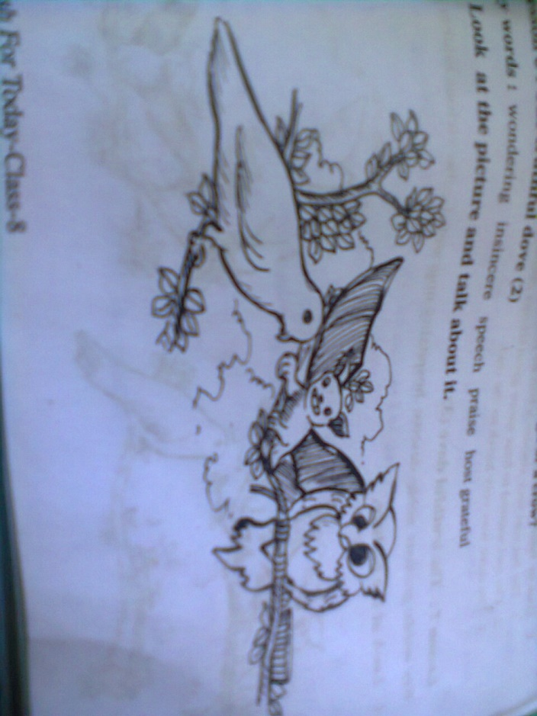
All this time the dove was listening to her friend’s false praises. She was wondering how insincere his praises were. The dove hung her head down and was quiet. The owl got impatient. He wanted to hear more praises. He looked at the dove and asked, ‘ Don’t you have any good thing to say about me? ‘

Slide 15
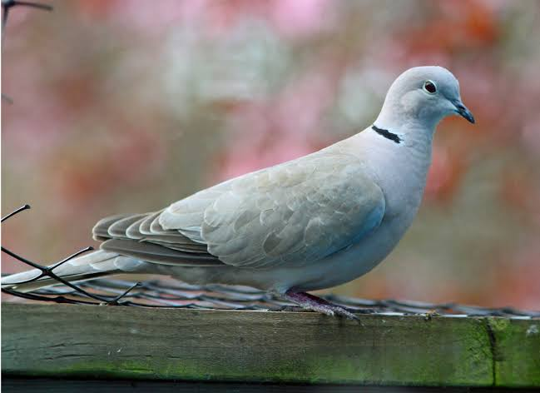
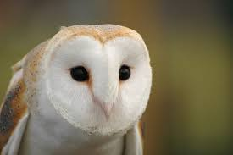
The dove lifted her head slowly and said ,’’’Master owl, thank you very much for the shelter you have given me, thank you for the food you have offered me. I will remain ever grateful for this’’.

Slide 16
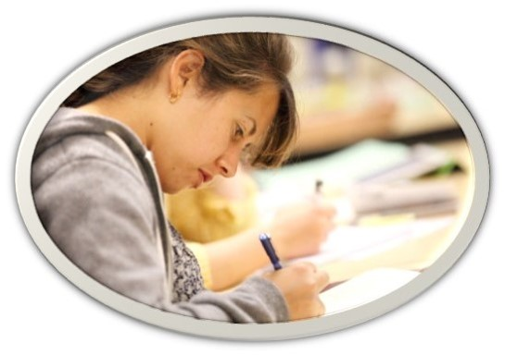
Silent Reading

Slide 17
Individual Work
Who were the two good friends?
Why was the dove ashamed of her friend?

Slide 18
Group Work
Choose the correct answer to each from the alternative:
The dove and the bat flew over---------------------------.
(a) the rivers (b ) the hills (c ) big jungle (d) the rivers and hills
They started to look for-----------------------.
(a) shelter (b) food (c ) dinner (d) their nest
The owl was very -----------------at the bat’s flattery.
(a) angry (b) pleased (c ) cousins (d ) content
The owl wanted to hear more good things about--------------------------.
(a) the dove (b) the bat (c ) himself (d ) others
The bat was very -------------------------------------------------------------.
(a) honest (b) loyal (c ) dishonest (d) clever

Slide 19
Evaluation
Answer the following questions from reading the text:
Where did the dove and the bat come?
Which words pleased the owl?
Why did they look for a shelter?
Why did the dove think that the bat is insincere?
What made the owl impatient?

Slide 20
Home Work
Fill in each gaps with suitable words from the text:
The word hygiene ‘ means the(a ) ------------of keeping ourselves clean. Hygiene is thought to be next to (b )-------------------. Its also(c ) --------------to keep our home and work places clean. It is (d )---------------for our good health. Nobody likes an (e)--------------person either. So we must follow the rules of (f )--------------------.

Slide 21
THANK YOU ALL STUDENT

