Slide 1


Welcome

Slide 2

INTRODUCTION
Md.Shamsul Alam
Assistant Teacher( English)
Nabodoy Girl’s High School
Shailkupa, Jenaidah.
Phone:01917-452052,01722-922691
SUBJECT: English 2nd Paper
CLASS: Six/Seven
Topic: “Use of Capitalization”

Slide 3

What can you see?
A picture of a girl
Najnin is a pretty lady. She is standing infront of a spreading field. She is a debater, anchor , reciter and a rover. She lives in Australia with her husband, Dr. N. Alam and 2 years old daughter, Nishita . She is now doing P.H.D. She worked as a sub editor in The Daily Sabuj Sylhet in Bangladesh.

Slide 4
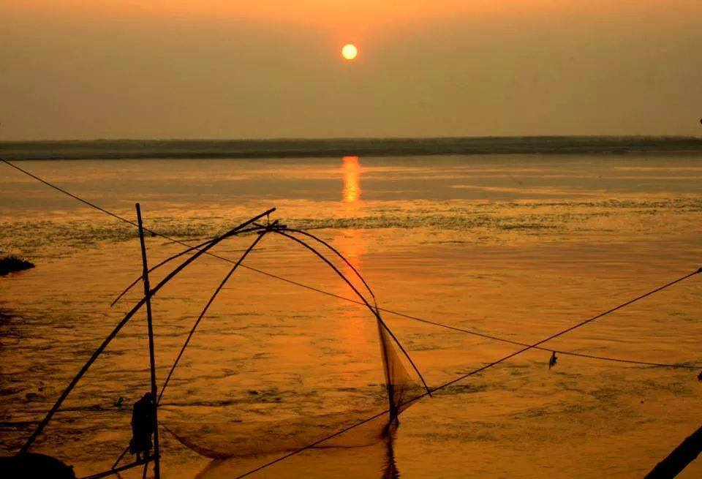

THE RULES OF CAPITALIZATION
Beauty of
Bangladesh

Slide 5
Learning Outcomes:
After the end of the lesson the learners will be able to-
a) write the name of any thing using the rules of capitalization.
b) rewrite a passage using the rules of capitalization.

Slide 6
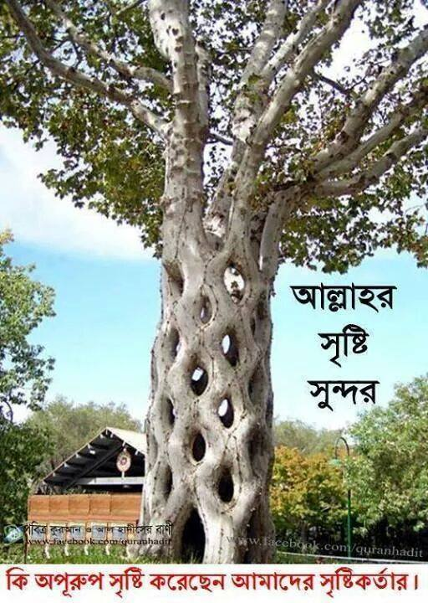
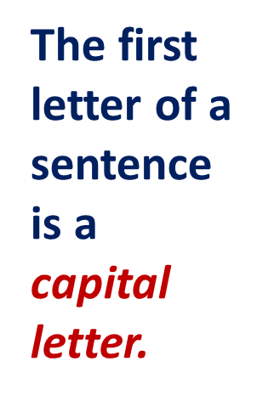
T
his is an outstanding picture.

Slide 7
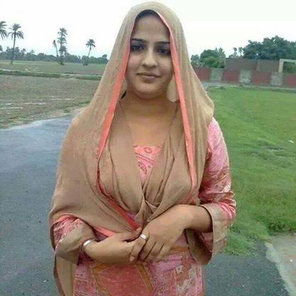
Ms.Nazma Parvin is an Associate Professor.
A capital letter is used in case of the first letter of a
Proper noun .
The first letter of a is a capital letter.
designation

Slide 8
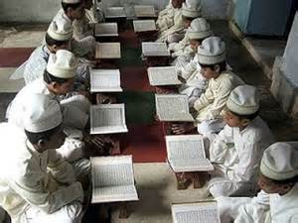
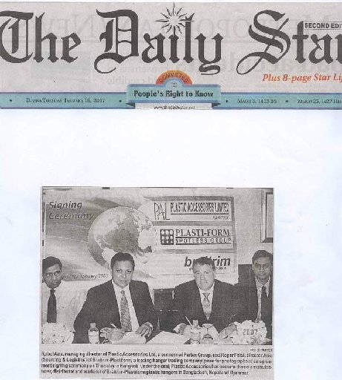
Children read the daily in the mosque.
Holy Quran
The first letter of the holy religious book is a capital letter
Daily Star
The publishes news
full of intrinsic value.
The first letter of a daily newspaper is a capital letter

Slide 9
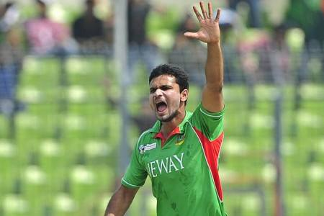
Mashrafee is a Bangladeshi cricketer.
An adjective, created from a proper noun, takes a capital letter in the beginning.

Slide 10
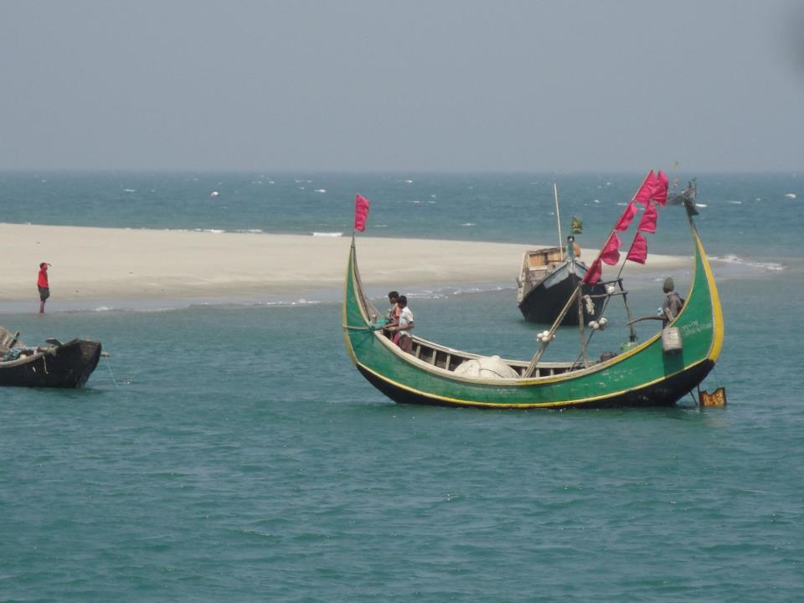

Padma
The is a big river.
The first letter of the name Of a river is a capital letter.
The first letter of the name Of a an ocean
is a capital letter.
The principal divisions of the ocean include the
Atlantic, Pacific, Indian, Arctic, Antarctic
oceans.

Slide 11
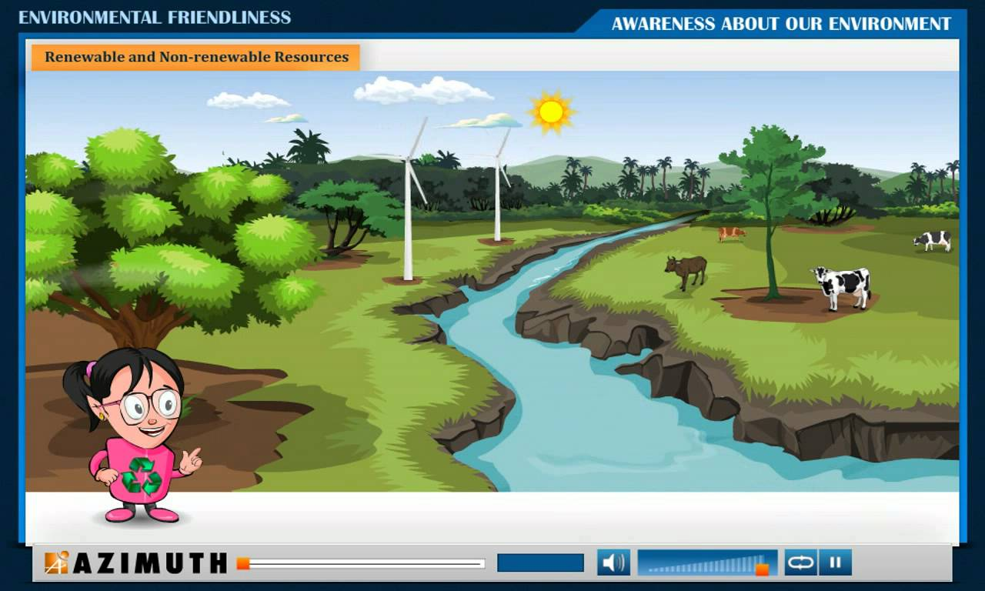
Rewrite the passage using the rules of capitalization where necessary..
I
C
T
M
A
A
S
S
T
R
in the picture, we see a river is flowing in a zigzag way. cattle are grazing in the nearby green field .the sun is shining brightly.ms ayesha amin is pointing to the river. she is in a smiling face. she will prepare a content for class six on “the rivers of bangladesh”.
B

Slide 12
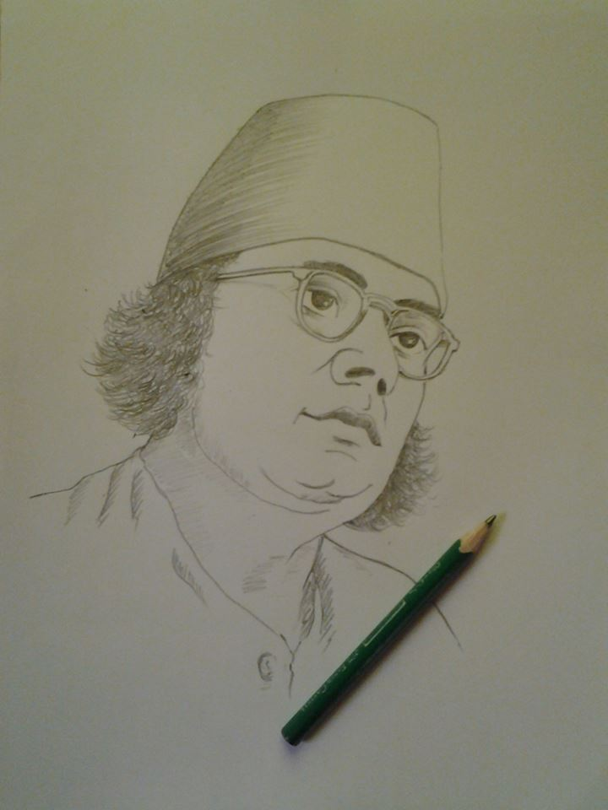
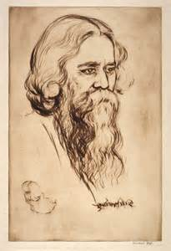
Group Work
Discuss the pictures within the groups . Now write 5 sentences about these pictures using the rules of capitalization . ( picture 1 for G-A & 2 for B ) .

Slide 13
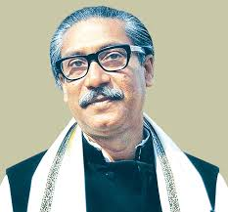
HOME WORK
Write 5 sentences about this given picture using the rules of capitalization.
Notes:
I’ll supply a picture among the learners each.

Slide 14

To be continue………

