Slide 1
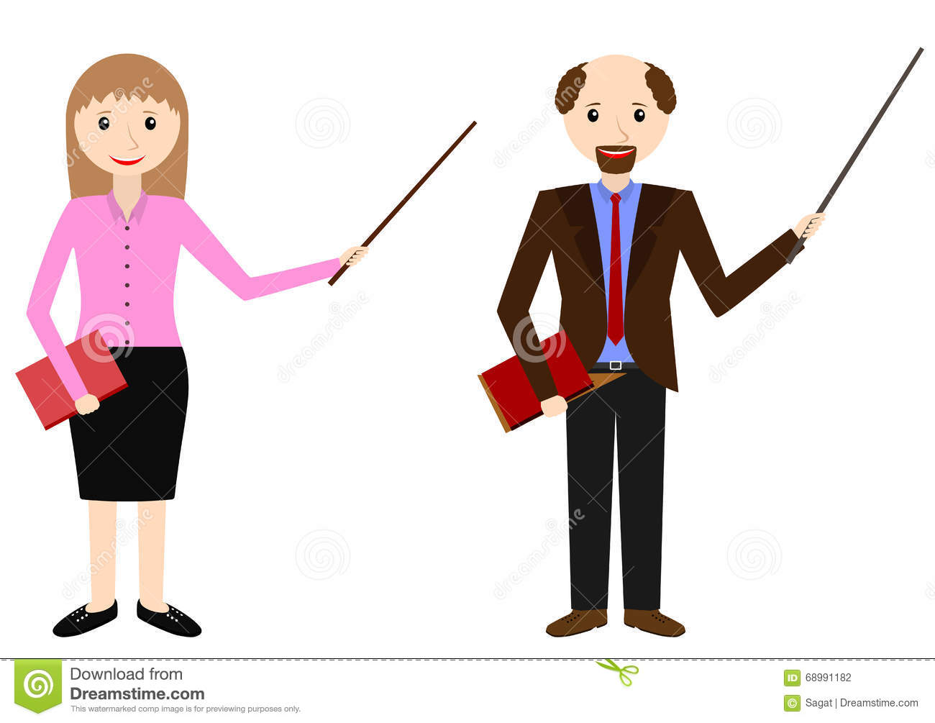
Welcome

Slide 2
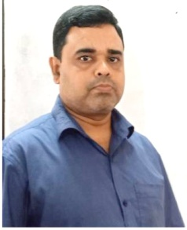
INTRODUCTION
ABDUL AZIZ
B.A(HON’S), M.A(ENGLISH)
MADHAIA BAZAR SADIM HIGH SCHOOL
Unit : 01, Lesson : 03
Topic : Gender

Slide 3
Look at the picture
Male
Female

Slide 4
So, our today’s topic is
Gender

Slide 5
What is Gender?
Gender specifies whether a noun or a pronoun is masculine,
feminine, neuter or common

Slide 6
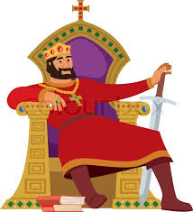
Types of Gender
Generally, gender is of four kinds :
Masculine Gender
Feminine Gender
Common Gender
Neuter Gender

Slide 7
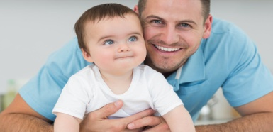
Masculine Gender
The noun or pronoun which refers to male person or thing is masculine gender
Example
Father
Lion
Son

Slide 8
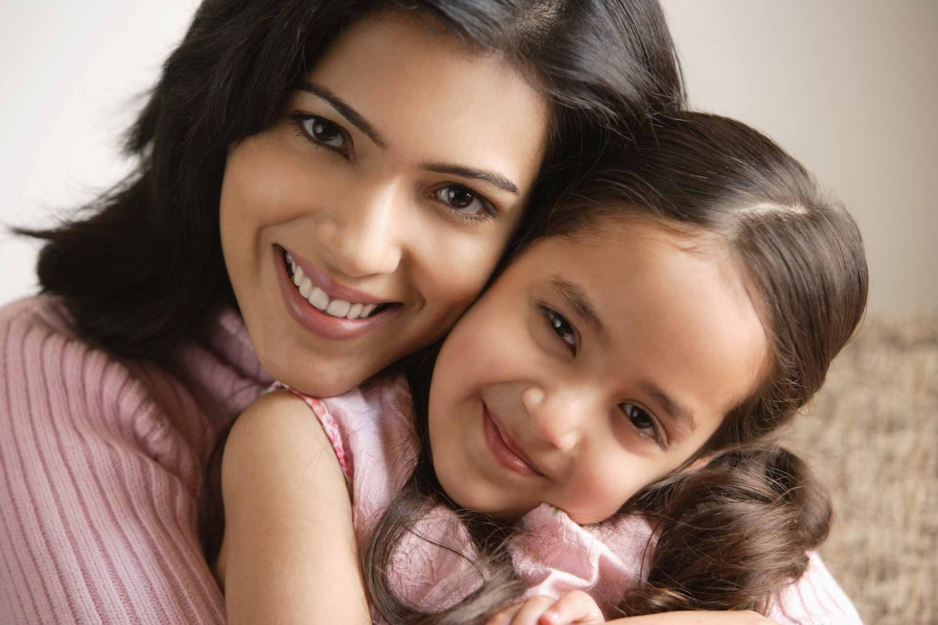
Femine Gender
The noun or pronoun which refers to female person or thing is called Femine gender
Example
Mother
Lioness
Daughter

Slide 9
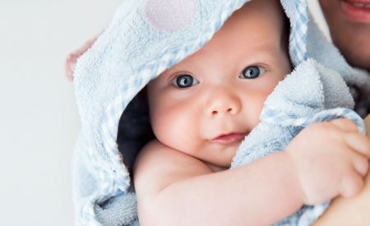
Common Gender
The noun or pronoun which refers to common person or thing is called common gender
Example
baby
Teacher

Slide 10
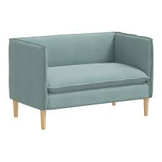
Neuter Gender
The noun or pronoun which refers to neither male nor female person or thing is called neuter gender
Example
furniture
Book
Computer

Slide 11
By adding ‘ess’
Author authoress
Host hostess
Lion lioness
manager managerss
Mayor mayoress
Peer peeress
Shepherd shepardess
Poet Poetess

Slide 12
Rules of Changing Gender
By using different words
By using different words
Father Mother
Brother Sister
Boy Girl
Uncle Aunt
Nephew Niece
Husband Wife
Man Woman
Gentle man Lady
KIng Queen
Son daughter
Sir madam
Bull cow
Fox vixen
Horse mare
Ram ewe
Cock hen
Bachelor maiden

Slide 13
By dropping the vowel before “ess”
Actor actress
Duke duchess
Emperor empress
Governor governess
God goddess
Hunter huntress
Instructor instructress
Prince princess
Mr. Mrs.
Master mistress

Slide 14
By changing the Masculine word of a compound word
Boy-friend girl –friend
He-goat she –goat
Grand –father grand mother
step –brother step –sister
Man – servant maid –servant
Son –in-law daughter –in-law
Milk –man milk –woman

Slide 15
Evaluation
Read the passage and change the gender of the underlined words.
Kajol is a boy of 13. He has a friend named Rony. They read in the same school. Kajol has a peacock and Rony has a ram. They play with these animals. There is a man-servant in Kajol’s house. He likes Kajol very much.
girl
She
pea-hen
ewe
maid-servant
She

Slide 16
Home work
Fill in the blanks with the appropriate word given in the bracket.
a)Nature removes our monotony. ___(He/She) gives us pleasure. b)___(Prince/princess) Diana died in a car accident. c)___ The Titanic sank when (he /she) hit an iceberg. d) My aunt is a good ____(actor/actress) e) She was selected as the ___(author/authoress) of the year.

Slide 17
Thank you

