Slide 1
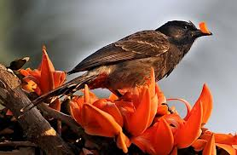
Welcome

Slide 2
Introduction of Teacher:
Md. Saiful Islam.
Assistant Teacher.
School Name: Dakkhin Jawrani Gov’t.Primary School.
Class- Three.
Subject- English
Lesson-

Slide 3
Listen the song:

Slide 4
Learning outcomes:

Slide 6
Title of the lesson:

Slide 10
Thanks all.

