Slide 2
WELCOME

Slide 3
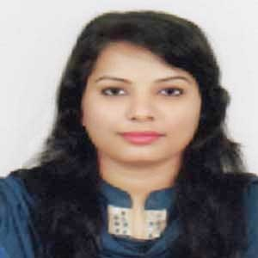
INTRODUCTION
RUBAIYA SULTANA
Assistant Teacher
Hafiz Ahmed High School
Barura, Cumilla.
English For Today
Class - Seven

Slide 4
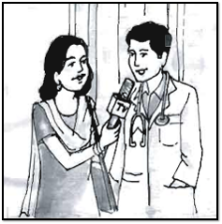
A. Look at the picture and guess what they are talking about.

Slide 5
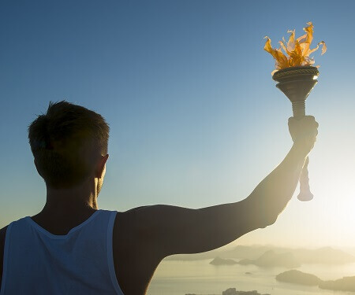
Our Today’s Lesson Is-
Waiting for a torch bearer
Unit- Four, Lesson-10

Slide 6
Learning Outcomes
After we have studied this lesson, we will be able to ---
ask and qnswer questions
read and understand texts
prticipate in dialogues and conversations
talk about people, places, and events
match the words with their meaning

Slide 8
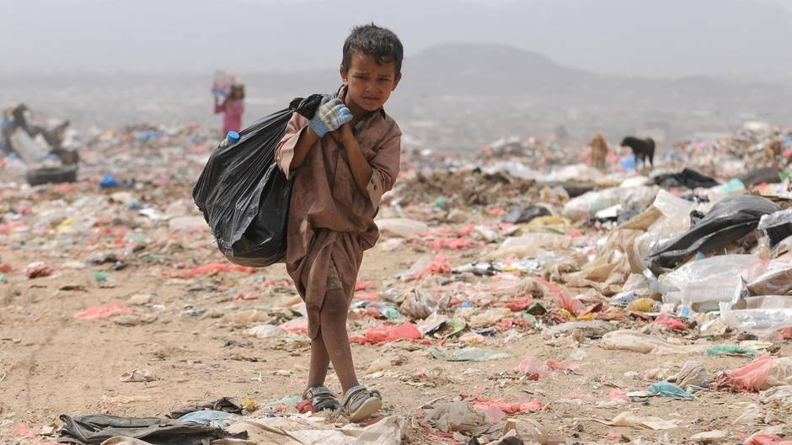
Poverty
Meaning: Impoverishment/Penurity

Slide 9
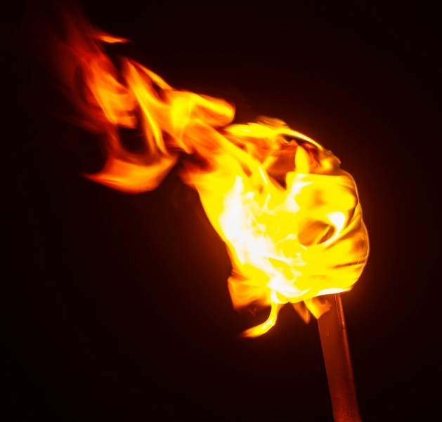
Torch
Meaning: Flare/Meteor

Slide 10
Responsibility
Meaning: Duty/Liability

Slide 11
B. A TV reporter is interviewing Dr Mahmud Hasan about his dream. Read the interview.

Slide 12
Note
MBBS= Bachelor of Medicine and Bachelor of Surgery

Slide 13
B.
C. Match the words with their meanings.
Words | Meanings
take charge of | the feeling of happiness
poverty | have control over
pleasure | duty
responsibility | the situation of being poor

Slide 14
B.
D. Ask and answer the questions.
1. Is the healthcare support free to all?
Ans: Free healthcare support is only for the very poor people.
2. Why is the doctor waiting for a torch bearer?
Ans: The doctor is waiting for a torch bearer because he is getting old.
3. Who will be in charge of the centre?
Ans: One of the students who get MBBS degree will be in charge of the centre.
4. Do you think the money he gets from the patient is enough to run the centre? Why do you think so?
Ans: I think, the money he gets from the patient is not enough to run the centre.I think so,because medical instruments are expensive and it costs much but he gets a few amount from the patient.

Slide 15
E. Fill in the gaps with the right from of verbs given in the box. You can use a word more than once.
give | choose | do | is | get | help
I want to ______ the poor people. I will ______ it to ______ healthcare support to the poor. They do not ______ treatment because of poverty. So my dream ______ to be a doctor. To ______ the poor people, I will ______ my village work.
help
do
give
get
is
help
choose

Slide 16
Evaluation
Why do you choose the village for your work?
How much does a patient pay for the support?
Isn’t the work very hard?
What is your future plan for the centre?

Slide 17
Home Work
Project work: Find a person in your area who is different from others in giving service to the society. Talk to her/him and prepare a short biography of the person.

