Slide 1
WELCOME TO BOGURA ONLINE EDUCATOION

Slide 2
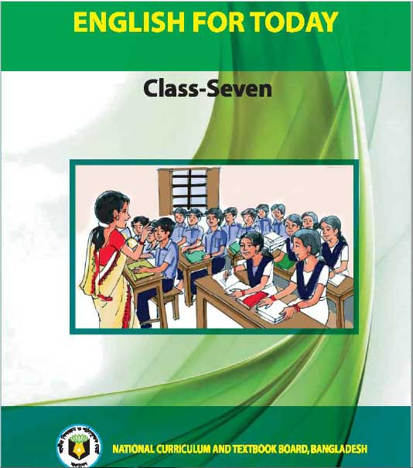
Introducing
Mst.Beauty Begum
Asst. Teacher
Behar M.A.M High School Shibganj ,Bogura.
Class: Seven
Sub : English 1st paper
Unit :3
Lesson: 1

Slide 3
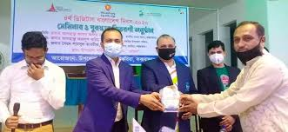

Slide 4
Topic: Prize-giving day at school

Slide 5
Learning Outcomes 1. Talk about familiar events 2. read and understand texts 3. write answers to questions

Slide 6
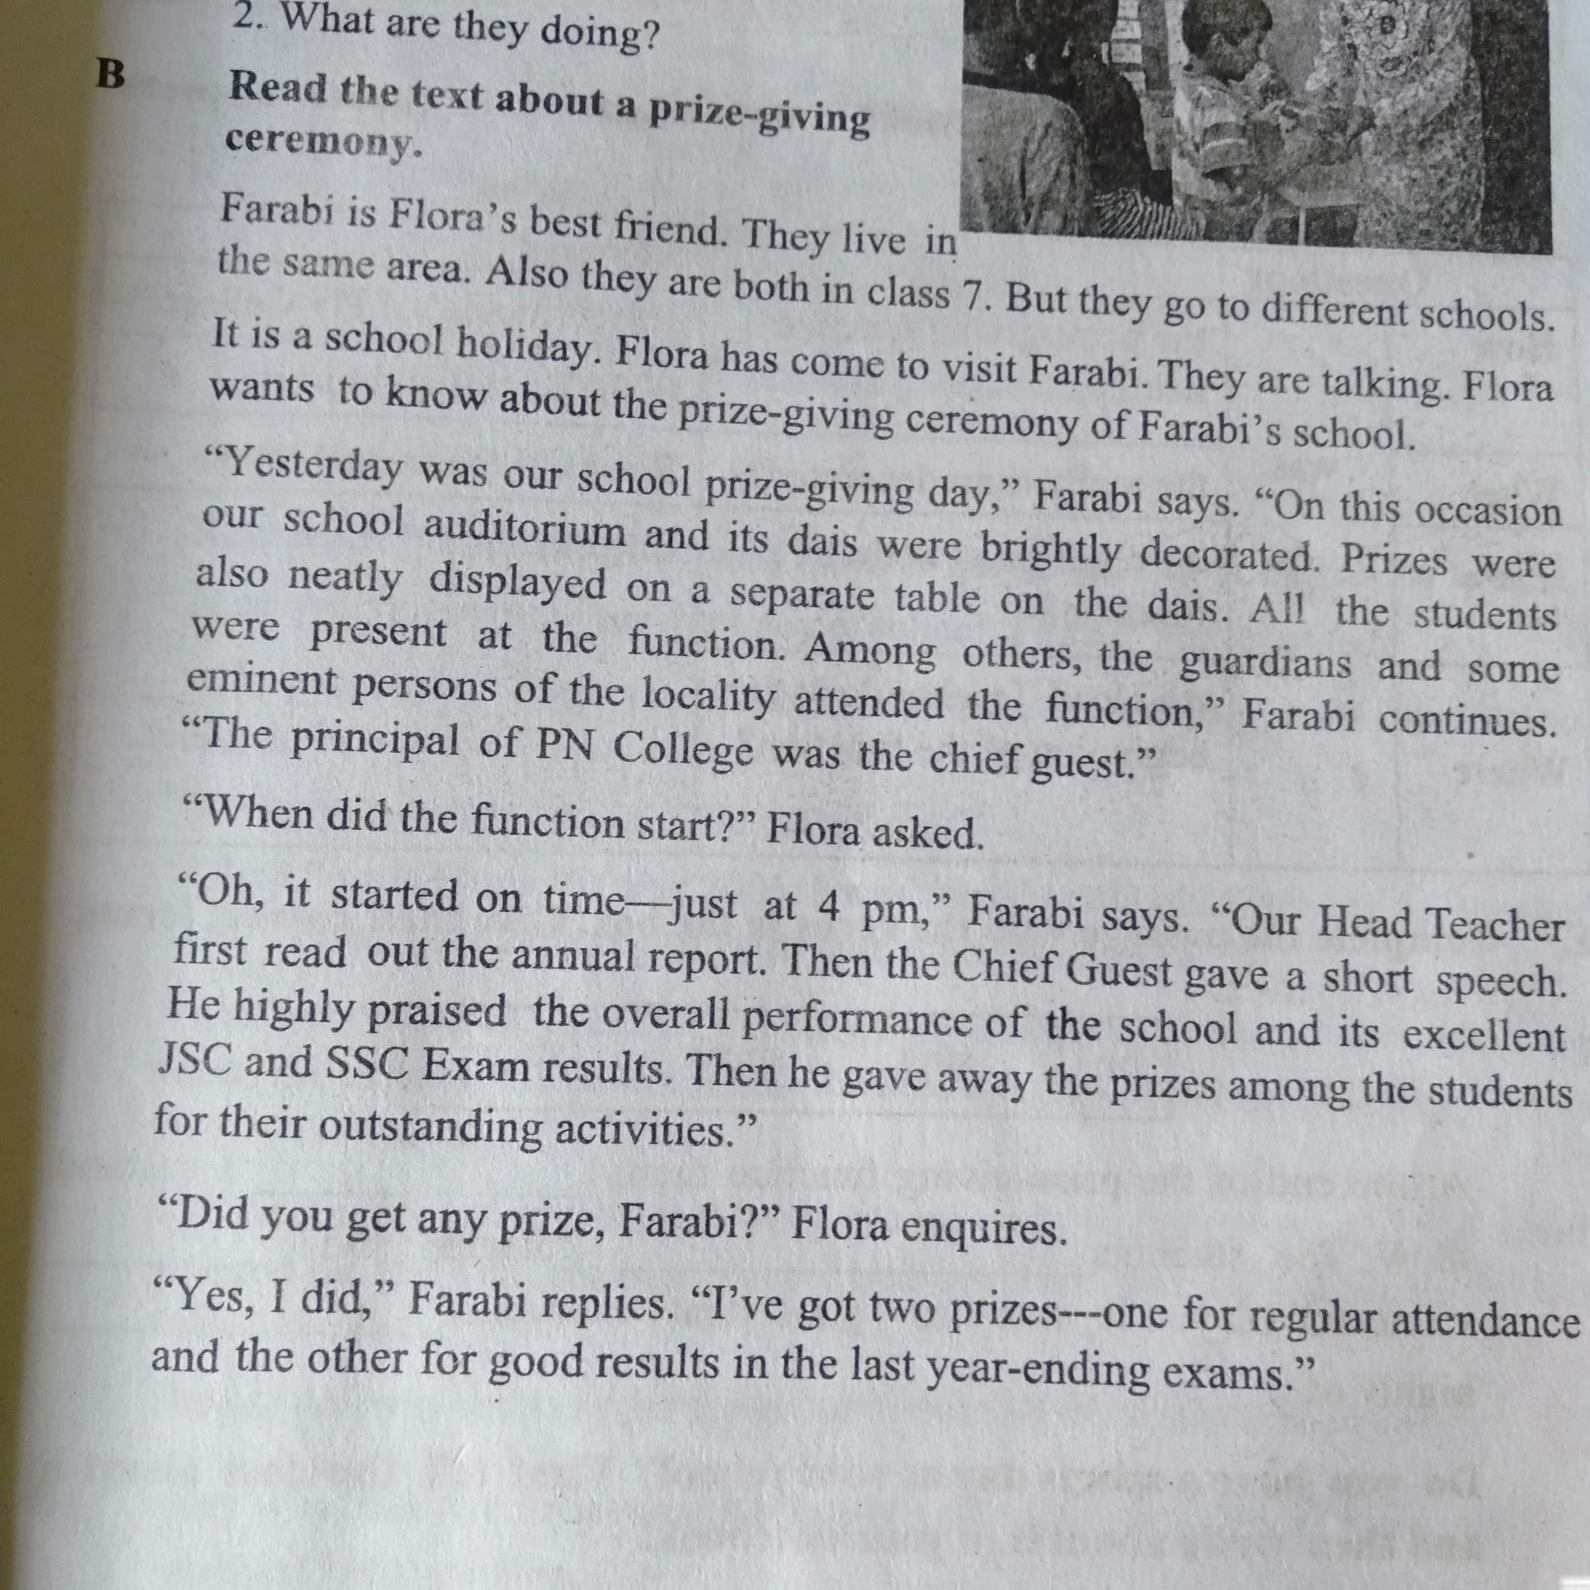

Slide 7
Match Words with their meanings:
Visit
Ceremony
Eminent
Praise
Outstanding
Disply
Speak highly of something
Extremely good
Go to see a person or place
Put something in a place where you can see it easily
Function
People having lots of power and influence

Slide 8
Questions
Where was the prize-giving function held?
How was the auditorium decorated?
Who was the chief guest at the function?
In the school auditorium .
The auditorium decorated brightly.
The Principal of PN college was the chief guest at the function

Slide 9
Home Work : Doyou have a sports day at your school? Write about it .

Slide 10
Thank you very much for enjoying my class And see you next class

