Slide 1
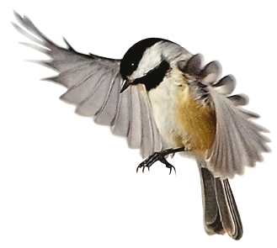

Slide 2
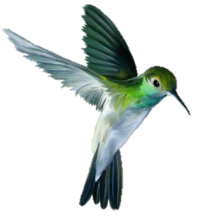
Teacher identity
Ramjan Ali
Head Teacher
Kowerkhope govt. primary school
Ramu, Cox’sBazar

Slide 3
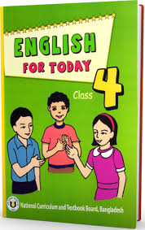
Lesson identity
Subject : English
Class : Four
Lesssons :1-2
Unit :14(Mita’s day)

Slide 4
Learning outcomes:
Listening:
1.1.1 recognize sound differences in the context of words.
Speaking:
1.1.1 repeat after the teacher and say words , phrases and sentences with proper sounds , stress and intonation.
Reading:
1.5.1 read words , phrases and sentences in the text with proper pronunciation , stress and intonation.
Writing:
8.1.2 make sentences using phrases given in the text book
7.2.1 write the time(hours only) and mention a.m/p.m

Slide 5
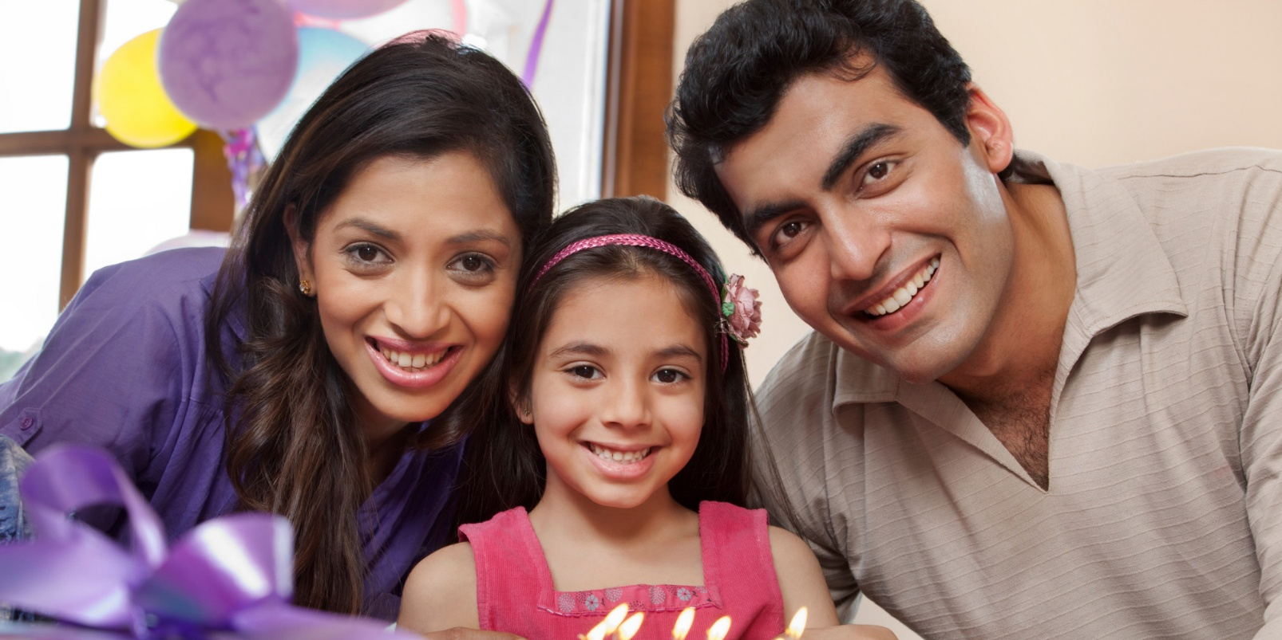
Look at the picture
Todays lesson: Mita’s day

Slide 6
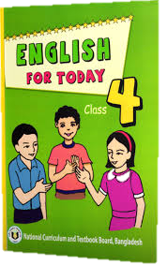
Open your english book page 28

Slide 7
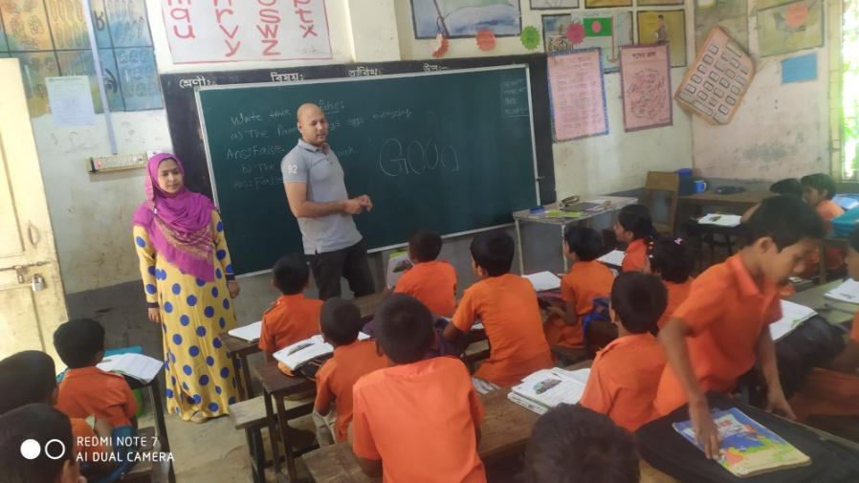
Teacher’s loud reading
Mita is in Class 4.

Slide 8
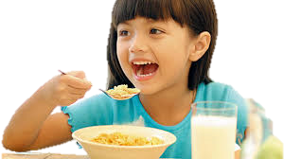
What are she doing?
What are she doing?
She has breakfast at
seven o’clock.
She washes her face.

Slide 9
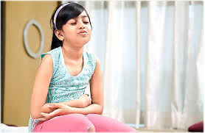
She gets up at six o’clock.

Slide 10
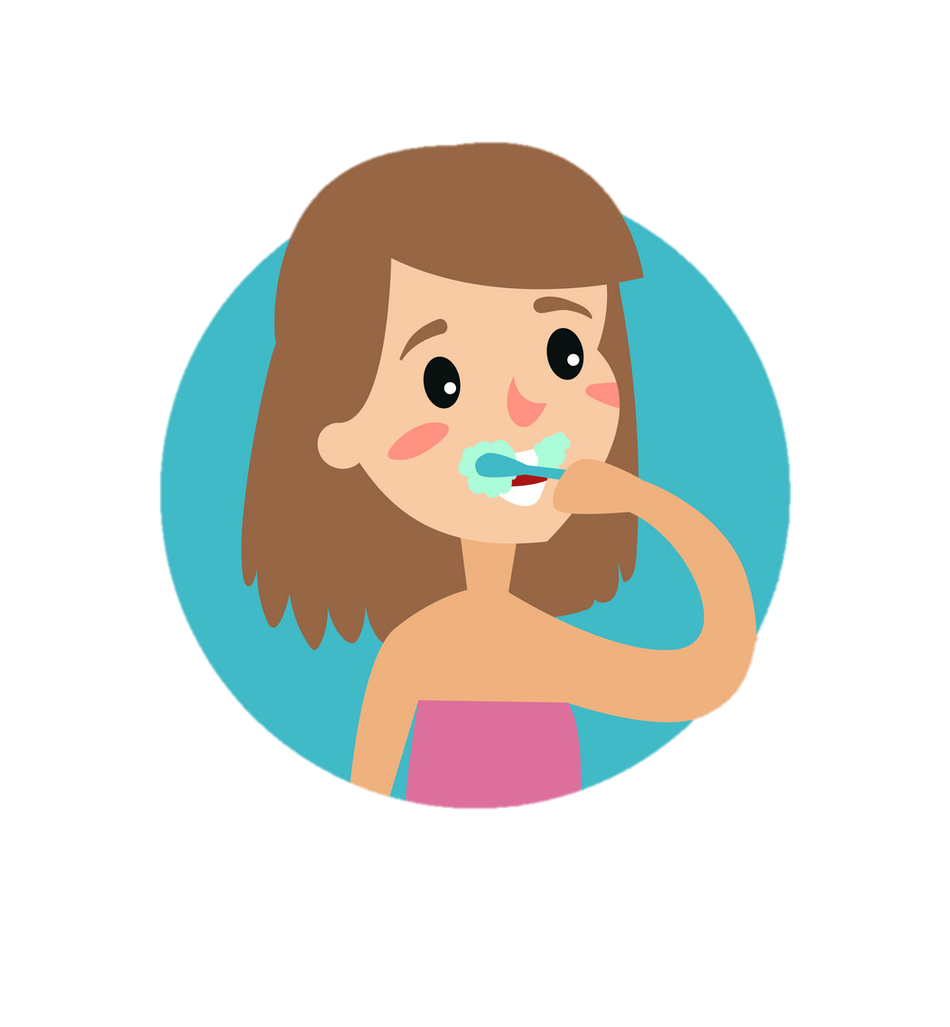
Then, she brushes her teeth.

Slide 11
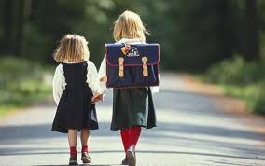
She goes to school at nine o’clock.
She walks to her school.

Slide 12
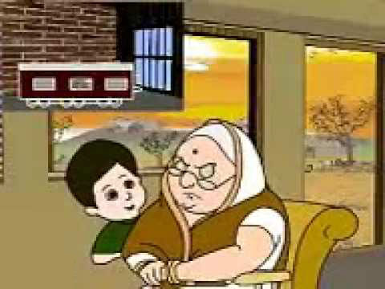
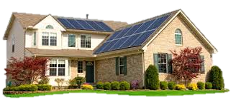
After school, she visits her grandmother at three o’clock.
Then, Mita returns home at five o’clock.

Slide 13
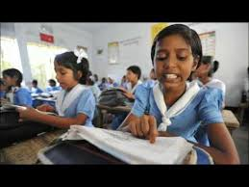
Students silent Reading

Slide 14
Group Work:
Complete the sentences with the time in numbers.
Group-A
Mita gets up at 6 a.m.
She has breakfast at 7 a.m.
Group-B
1.Mita goes to school at 9 a.m.
2.She returns home at 5 p.m.

Slide 15
Make sentence with following words:
gets up - She gets up at six o’clock.
face - She washes her face.
Walk - She walks to her school.
Visit - She visits her grandmother
Return - I return home at five o’clock.

Slide 16
Find out new words
wash
face
grandmother
return
home
visit
brush
school

Slide 17
Fill in the blanks (IW)
four
five
9
6
a) Mita gets up at o’clock.
b) Mita is in class .
c) She goes to school at o’clock.
d) Mita return home at o’clock.

Slide 18
Evaluation
Individual Work:
Answer the questions about yourself.
1.What time do you get up?
2.When do you have breakfast?
3.What time do you go to school?
4.When do you return home?

Slide 19
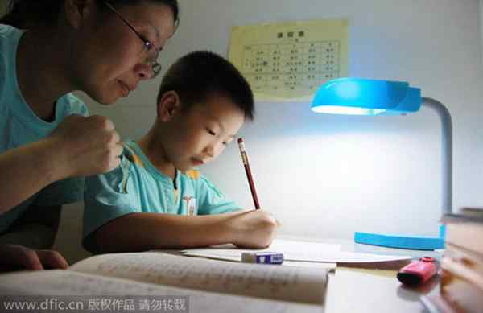
Home task
Write five sentences about Mita

Slide 20
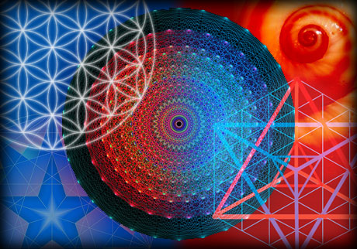
THANK YOU EVERYBODY

