Slide 1



Greetings To All Good Morning

Slide 2


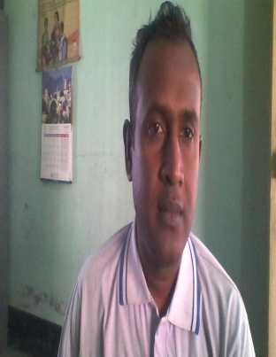
Teachers Identity
Md. Motiur Rahaman Manik
Assistant teacher
8 no Gopalpur GPS
Kaligonj, Jhenaidah

Slide 3


Lesson’s identity
Class : Three
Subject : English
Unit: Nine
Lessons : A. (Look and say)
Lesson unit : (Command and instruction)
Date: 7th April 2019 Time: 35min

Slide 4

Now Let’s Enjoy a Video
https://www.youtube.com/watch?v=UyFkcBUonr0
Notes:
এখানে ভিডিও কাটিং করা হইছে। এটিউব ক্যাচার থেকে টুলস >Crop video & audio >Browse>selected video>icon change> ok. তারপর স্লাইডে গিয়ে Insert >object>Browse>selected video> action >ok.

Slide 5


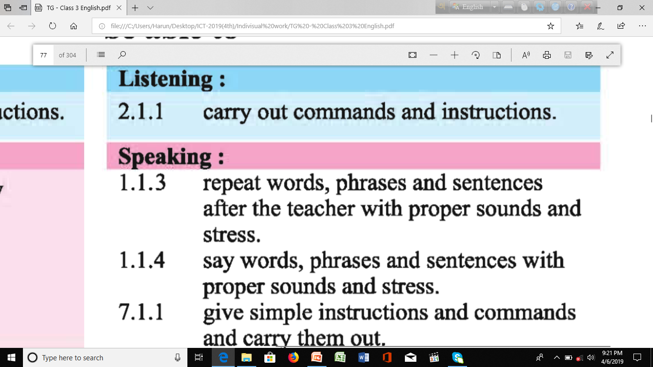
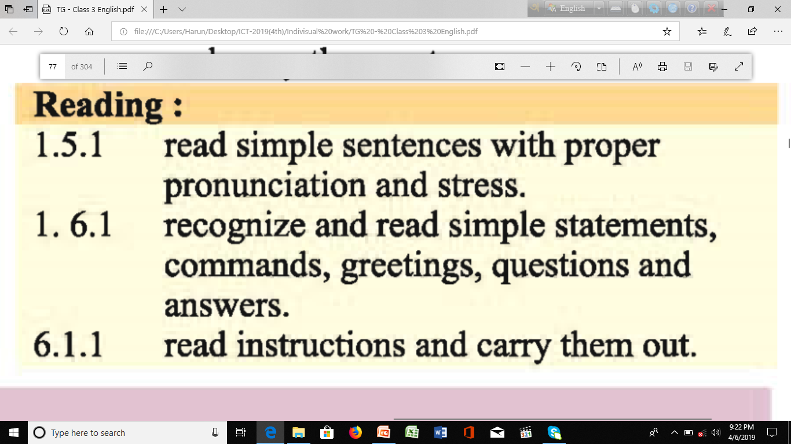
LEARNING OUTCOMES
Notes:
Page--18

Slide 6

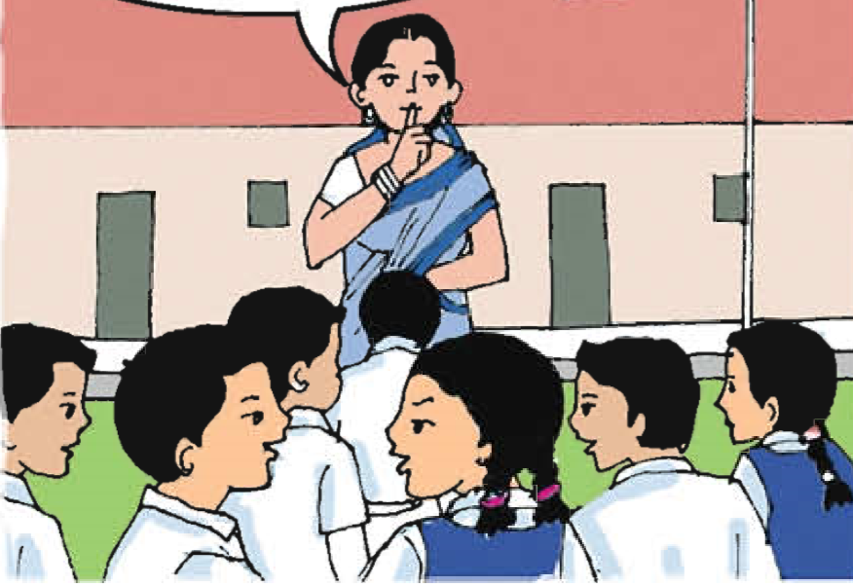
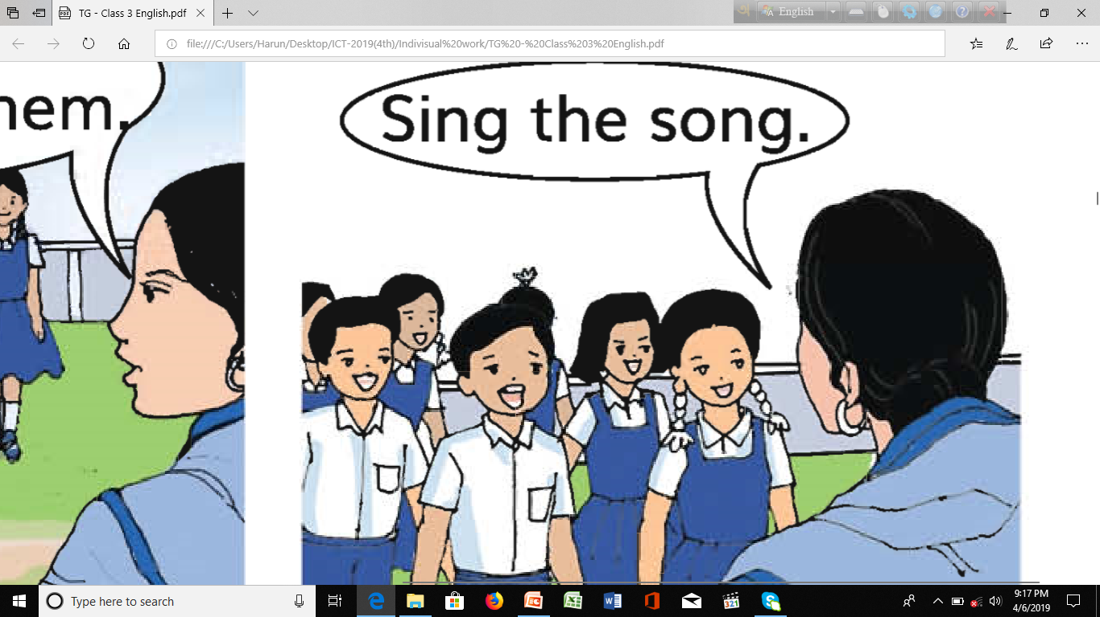
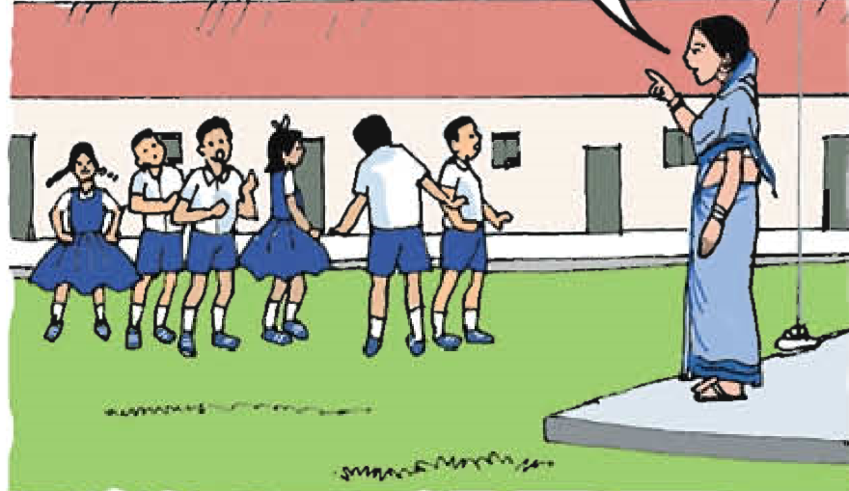
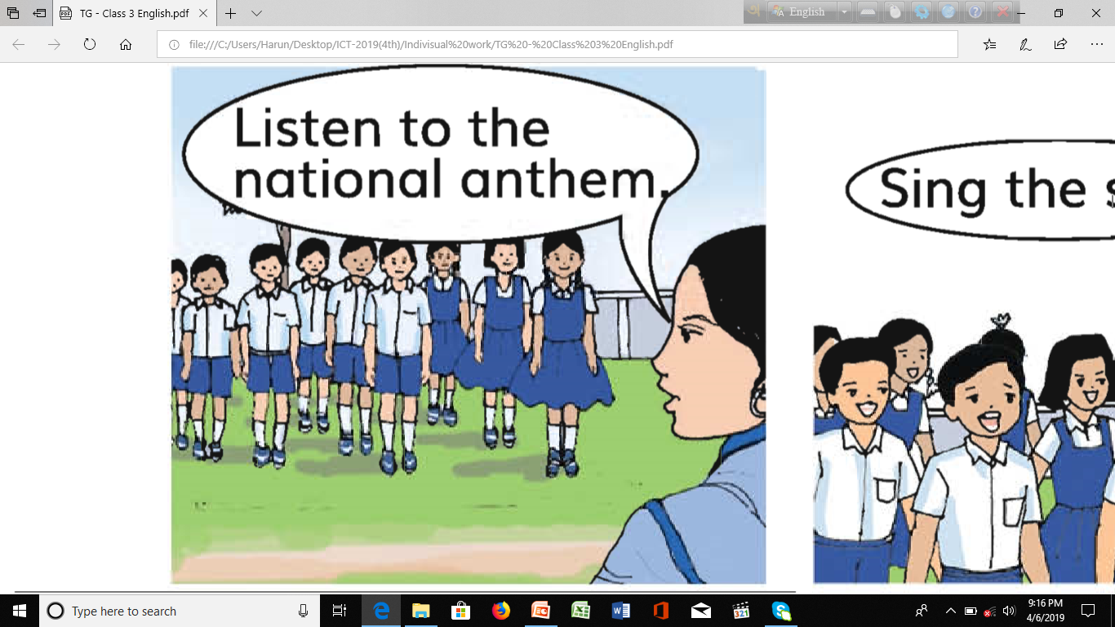
Let’s watch something in the pictures

Slide 7
1. What is the place?
2. Who are the people in the picture?
Madam gives ‘COMMAND AND INSTRUCTION’ to the students in school yard.
Notes:
Iw---4 ss display in front of others , pair work: simple command, instr to each other.

Slide 8


Open your Book at page 18

Slide 9

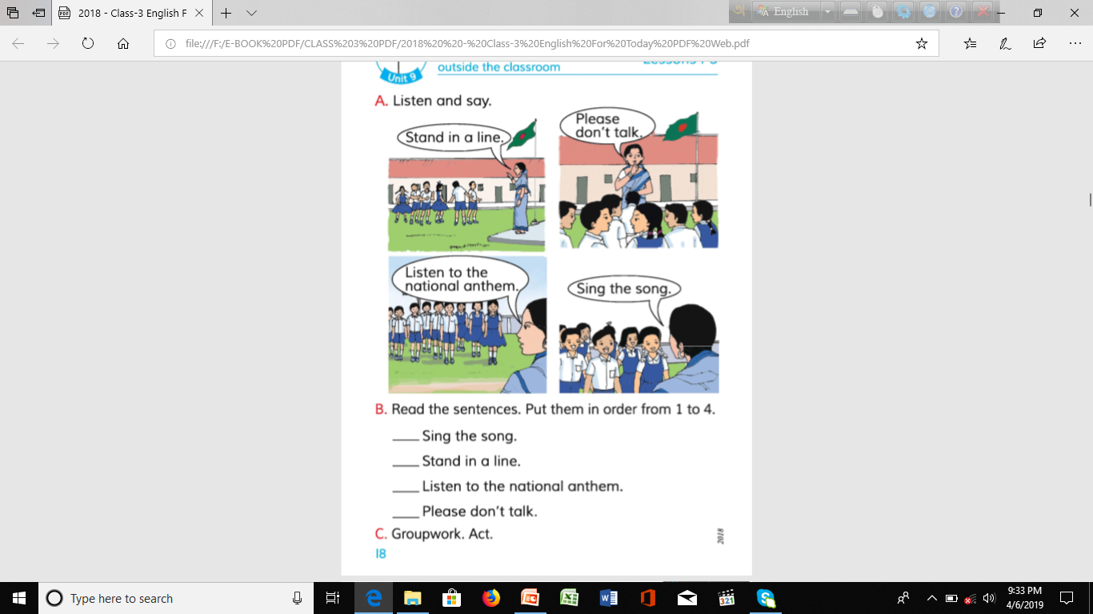
LETS GO TO LOOK LISTEN AND READ ALOUD

Slide 10

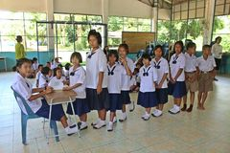


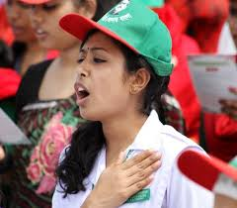
LETS GO TO LOOK LISTEN AND READ ALOUD
Teacher read aloud. Student follow the teacher .
Stand in a line.
Please don’t talk.
Listen to the national anthem
Sing the song.

Slide 11


Pair Work.
Ruma: Stand up.
Sima: Listen to my song
Indivisual Work.

Slide 12


Today’s learning word
Listen(লিচেন )
শোনা
Please listen to the music

Slide 13
Evaluation.
Indivisual test .
T: Rahim, come here. Give me a pen .
Stand up everybody. Please sing the national anthem

Slide 14
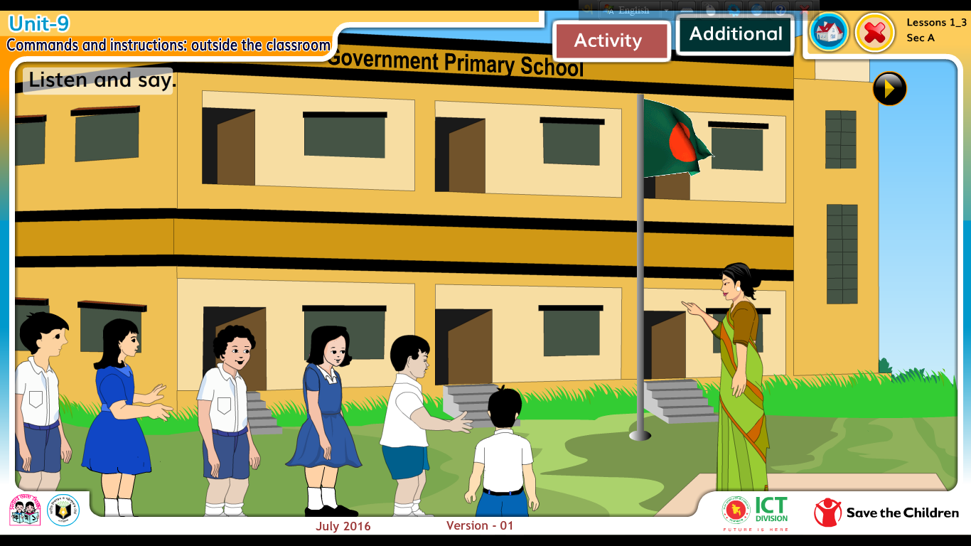
Match the sentence with the picture
Sing the song.
Yes
Stand in a line.
Don’t talk.

Slide 15
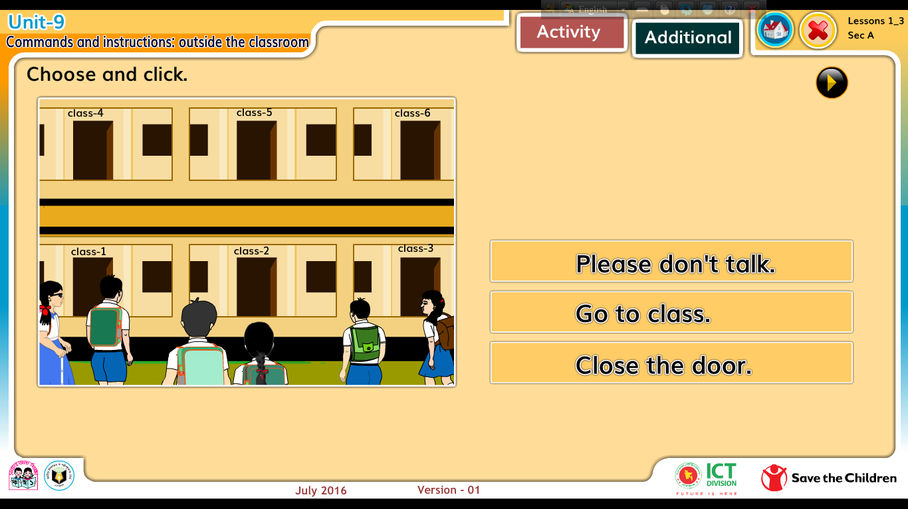
Match the sentence with the picture
Sing the song.
Yes
Stand in a line.
Go to classroom .

Slide 16


Match the word
in a line
Please
Stand
don’t talk
Listen
to the national anthem

Slide 17

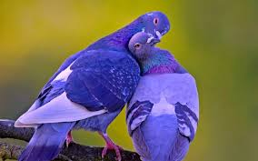
See you again Bye

Slide 18


