Slide 2
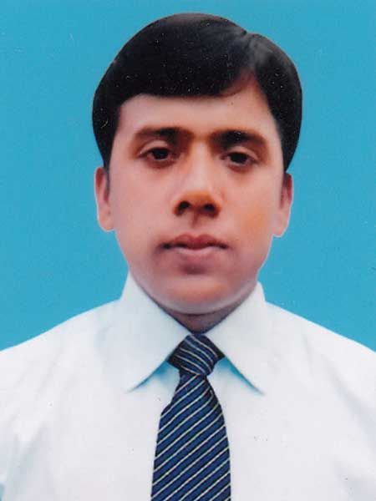
About me and book
Md. Robiul Islam
Assistant Teacher English
Pioneer Girls’ High School, Khulna
ICT4E Ambassador, Khulna Sadar, Khulna

Slide 3
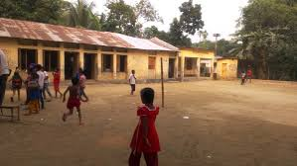
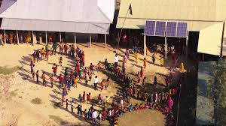

Slide 4
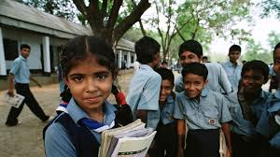
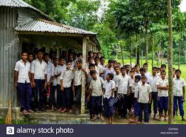

Slide 5
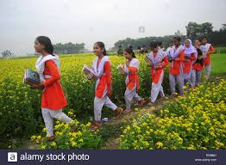
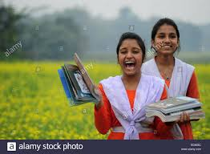

Slide 6
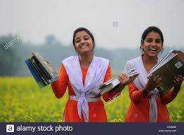
Where do the students locate?
The students are outside School.

Slide 7
After we have studied this lesson, we will be able to -
Make short conversation.
How to make request.

Slide 8
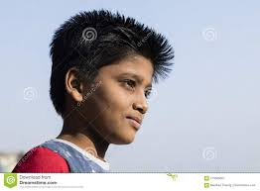
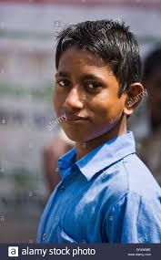
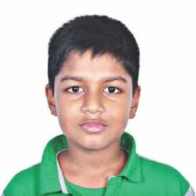
A. Listen and read these short conversation.
Yes, of course you can. Here you are.
Can I borrow you pen, please?
Fahim:
Could you please help me with my maths?
Tamim:
Radif:

Slide 9
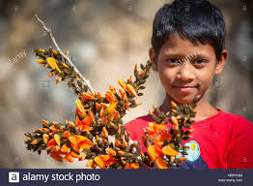
Sorry, I can’t . I’m not good at maths.
Would you turn the television off? I’m doing my homework.
Rahin:
Sorry, I didn’t notice that. Please go on with your studies.
Sister:
Brother:

Slide 10
B. Complete these dialogues, using suitable words.
Could
Can’t
Couldn’t
Could
I could
1. A: -------------- you lend me your English book for a day?
B: Sorry, I --------------- . I need to read it tonight.
2. A. Could you give me TK 50?
B: Sorry, I ------------------ . I have only TK 20 with me.
3. A: ------------------ you give me your calculator, please?
B: Yes, -------------------------.

Slide 11
Could
could
I can
4. A: ------------------ you get me a notebook and a ball pen from the stationer’s?
B. Yes, of course. I ---------------------------.
5. A: Can you put box in the car, please?
B: Yes, ---------------------------- . I will.

Slide 12
C. Make requests, using the prompts.
1. You want someone to help you with the washing.
May you help with the washing.
2. You want someone to give you change for a one hundred taka note.
May you want to give you change for a one hundred taka note.
3. You want someone to wait a minute.
May you want to wait a minute.
4. You want some one to carry your bag.
May you want to carry your bag.
5. You want someone to call you a rickshaw.
May you want to call you a rickshaw.

Slide 13
Thank You

