Slide 1
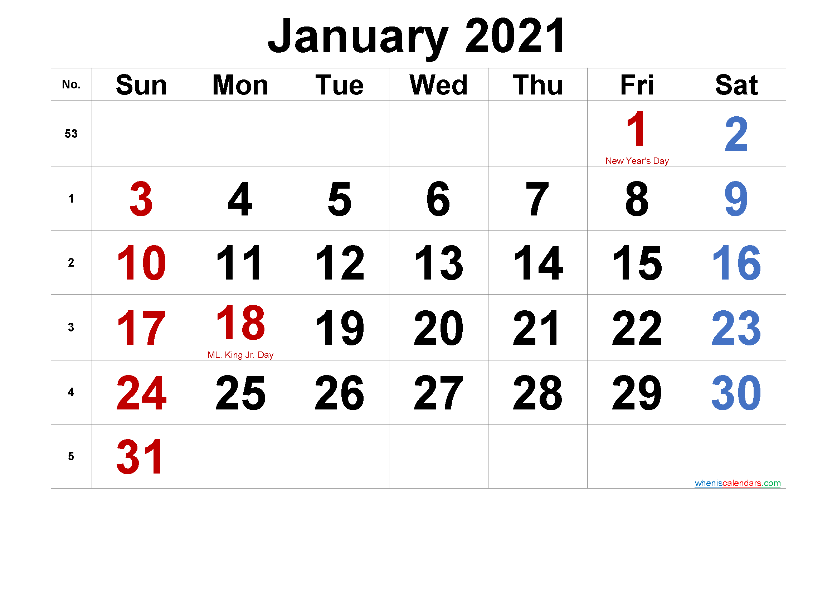
Good Afternoon
students
How are you today?

Slide 2
Teacher introduction
Taslima Akter
Assistant Teacher
Doani Govt. Primary School
Narsingdi Sdar, Narsingdi.
Phone: 01778474789
email: taslimaakter1988bd@gmail.com

Slide 3
Text introduction
Class: Three
Subject: English For Today
Unit: 17( Names of the months)
Lesson: 1-3, Period:1
Page: 34, Activity A(Say the names of the months)
Time: 40 minutes

Slide 4
We learned in the previous lesson---
# Say words phrases and sentences with proper sounds and stress.
# Recognize and read cursive letters both smalls and capital.
# To write cursive small letters.

Slide 5
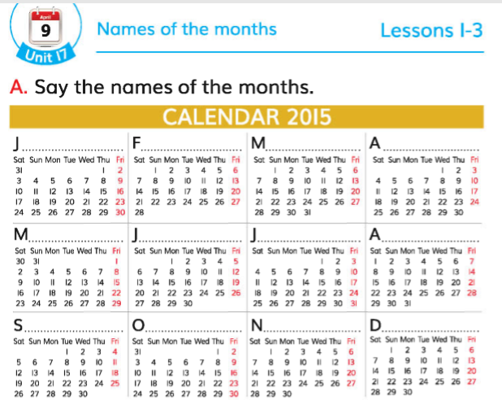
Our lesson today
Say the names of the months
page 34

Slide 6
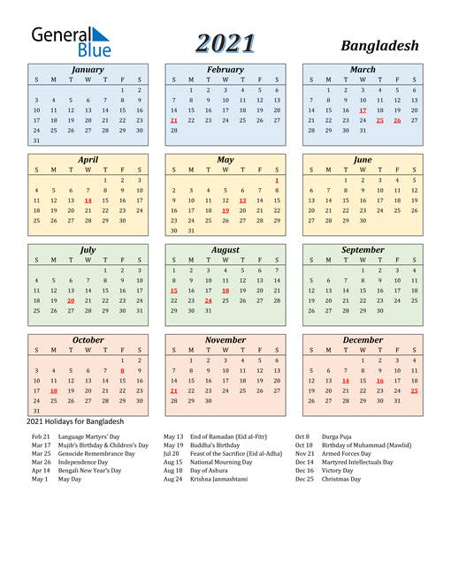
1. January
7. July
8. August
2.February
9. September
3.March
10. October
4.April
11. November
5.May
12. December
6.Jun

Slide 7
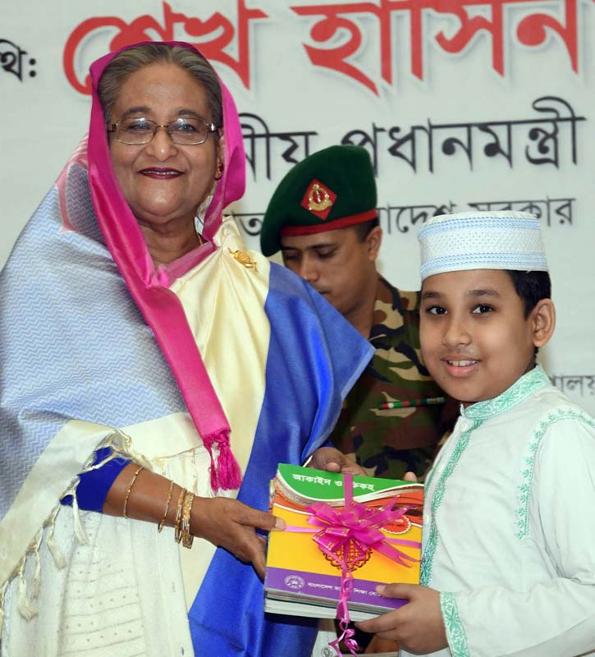
January

Slide 8
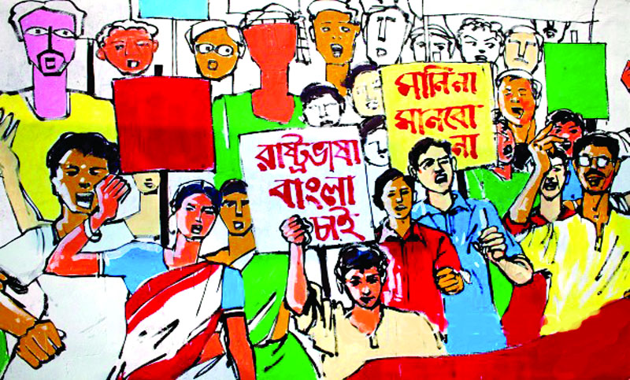
February

Slide 9
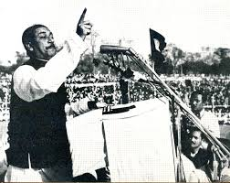
March

Slide 10
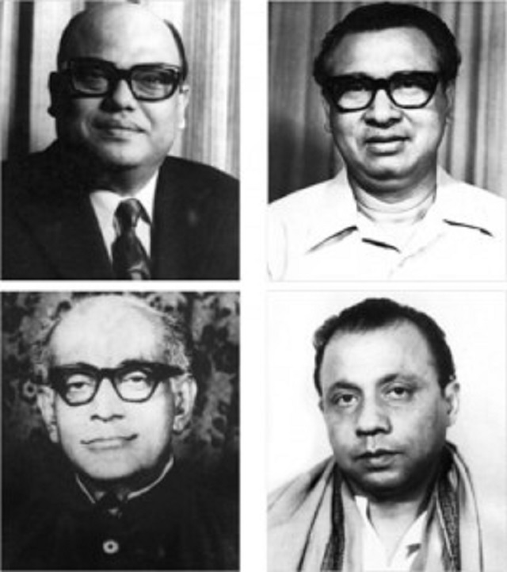
April

Slide 11
Jun
July
May

Slide 12
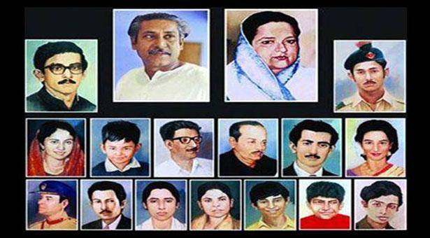
August

Slide 13
October
November
September

Slide 14
December

Slide 15
Lessons for students
Page 34

Slide 16
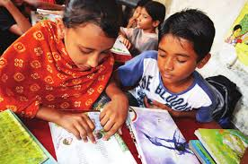
Team work
Tell each other the names of the month in pairs

Slide 17
Evaluation
Say the names of the month

Slide 18
THANKS
Try it youself

