Slide 1
p

Slide 2
WELCOME

Slide 4
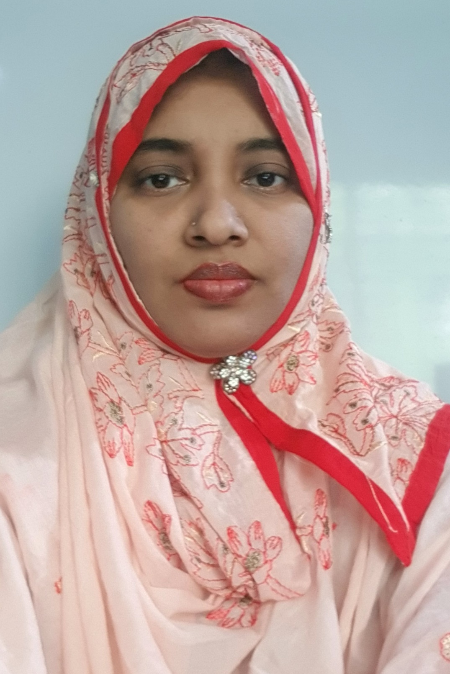
Teacher’s identity
Marina Akther
Assistant teacher
KB Govt Primary School
Begumgonj,Noakhali

Slide 5
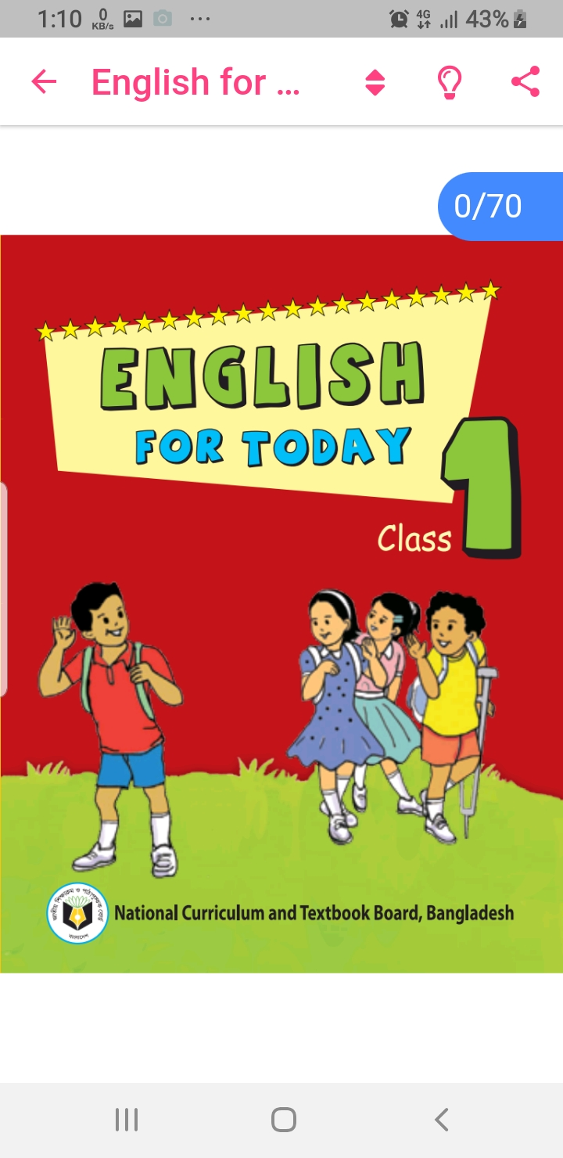
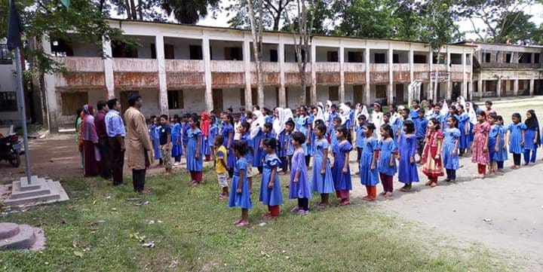

Slide 6
Lets sing.
Phonics Song.

Slide 7
Learning outcomes
1.1.1- Repeat after the teacher simple words and phrases.
1.1.2- Say simple words and phrases.

Slide 8
Pp

Slide 9
Pencil
P
p

Slide 10
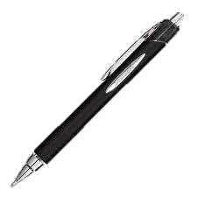
P
p
Pen

Slide 11
P
P
Capital P

Slide 12
p
p
Small P

Slide 13
Let’s practice writing
P
P
P
P
P
p
p
p
p
p

Slide 14
P encil
e
n
c
i
l

Slide 15
Lets sing
Goodbye song.

Slide 16
Thank you all

