Slide 1


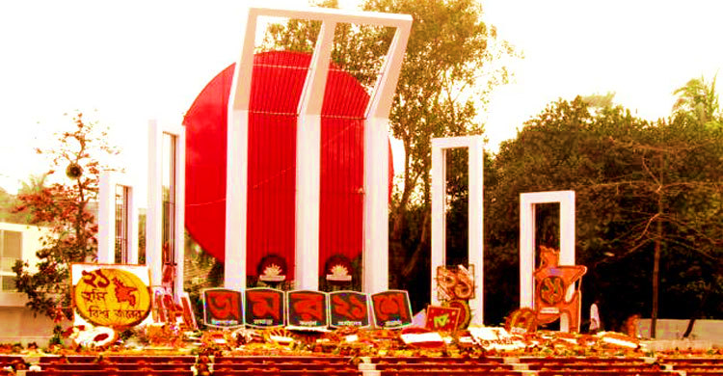
Welcome
TO
Our Multimedia CLASS

Slide 2
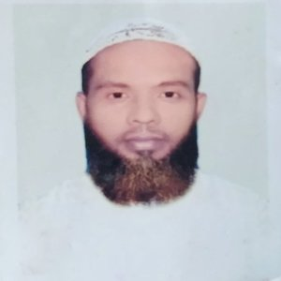
teacher IDENTITY
Muhammad Ahsan Habib
Assistant Teacher
Mohsenuddin Nuria Fazil (Degree) Madrasah
Bauphal, Patuakhali
Mobile-01754755169
E-mail- ahsanhabib251281@gmail.com

Slide 3

Introduction of lesson
Class- Nine & Ten
Subject –English 1st paper
Unit: 3
Lesson: 3
(International Mother Language Day)

Slide 4
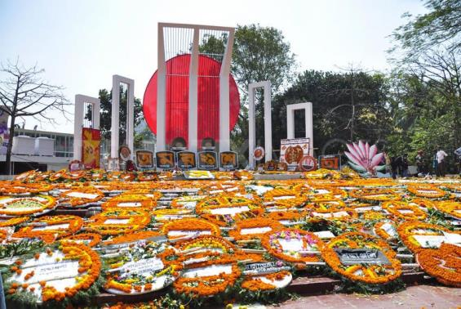
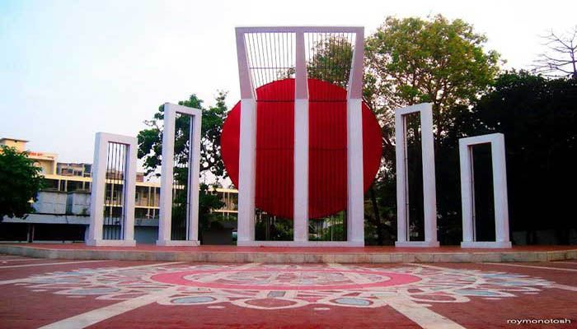
Look at the picture very carefully and guess what our today’s lesson is....
1. What is this?
2. What’s the picture about?
3. Where is it situated?

Slide 5
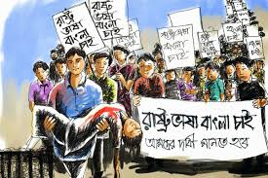
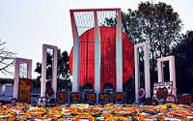
1. The picture is about “Shahid Minar.”
2. It was build to honour and commemorate the sacrifices of the language martyrs
3. I think it is in near Dhaka Medical College.

Slide 6
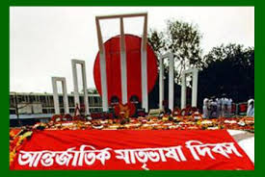
Today’s lesson……
International Mother Language Day

Slide 7
Learning outcomes
After this lesson the students will be able to---
read and understand texts through silent reading.
Talk about events and festivels .
ask and answer questions .
Fill in the blanks with apropat word .
Notes:
All the four skills will be focused in this lesson.

Slide 8

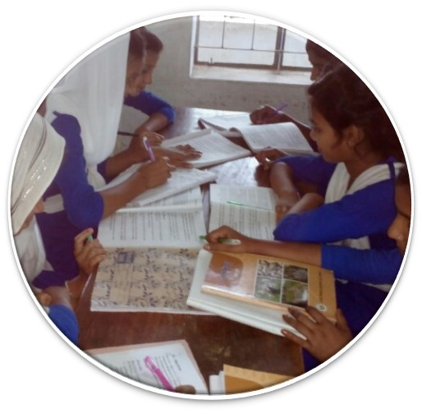
Read
the text
silently
and
carefully
Unit-Three
Lesson-3
Page-33 & 35

Slide 9
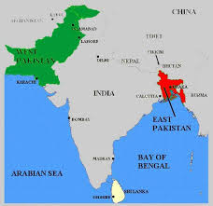
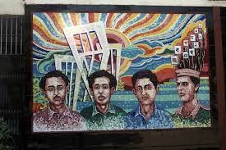
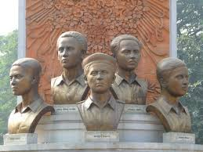
21 February is a memorable day in our national history. We observe the day every year as International Mother Language Day. The day is a national holiday. On this day, we pay tribute to the martyrs who laid down their lives to establish Bangla as a state language in undivided Pakistan in 1952.This is known as the Language Movement.
The seed of the Language Movement was sown on 21 March 1948 when Mohammad Ali Zinnah, the then Governor General of Pakistan, at a public meeting in Dhaka declared that Urdu would be the only official language of Pakistan. The declaration raised a storm protest in the eastern part of the country. The protest continued nonstop, gathering momentum day by day. It turned into a movement and reached its climax in 1952.
The government outlaw all sorts of public meetings and ralies to prevent it. The student of Dhaka University defied the law and they brought out a peaceful protest procession on 21 February 1952. When the procession reached near Dhaka Medical College, the police opened fire on the students, killing Salam, Rafiq, Barkat and Jabbar. So we should respect to the Martyrs. This enkindled the sparks of independent movement of Bangldesh.

Slide 10
Read more about International Mother Language Day.
21 February is observed as Shaheed Dibosh every year throughout the country in remembrance of the martyrs of language movement of 1952. The comme­moration begins at the early hours of the day with mourning songs that recall the supreme sacrifices of our language martyrs. People wear black badges and go to the Shaheed Minar in barefoot processions, singing mourning songs. They place wreaths at the Minar. Many of them visit the graves of the martyrs at Azimpur graveyard and pray for them. They also attend various programmes organised in remembrance of the language martyrs.
The UNESCO (United Nations Educational, Scientific and Cultural Organisation) on 17 November in 1999 proclaimed February 21 as the International Mother Language Day in recognition of the sacrifices of the martyrs for the rightful place of Bangla. The day is now annually observed worldwide to promote awareness of linguistic and cultural diversity and multilingualism.

Slide 11
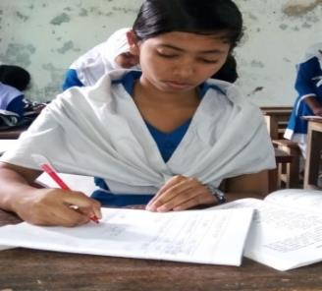
Individual works.
Complete the passage with suitable words.
blood
On 21 February 1952 ____ was shed at a place between Dhaka Medical College and Dhaka University ____ to establish Bangla as
a state ____ of Pakistan. All subsequent movements ____ the struggles for independence had their origin in the historic language ____ . Shaheed Minar is the ____ of die supreme sacrifice ____ the mother tongue.
area
language
including
movement
symbol
for

Slide 12
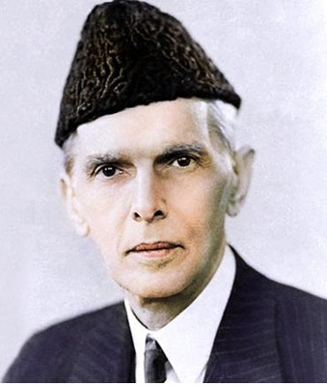
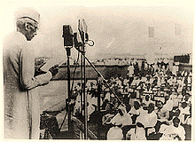
Let's know the history of the language movement
“Mohammad Ali Jinnah” The Governor General of Pakistan
21 March 1948 when Mohammad Ali Jinnah The Governor General of Pakistan, declared in a voiceless voice in the rally of the student teachers at the Curzon Hall of Dhaka University that "Urdu" would be Pakistan's only state language.

Slide 13
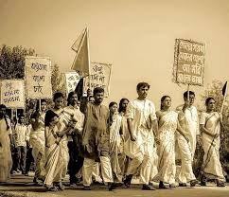
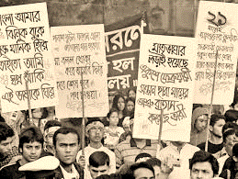
Let's know the history of the language movement
Students of Governor General Mohammad Ali Jinnah's announcement immediately protested.

Slide 14
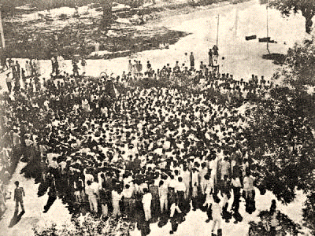
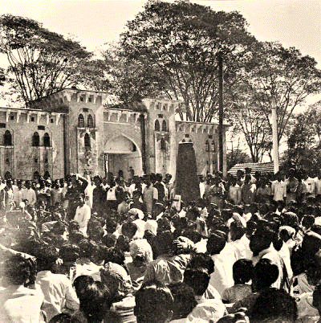
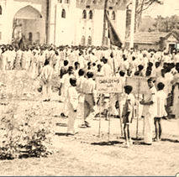
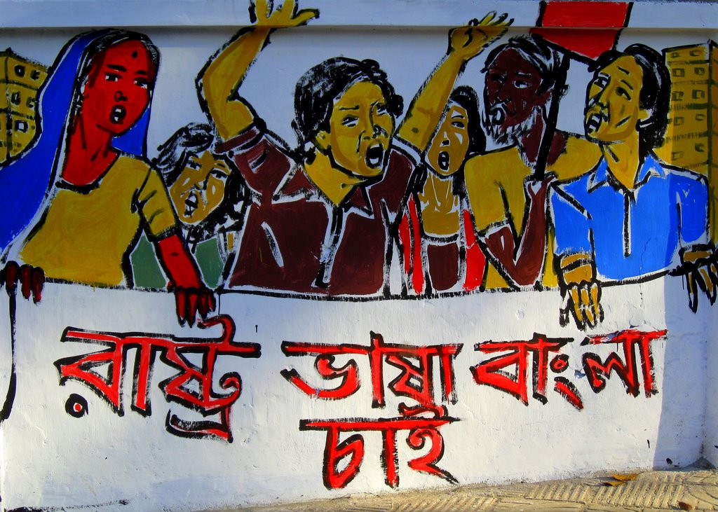
Let's know the history of the language movement
Peaceful protest of the students of Dhaka University.

Slide 15
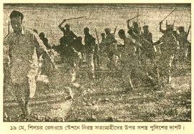
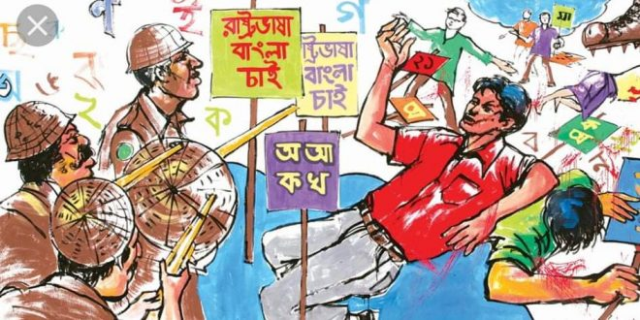
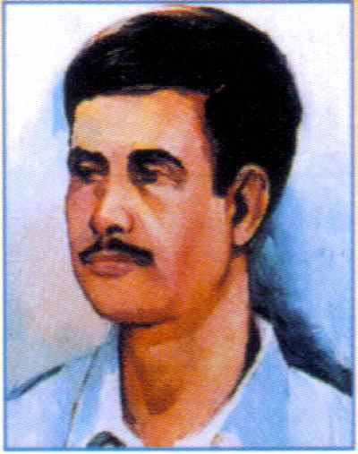
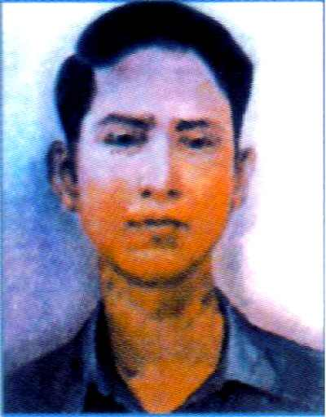
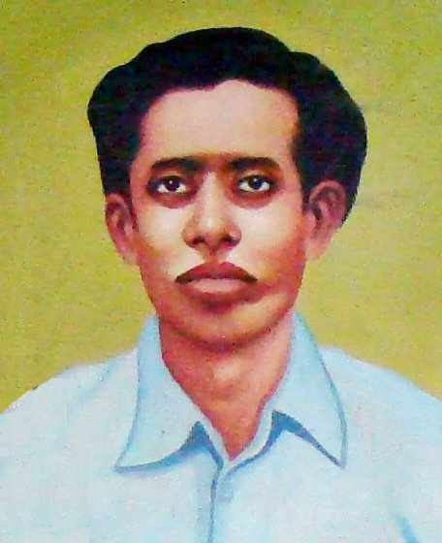
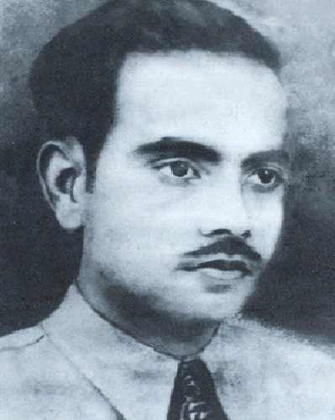
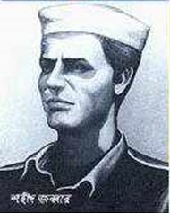
Let's know the history of the language movement
Police opened fire on students who were protesting for Bangla language.
Salam, Barkat, Rafiq, Jabbar, Shafiur and many others were killed in police firing.

Slide 16
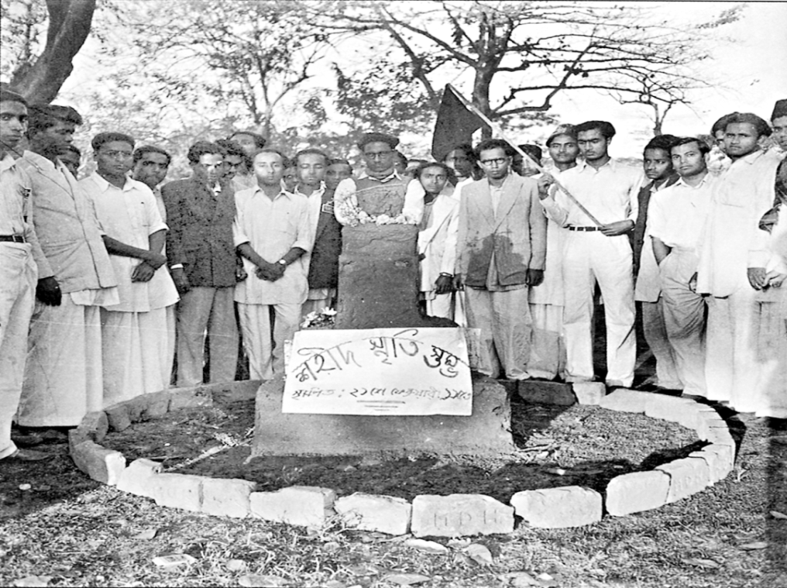
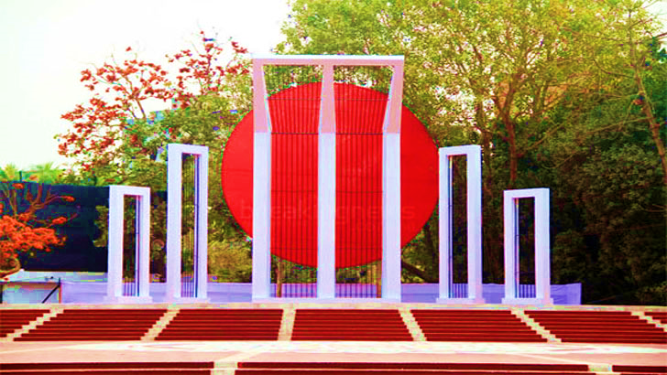

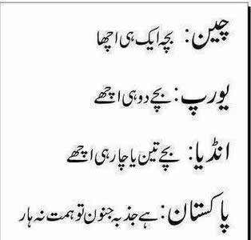
Let's know the history of the language movement
This is the central Shaheed Minar.
অ
আ
As a result of the language movement, both Bangla and Urdu gained the status of the official language of Pakistan.

Slide 17
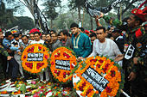
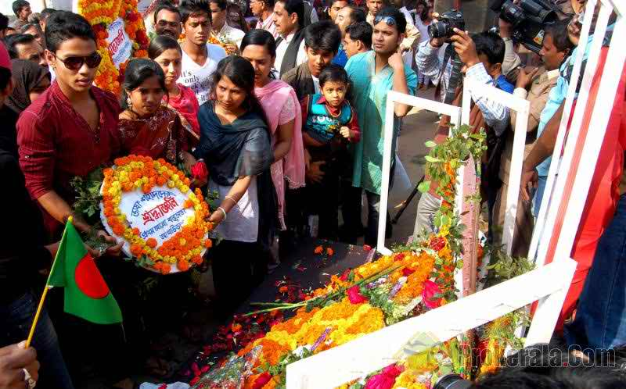
Follow the pictures
People are paying homage to the language martyrs.

Slide 18
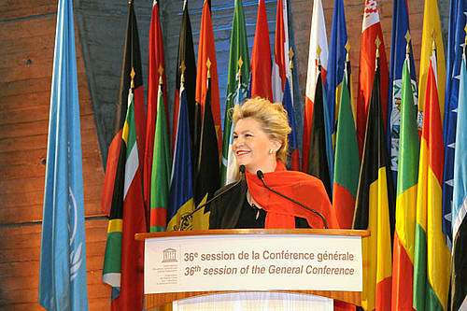
Follow the pictures
UNESCO
Announcement of 1999 of 17 November 21 February as The International Mother Language Day.

Slide 19
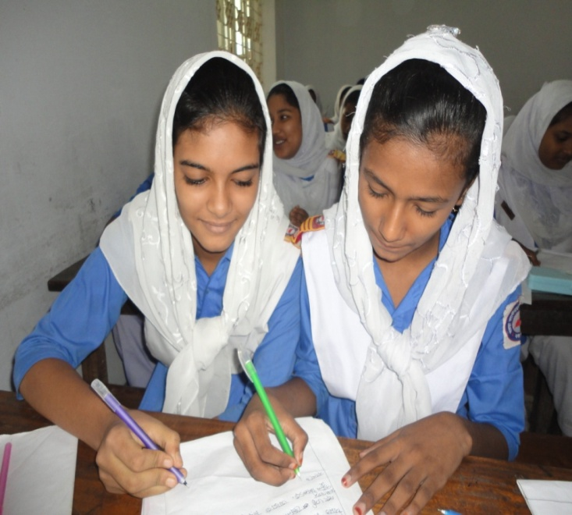
Pair Work
Discuss in pairs and Complete the following chart.
Time | What happened
1947
1948
1952

Slide 20
Now match your answer Pair Work
Time | What happened
1947 | India and Pakistan divided .
1948 | Md. Ali Zinnah, the then Governor general of Pakistan declared that Urdu would be the only state language of Pakistan
1952 | All classes of people headed by the students of DU bought out procession demanding Bangla as one of the state language. But police opened fire on the procession killing several students

Slide 21
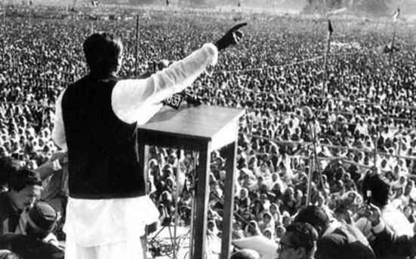
Key Word
connected with history or past events
Historical
This is a historical picture.

Slide 22
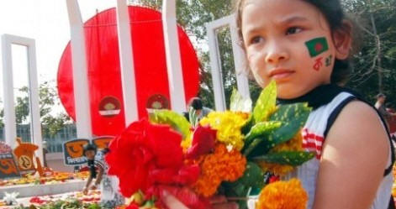
Key Word
An act of showing respect
Tribute
We pay tribute to the language martyrs.

Slide 23
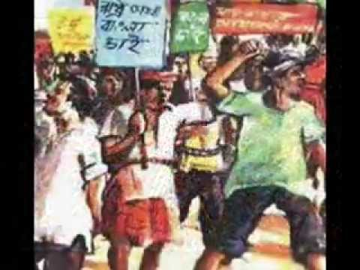
Key Word
Movement
revolution
Our language movement took place in 1952.

Slide 24
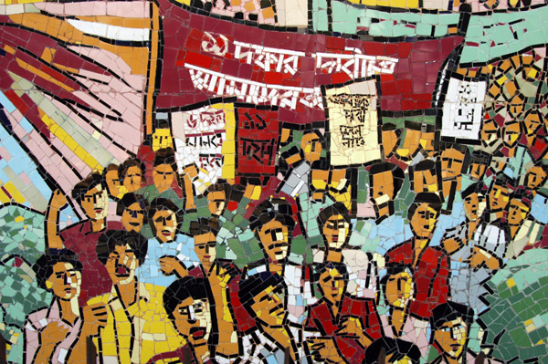
Key Word
a number of people
moving in an orderly way
Procession
The students brought out a procession.

Slide 25
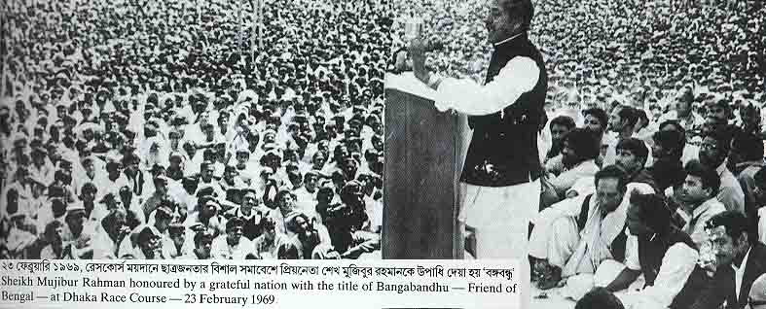
Key Word
declaration
announcement
Sheikh Mujib made the declaration of our independence.

Slide 26
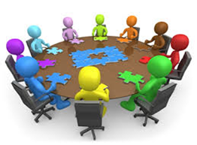
Group Work
Discuss in a group and answer the following questions.
Q 1. Why do we observe 21 February as the International Mother language Day?
Q 2. What happen when Urdu was declared as the only official language of Pakistan. ?
Q 3. “The seed of independence was sown in 21 February 1952”. Do you agree with the comment? Why?

Slide 27
Answer Group Work
1. The UNESCO has proclaimed February 21 as the International Mother Language Day in 1999. So we observe 21 February as International Mother Language Day.
2. The declaration raised a storm of protest in East Pakistan. It continued non-stop. The government banned all types of public meetings.
3. Yes, I agree. On this day, by protesting the one sided decision of the then Government of Pakistan, the people of East Pakistan understood how to struggle against illegal decision and oppression. So the people of East Pakistan dreamt to be free from West Pakistan.

Slide 28
Evaluation
Fill in the blanks with the suitable word
February 21 is a glorious (a)……………………for Bangalee nation. We are always (b)………….. against the (c)…………….. and untruth. Let us (d) …………….. our pledge on (e)………………. day and (f)……………… our motherland a “Sonar Bangla” so (g)……………… our next (h)………………… can hold their (i)…………… high in the (j) ………………… .
Milestone
vocal
injustice
renew
this
build
that
generation
heads
world

Slide 29

Home Work
Write a paragraph On “International Mother Language Day”.
Notes:
This is a creative work that the students will perform at home to show the teacher in the nest class.

Slide 30

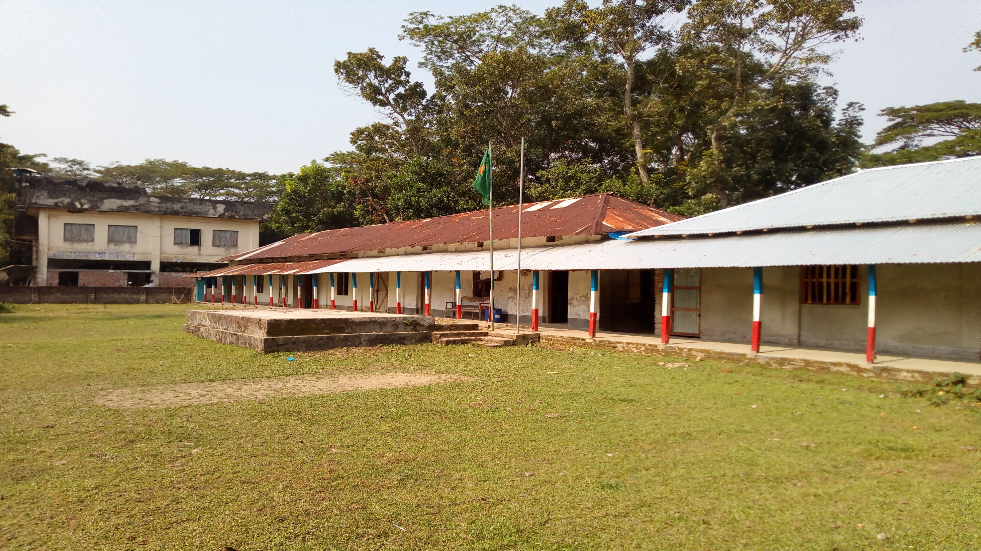
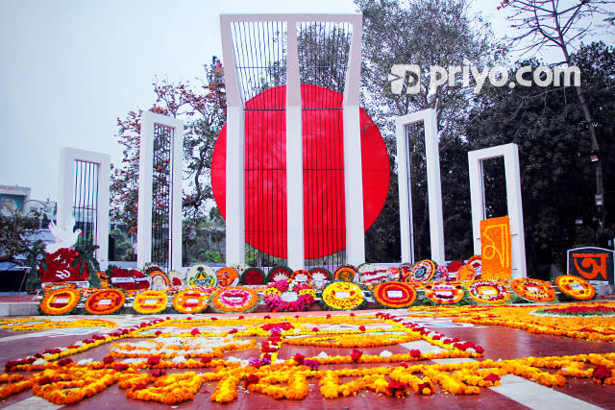



THANK YOU FOR
YOUR ATTENTION
GOOD BYE
(May allah bless you)

