Slide 1
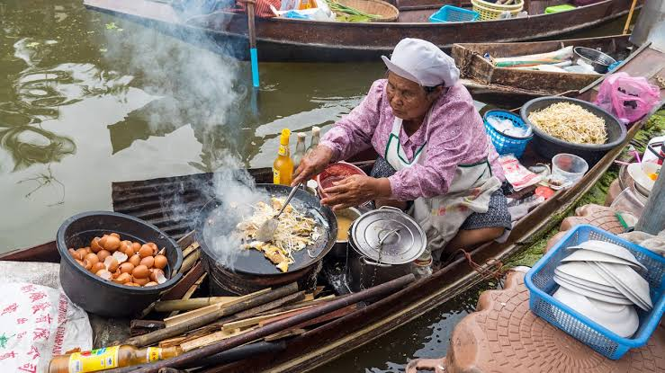
Good morning

Slide 2
Identity
Md shafiqul islam
Assistant Teacher(English)
Sonatan darussannat dakhil madrasha,kawnia,Rangpur.
Mail: shafiqulislam42347@gmail.com
English For Today
Class: Eight
Unit: Six
Lesson : nine
Date: 10/01/2021

Slide 3
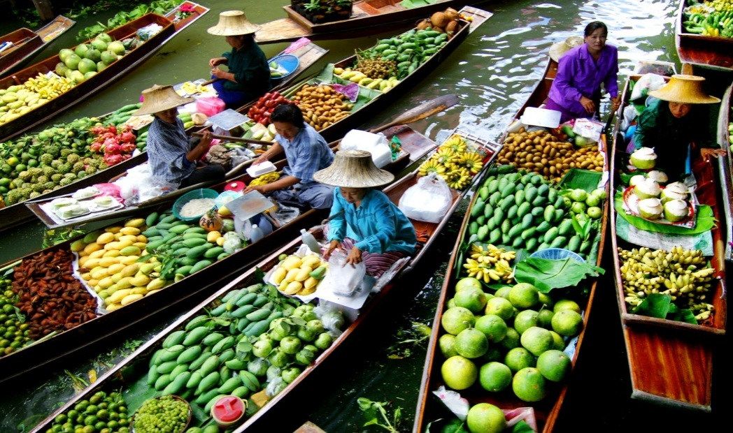
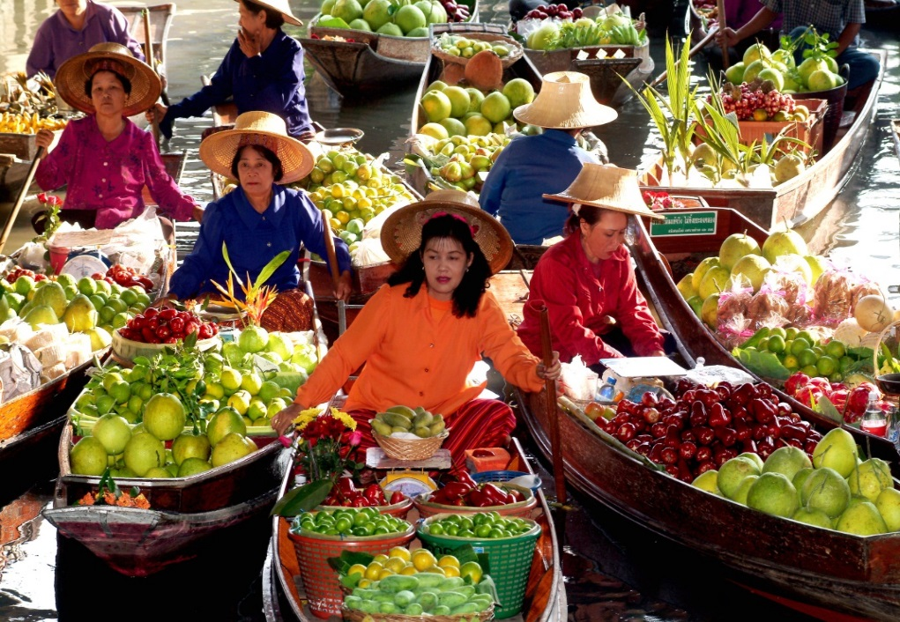
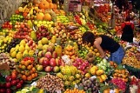
LOOK AT THE PICTURE

Slide 4
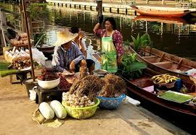
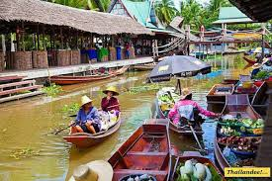
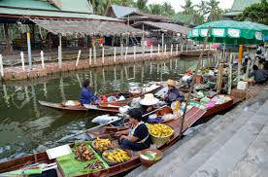
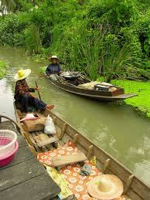
LOOK AT MORE PICTURE

Slide 5
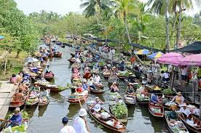
Todays Topic
THE THA KHA FLOATING MARKET

Slide 6
LEARNING OUTCOME
By the end of the lesson student will be able to---------------
Lesson information.
Read and understand text.
Word meaning.
Choose the best answer from the alternative.
Read the lesson and answer the question.
Fill in each gaps with suitable words from the text.

Slide 7
Word meaning
Quickly -------------------দ্রুত
Sharp ---------------------ধারালো
Reach --------------------পৌছা
Breakfast ------------------সকালের নাস্তা
Surrounded --------------চারদিকে
Hire ------------------------ভাড়া
Centre ---------------------কেন্দ্র
Seller -----------------------বিক্রেতা
Display ---------------------দেখানো
Bundle ---------------------আটি
Delicious ------------------সুস্বাদু
Lotus ----------------------পদ্ম
Local ----------------------স্হানীয়

Slide 8
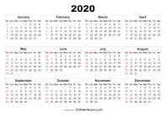
Describing text
It was Sunday. Mita, Zara, Jhuma Islam and Mazharul Islam woke up very early. They quickly got ready and started for Tha Kha floating market.

Slide 9
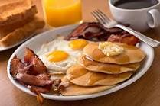
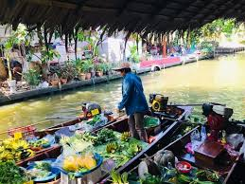
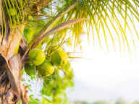
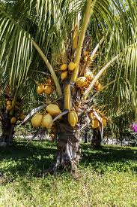
They planned to have breakfast at the market. They reached the market place sharp at 7. The canals were surrounded with coconut palm trees. The boatman started to row slowly taking them to the centre of the market.

Slide 10
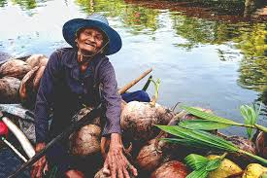
The sellers were mainly elderly Thai women. Their small boats were laden with bundles of lotus flowers, farm-fresh coconuts, fruits, vegetables , local food and delicious sweets.

Slide 11
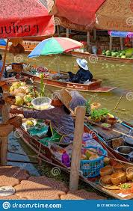
They sellers and buyers rowed their boats slowly. The sellers displayed their goods for sale and the buyers chose their pick.

Slide 12
Silent Text

Slide 13
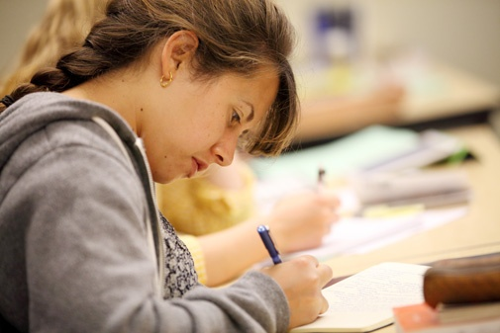
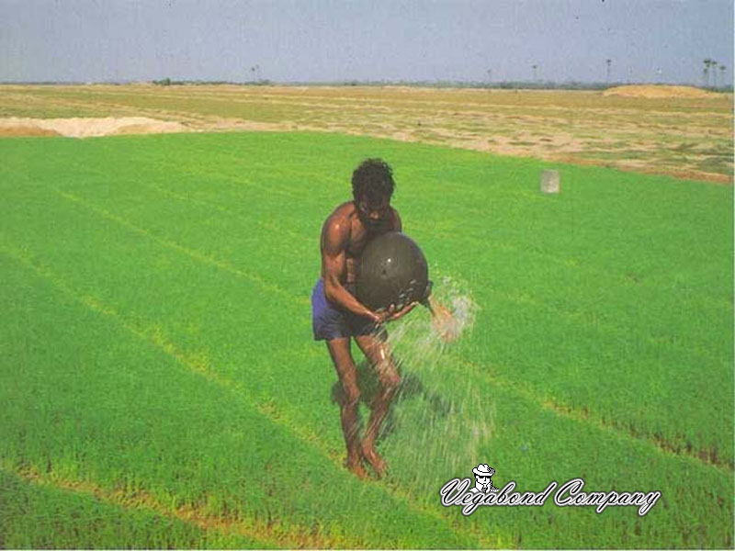
INDIVIDUAL WORK
Why do you think people at the floating market know each other so well?

Slide 14
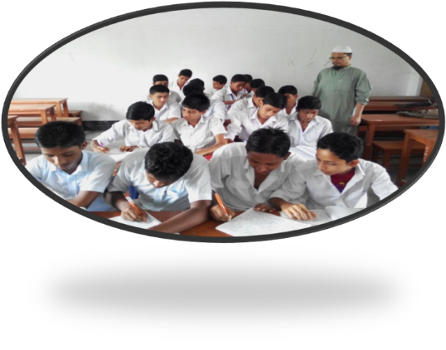
GROUP WORK
Choose the correct answer to each question from the alternatives:
Where will they take breakfast?
(a) in the hotel (b) in the restaurant (c ) at the market (d) at home
2. They went to the centre of the market by---------
(a) bus (b) boat (c ) car (d) train
3. The sellers were mainly-------------------women.
(a) young (b) aged (c ) tender (d) mid aged
The canals were surrounded with----------------------.
(a) coconut tree (b) palm trees (c ) tall trees (d) coconut palm trees
5. The market sits on---------------.
(a) canals (b) river (c ) fountain (d ) pond

Slide 15
EVALUATION
Answer the following questions from reading of the above text.
1. Why did the get up early?
2. Where did they plan to have their breakfast?
Why is Tha Kha floating market ‘ traditional’ ?
What did they hire?
When did they reach the market?

Slide 16
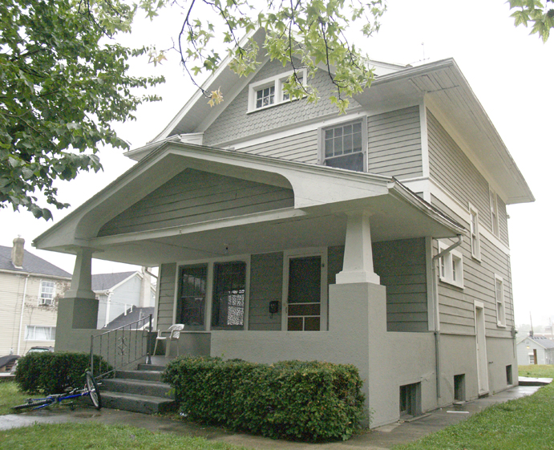
HOME WORK
Read the text below and fill in the gaps with words that are appropriate.
The world is changing every day. People are constantly moving to different (a)------------for different reasons. So people need(b )-----------------journey. People also need speed. Wheels (c )---------------------made it possible. This is why, (d )-------------of wheels is so important to(e )-----------------------.

Slide 17
THANK YOU ALL STUDENT

