Slide 1
WELCOME TO MULTIMEDIA CLASS

Slide 2
Identity
MD.ALAUDDIN
Assistant Teacher
Pagla Govt.Model High School and College
South Sunamganj,Sunamgan.ICT District Ambessador

Slide 3
Look at the pictures and what you can see in these pictures
Bar graph
Line graph
Pie chart
A bar/ chart is used to compare different sets of information

Slide 4
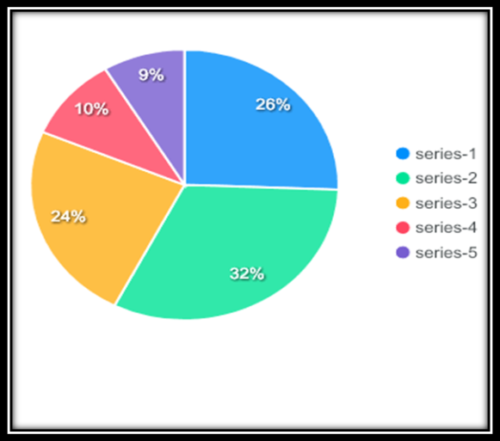
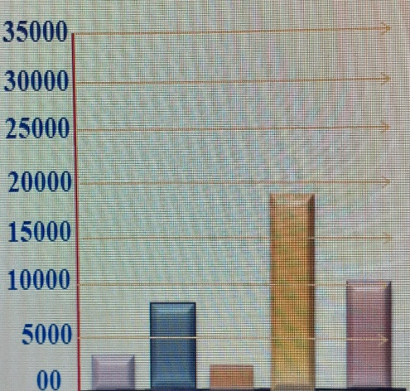
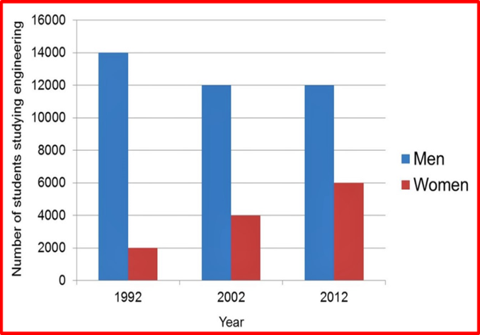
Our todays topic is –Graph/ Chart
Graph/Chart
Class: ix – x
English – First Paper

Slide 5
Learning out come
After this lesson, the learners will be able to –
explain about graph
explain about various types of graph charts
Explain the strategies of writing about the graph chart
Analyse following a graph

Slide 6
The graph shows the number of internet users in Bangladesh .The survey ranges from 2000 to 2009 .The graph covering these 9 years indicates that the percentage of internet users is increasing rapidly and constantly. In 2002 ,the first year of the survey period, we see that the number of internet users was 4.5% which rose to 5.6% in the next year 2002.In 2003, the number of internet users was 7.5% which increased to 7.9% in 2005 .In 2007, it was increasing and came into 8.3% . In the final year of 2009, it increased to 9.2%.It is the highest percentage of the graph.
From the graph it is quite clear that the number of internet users is increasing gradually. The survey shows a positive trends of the number of internet users in Bangladesh.

Slide 7
By following the graph,these16 graphs can be written
A graph belows shows the number of mobile phone users/ the number of internet users/ the number of Facebook usres/ the rate of population growth/the number of population living below the poverty line/death rate/birth rate/the world polpulation growth rate/the litreacy rate/the illiteracy rate/empowerment of woman/the infant mortality rate/ labour farce/import/ export/the rate of girls education.
Answer: The graph shows(বিষয়).The survey ranges from(প্রথম সাল ) to (শেষের সাল) .The grpah covering these (মোট কত বছর) years indicates that the percentage of (বিষয় ) is increasing/decreasing/fluctuating rapidly and constantly.In ( ১ম সাল) ,the first year of the survey period,we see that ( বিষয় ) was (প্রথম সাল অনুসারে যত%) which rose (উঠা )/decrased ( নামা ) to ( দ্বিতীয় সাল অনুসারে যত%)in the next year (২য় সাল ).In( ৩য় সাল ), ( বিষয়) was ( ৩য় সাল অনুসারে যত%) which incresed/decresed to ( ৪র্থ সাল অনুসারে যত% )in ( ৪র্থ সাল).In ( ৫ম সাল), it was increasing/decreasing and came into ( ৫ম সাল অনুসারে যত% ) আরো সাল থাকলে ………In (উক্ত সাল) it wsa ( উক্ত সাল অনুসারে যত%) এভাবে চলতে থাকবে .
From the graph it is quite clear that ( বিষয় ) is increasing/decreasing/ fluctuating gradually.The servey shows a positve/negative trends of ( বিষয়)

Slide 8
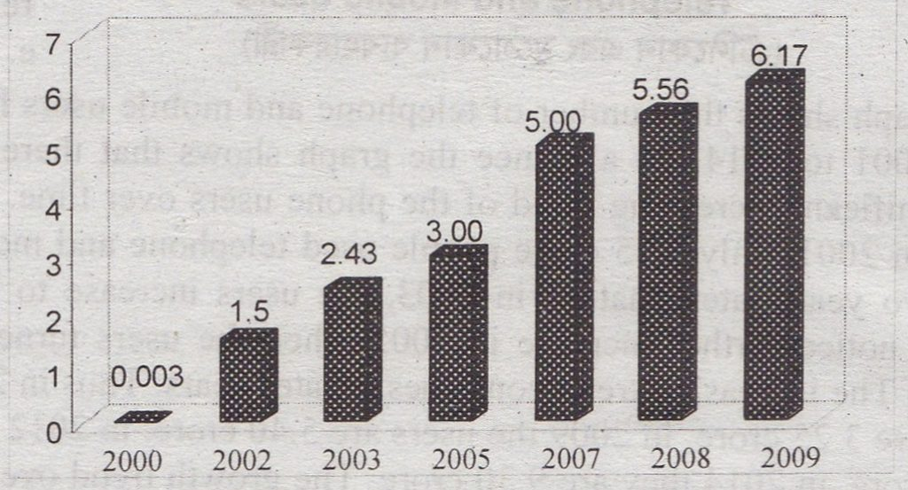
Home work
The graph shows the literacy rate of Bangladesh from 2000 to 2009. Now, describe the graph in 150 words. You should highlight and summaries the information given in the graph.

