Slide 1
Welcome to my class

Slide 2
Introduction
Lesson introduction
Sub: English
Class: Four
Lesson: The lion and the Mouse
Part of the lesson: One day a lion ….the mouse go.

Slide 3
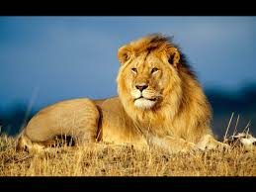
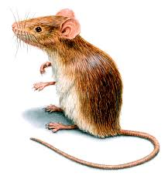
Dear Students –
See the pictures and try to say what is our today’s lesson

Slide 4
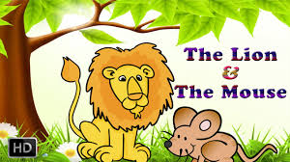
Our today’s lesson is--------

Slide 5
Learning outcomes
By the end of the lesson students will be able to------
1) Understand and enjoy the story.
2) Read silently with understanding the story .
3) Write answer the simple question.

Slide 6
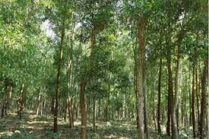
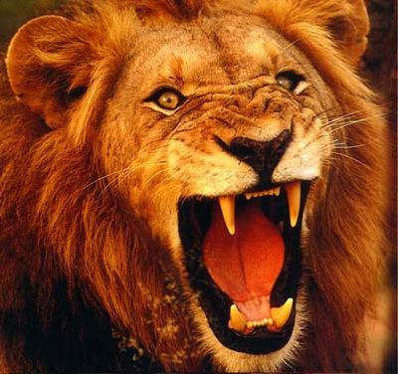
Let’s find out the new words and meaning them.
Forest
Jungle
Angry
Moody

Slide 7
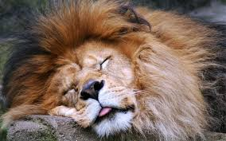
Oneday,a lion was sleeping in the forest.The lion was big and strong. All the animals feared the lion,apart from one mouse.

Slide 8
The mouse was playing near the lion.

Slide 9
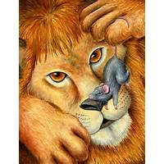
She ran onto the lions nose and he woke up.He was angry.

Slide 10
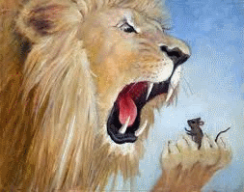
The lion lifted the mouse to his mouth and said,I am going to eat you!

Slide 11
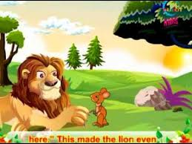
The lion laughed You are very small!How can you help me?But he let the mouse go.
The mouse said ,Please Mr. lion let me go.I am your friend.One day I will help you.

Slide 12
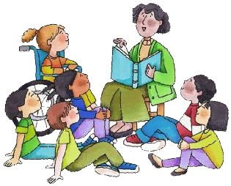
Teachers loud reading

Slide 13
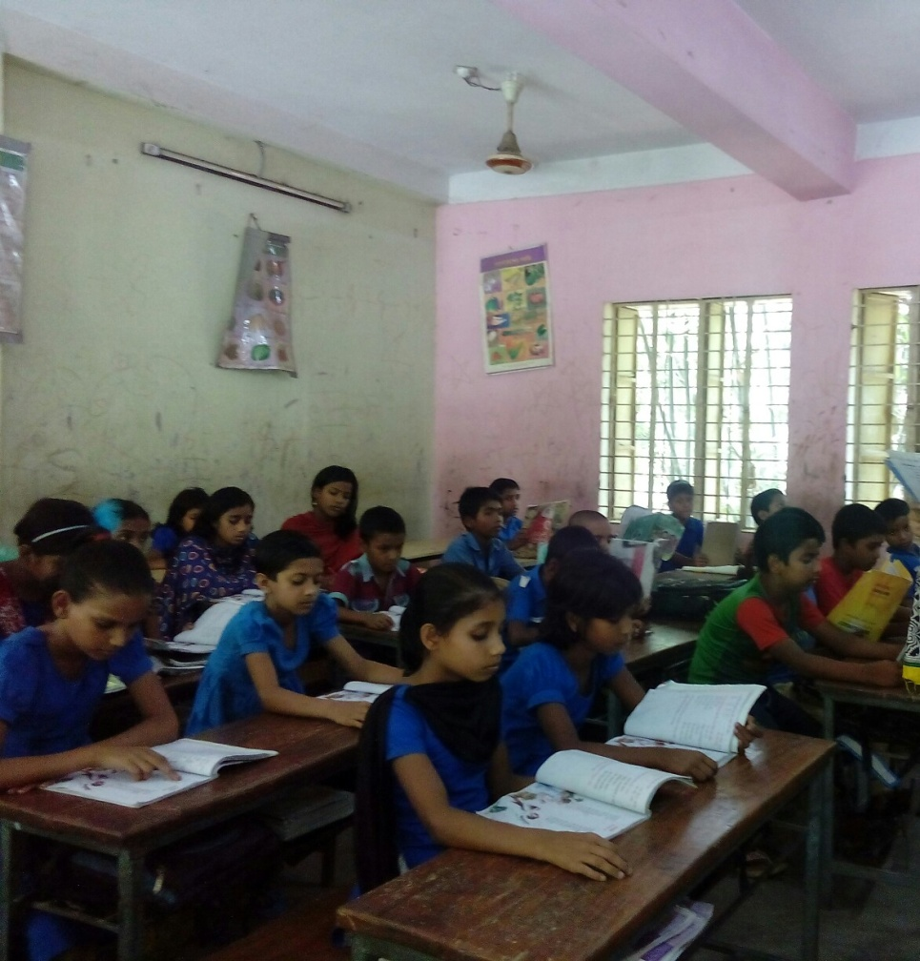
Student’s silent reading

Slide 14
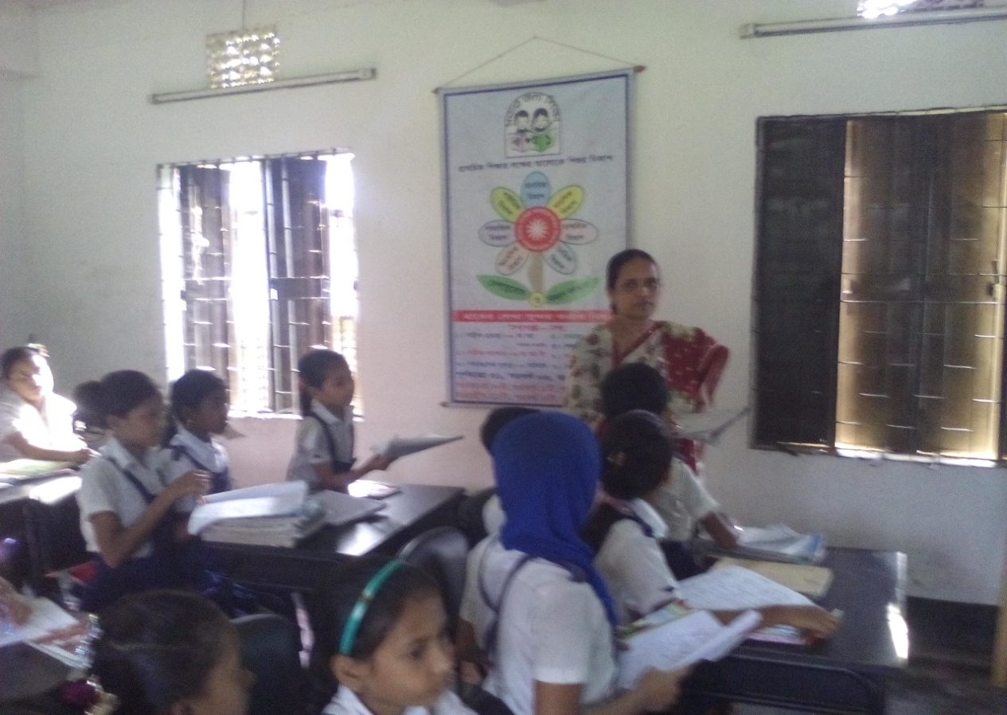
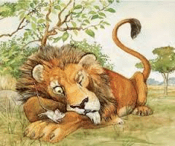
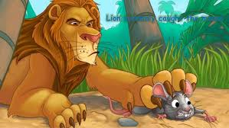
Checking learning

Slide 15
Fill in the gaps:
P.W
3.The mouse ran on to the lions………
4.The lion let the mouse ……....
5.The lion laughed You ?You are very …….
nose
go
small

Slide 16
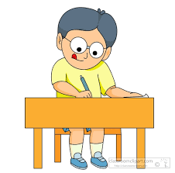
Individual work
Write the correct answer:
i. Where was the lion sleeping?

a) home
b) forest
c) bed
d) mat
ii. How was the lion?

a) big and strong
b) big
c)strong
d) weak
iii. The lion was angry with the---

a) animals
b) ant
c) mouse
d) fox
.

Slide 17
G.W
Answer the questions:
(1) Who feared the lion?
(2) Why was the lion?
(3) Why did the lion laughed?

Slide 18
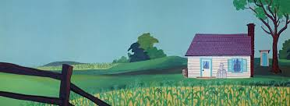
Home work
Write 3 sentences about the lion.

Slide 19
See you later

