Slide 2
Introduction
Name: Abul Kashem
Asst. Teacher
Pabna Cadet Collegiate School, Pabna.
Contact: 01718996445
Email: kashemsir87@gmail.com
Class-VIII
English First paper
Notes:
Introduction.

Slide 3
Enjoy a video and try to guess something.

Slide 4
Is it faster than the previous aircraft?
Notes:
Teacher may observe the slide first then go ahead accordingly.

Slide 5
Our Today’s Lesson is-
Future Aircraft
Unit-9, Lesson- 5 (B)

Slide 6
Aims of the lesson-
By the end of the lesson, students will be able to-
ask and answer questions
read and understand text materials
participate in a short dialogue
write answers to the questions
write short paragraphs
Notes:
Both speaking, listening, reading & writing skills will be focused in this lesson.

Slide 7
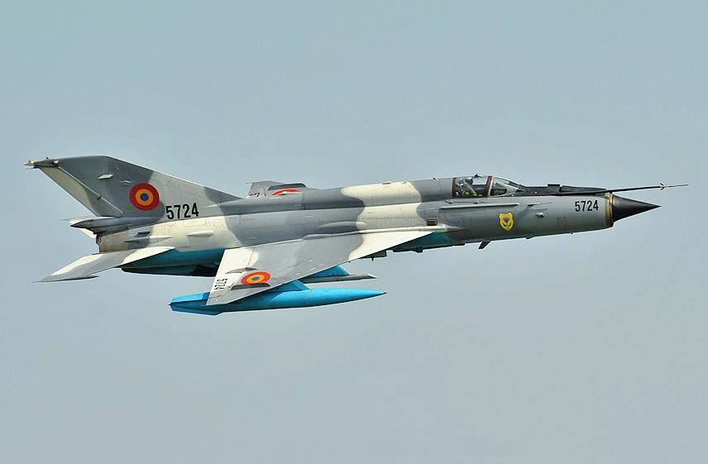
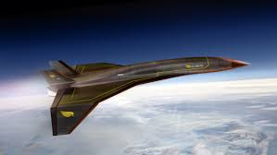
A Look at the pictures and say what they are. Discuss with your partner.

Slide 8
Key words

Slide 9
withstand
resist, sustain

Slide 10
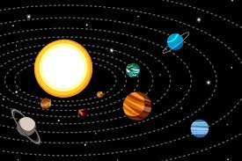
Space
empty pace, distance

Slide 11
Bade
See off

Slide 12
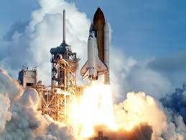
Launch
initiate,commence

Slide 13
display
show, exhibitation

Slide 14
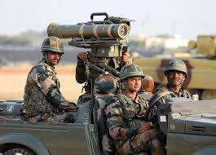
Defence
protection, security

Slide 15
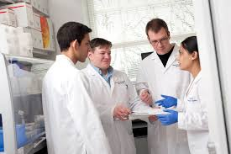
research
study, experiment.

Slide 16
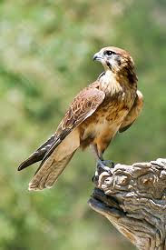
falcon
hawk

Slide 17
Melting
dissolving, mixing

Slide 18
Characteristics
The fastest plane ever built.
London-Sydney (less than 1 hour.)
Withstand temperature 2000 C.
This temperature is hotter than-

Slide 19
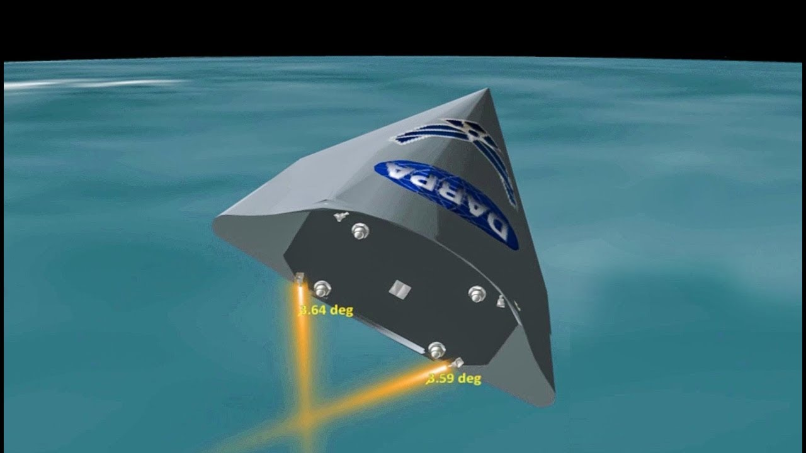
1. It was born in 2003.
About HTV-2
2. It was a part of US military project.
3. Its target is to reach any part of the world in less than 1 hour.
Hypersonic Technology
Vehicle - 2

Slide 20
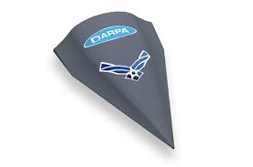
The plane would fly in hypersonic speeds of 13,000 mp/h. This speed is about 20 times the speed of sound.

Slide 21
Questions
1 What is HTV-2?
2 How was it born?
3 What purpose will it be used for?
4 Why was the HTV-2 developed?
5 Do you think that HTV-2 will be ‘mankind’s dream aircraft’? Why do you think so?

Slide 22
The following passage is based on the information in section B. Read the text in B. Complete the following sentences with will/ would, can/could/could not.
could not
Even Concorde ________ fly as fast as Falcone HTV-2. The news report says: the US defense Agency _____launch the Falcon Hypersonic Technology Vehicle-2 into space. Scientist expect that the Falcon HTV-2_______ fly at 13,000 miles per hour. The US military wishes that the Falcon ____ bomb any part of the world in less than an hour in the future. Engineers plan that they_____ set the Falcon on the back of a rocket to launch it into the distant space.
will
would
can
will

Slide 23
Home Work
How will the Falcon HTV-2 serve the world by quick moving?

Slide 24
Thanks To All

