Slide 1
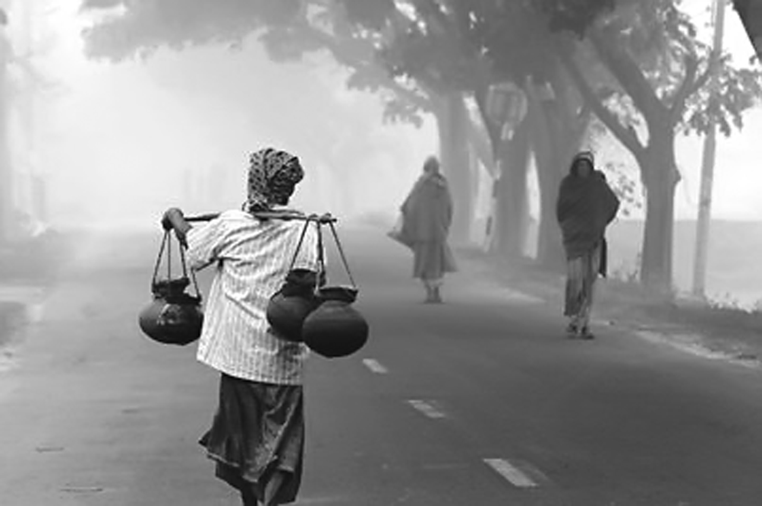
Welcome everyone

Slide 2
Teachers Introduction:
MASUD RANA
Assistant teacher
brommapur Government Primary school
Mobile: 01722729189
mmrana3434@gmail.com
Lesson Introduction:
Subject: English
Class: five

Slide 3
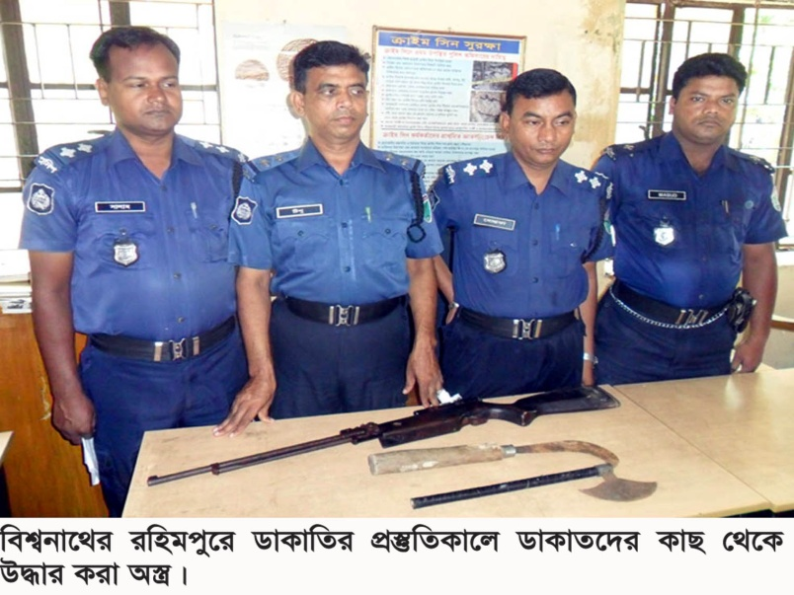
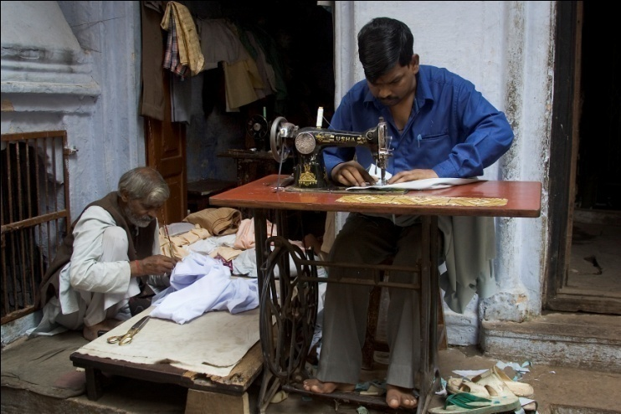
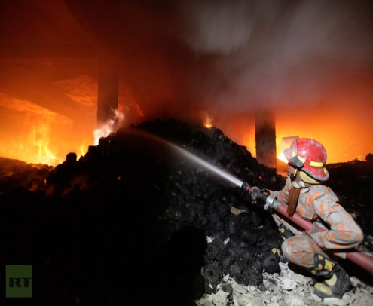
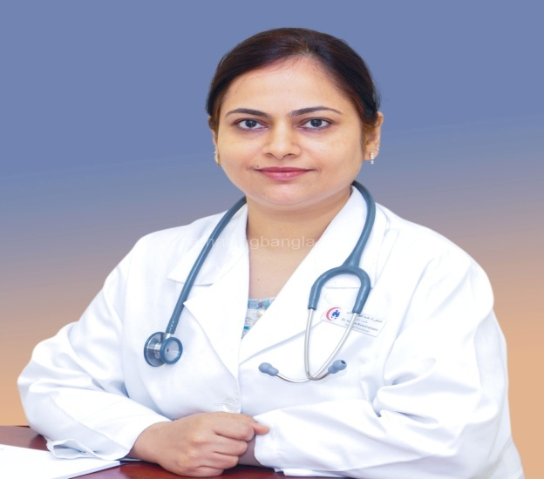
police
tailor
Fire fighter
doctor

Slide 4
A Firefighter
(Raju is---------------to become fire fighter)

Slide 5
Learning outcomes:
Student will be able to-
-listening to understand and enjoy the stories,
-read the simple stories
-write the short and simple paragraphs by arrange set of question
-write the answer of the short question
-say what about people and talk about object and event

Slide 6
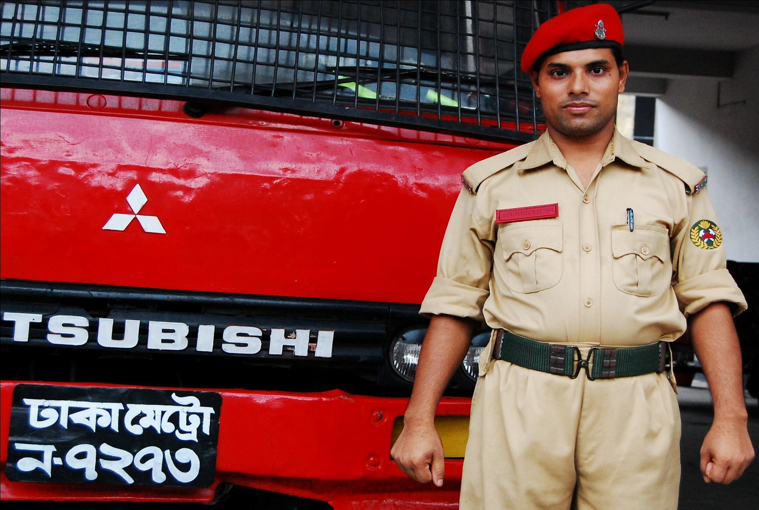
Raju is a firefighter

Slide 7
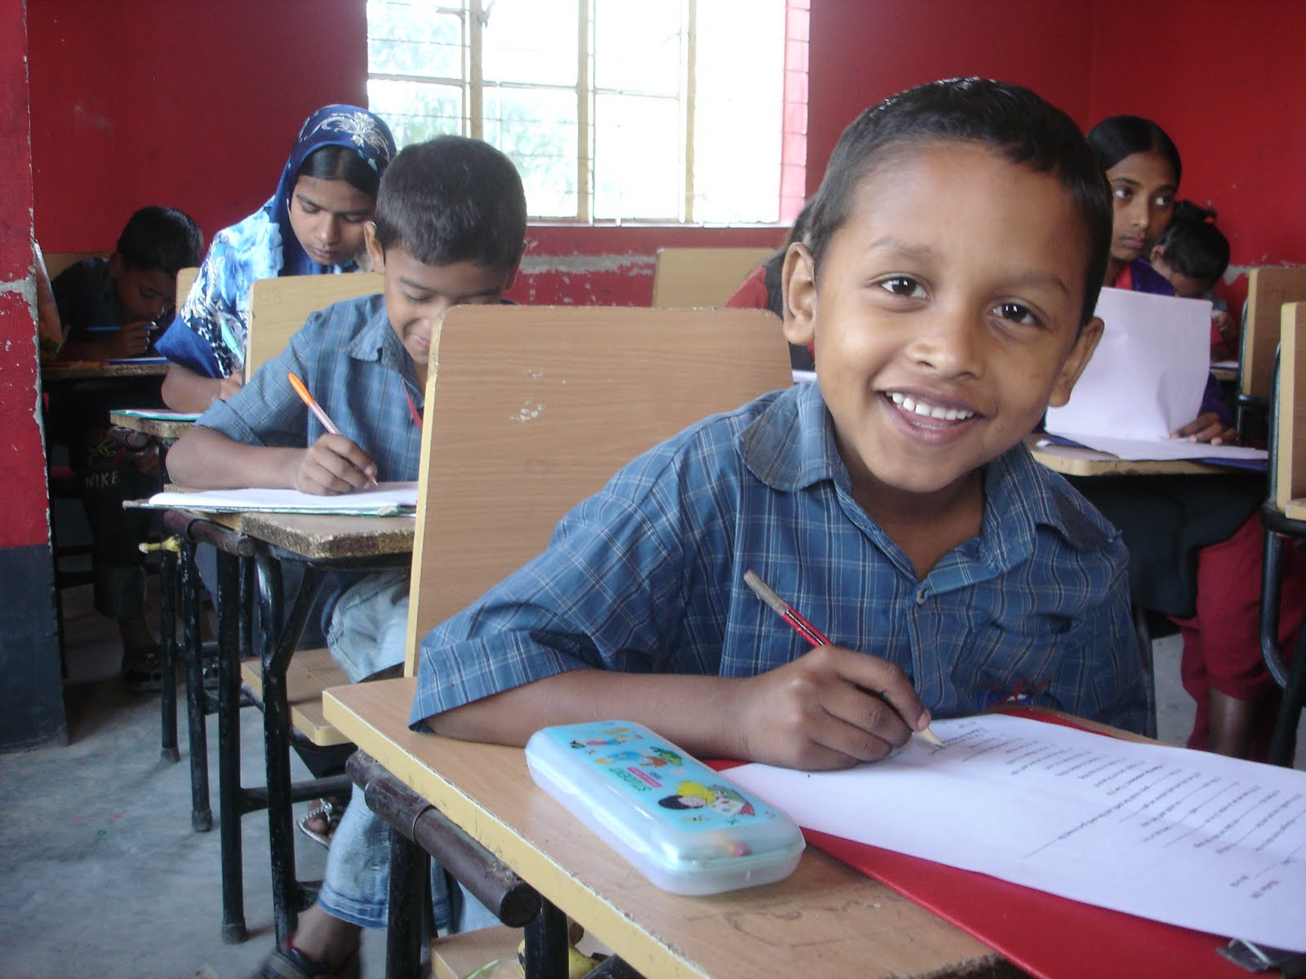
long time ago, when Raju in class five,

Slide 8
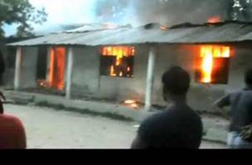
there was a fire in school building

Slide 9
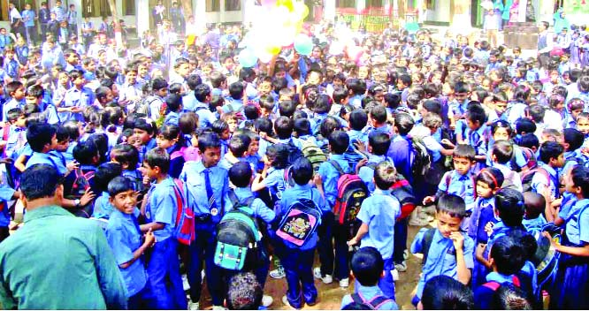
Every one got panicked

Slide 10
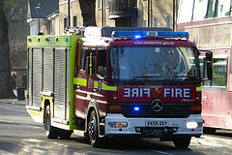
But soon a Fire brigade came

Slide 11
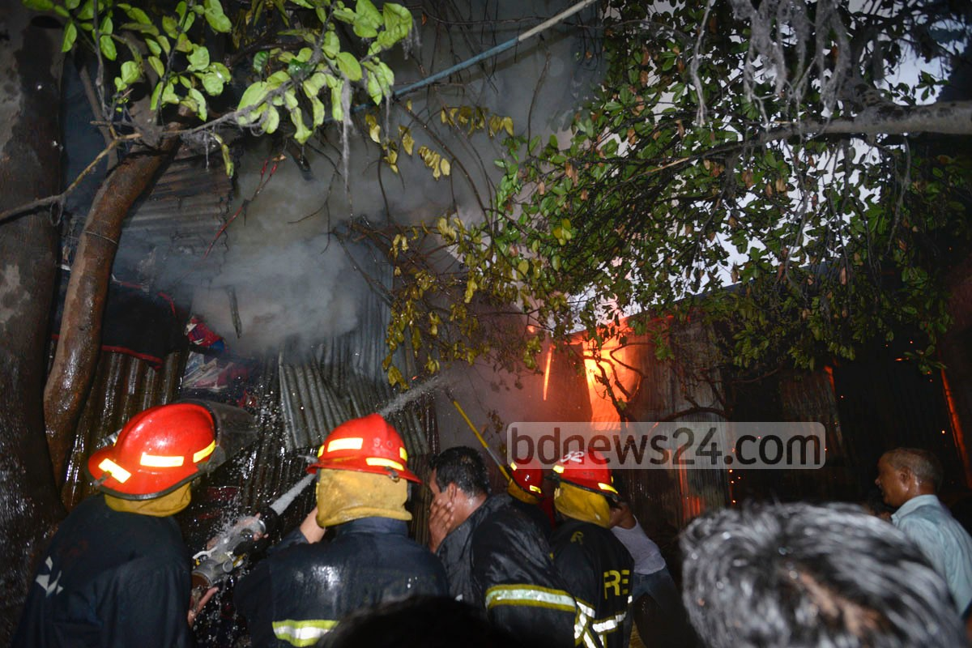
Put out fire

Slide 12
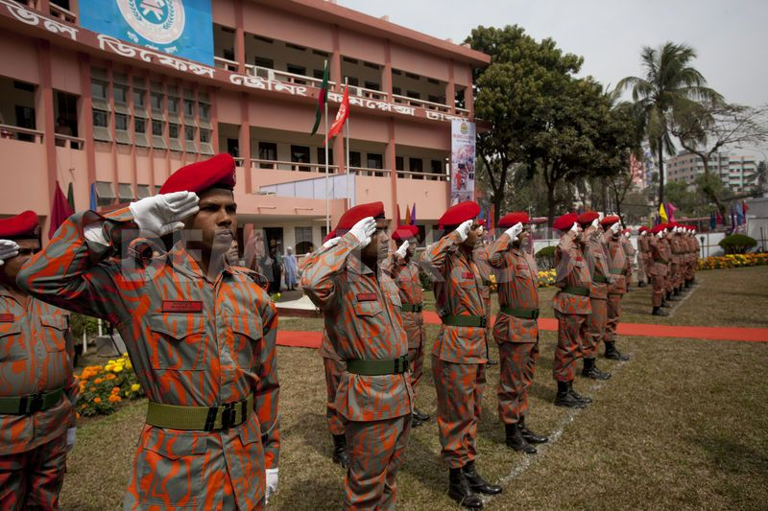
Raju
Fire department
after finishing the H.S.C Join a volunteer the fire department

Slide 13
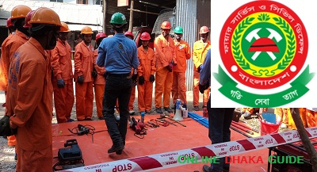
Now, Raju is a full time fire fighter

Slide 14
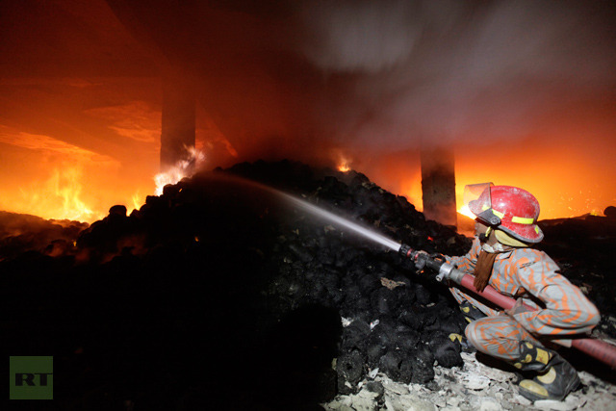
His man job is Putting out fire

Slide 15
New word
panicked
Full time
volunteer
Put out

Slide 16
Panicked
fear
He got panicked from the accident.
Volunteer
Who works willingly
I am volunteer in this game

Slide 17
Full time
All time
He is my full time partner
To close
Put out
I put out the lamp

Slide 18
Lets read with me

Slide 19
Student loud reading
(with correct pronunciations and intonation )

Slide 20
Group work
Match the meaning of the word-
1-paniked
2-put out
3-volunteer
-to close or protect
- who works willingly
-fear/frighten/alarm
1-fear/frighten/alarm
2--to close or protect
3-fear/frighten/alarm
Answer the short question-
1-when was Raju join as a volunteer?
2-who put out the fire?

Slide 21
Individual work
Fill the blank
1-Every one got
2-a put out fire
panicked
firefighter
Choose the best answer
1-when was Raju joined the fire department?
(a)Before HSC(b)after HSC(d)before SSC(C)after eight 2-Now Raju is a –
(a)full-time fire fighter(b)half time fire fighter
(c)Volunteer (d)none of them

Slide 22
TASK
Write five other profession that you know.

