Slide 1
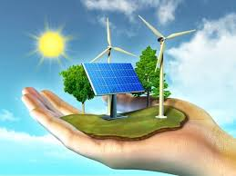
Welcome to All

Slide 2
Introduction
Md Shahneoaz
Assistant Teacher (English)
Jalalabad B/L High School,Sylhet.
E-mail: shahneoazmd@yahoo.com
Cell: 01631712091
Class: X
English 1st paper
Unit-11, Lesson-3
Time- 45 Minutes

Slide 3
Watch the video and answer:
https://youtu.be/44Wp3WE1AHs
What is the video clip about?
Probable Ans: This video clip is about renewable energy sources.

Slide 4
Today’s Topic
Renewable Energy Sources -3

Slide 5
Learning Outcomes:
After completing this lesson, students will be able to-
describe familiar objects.
answer some open ended questions.
listen and answer questions from a video clip.

Slide 6
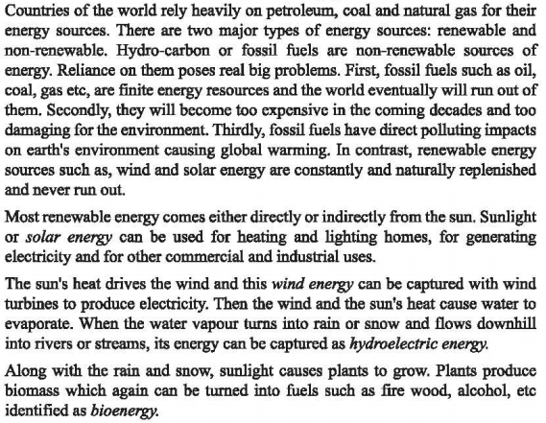
Read the passage silently in unit-11, lesson-3 (B)

Slide 7
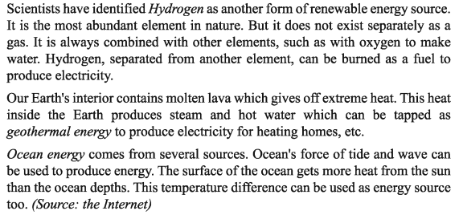
Read the passage silently in unit-11, lesson-3 (B)

Slide 8
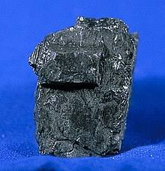
Let’s be introduced with new Words:
Fossil Fuel
A natural fuel such as coal or gas, formed in the geological past from the remains of living organisms.
Run Out
Be used up/dry up/be finished/give out

Slide 9
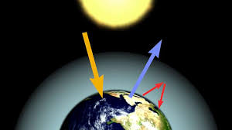
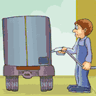
Let’s be introduced with new Words:
Global Warming
A gradual increase in the overall temperature of the earth's atmosphere
Replenish
Refill/fill up/recharge/
reload

Slide 10
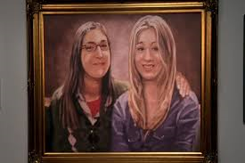
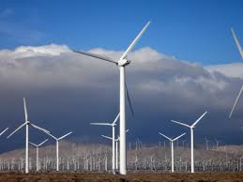
Let’s be introduced with new Words:
Capture
Catch/apprehend/seize
Wind turbine
A turbine having a large vaned wheel rotated by the wind to generate electricity

Slide 11
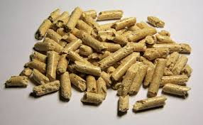
Let’s be introduced with new Words:
Evaporate
Turn from liquid into vapour
Biomass
Plant materials and animal waste used especially as a source of fuel.

Slide 12
Group Work
Answer the following questions:
What do you mean by renewable energy sources?
Ans. Renewable energy sources are such kind of sources that are constantly and naturally replenished and never run out.
What are the problems with non-renewable energy sources?
Ans. Firstly, the world will run out of them. Secondly, they will be too expensive in the coming decades and thirdly, most of them have direct polluting impacts on earth’s environment.

Slide 13
Individual work
Watch and listen the video clip carefully and answer orally:
https://youtu.be/81YqAbhj_wA
What are the renewable energy sources mentioned in the video?
2. What are the benefits of using renewable energy sources?

Slide 14
Write the summary of the passage.

Slide 15
Thanks a lot for being with me

