Slide 1
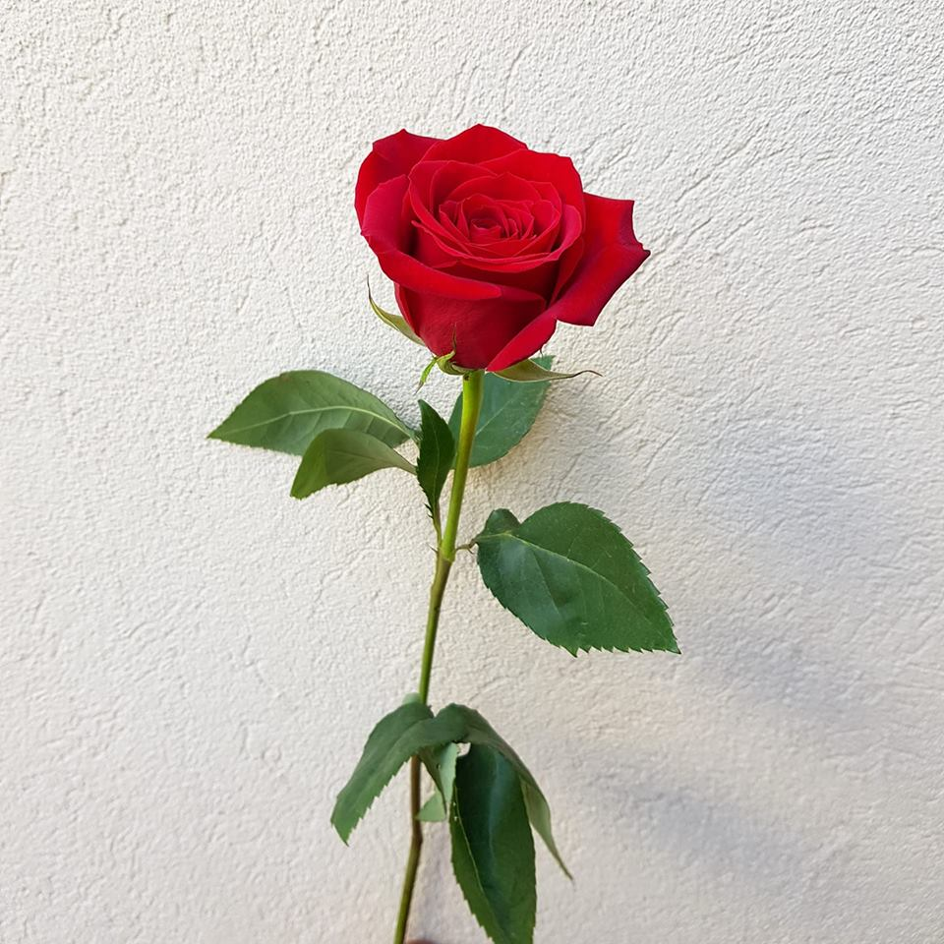
Thank you everybody

Slide 2
Identity of the teacher and the class
Shaiful Haque
Assistant Teacher
Sonargaon High School
Rangunia,chittagong
Class – Eight
Subject- English 2nd paper
Lesson- Article

Slide 3
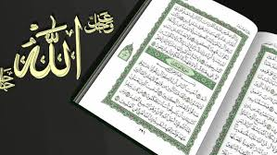
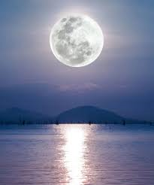
We should recite the Holy Quran daily.
The Moon gives us light at night.

Slide 4
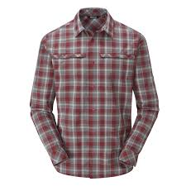
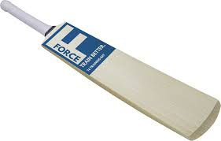
This is a shirt
This is a bat

Slide 5
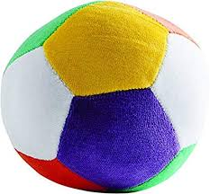
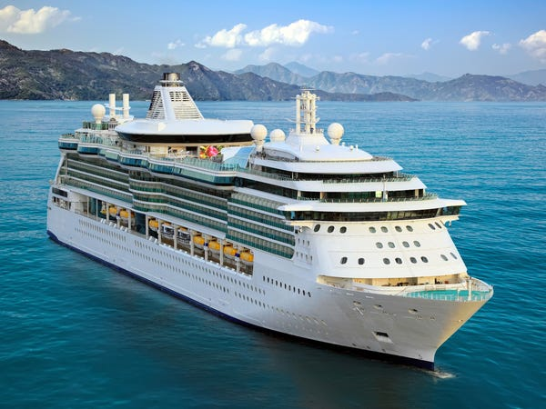
This is a ball.
This is a ship

Slide 6
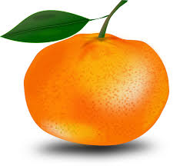
This is an umbrella.
It is an orange.

Slide 7
Can you guess what are the underlines about?
Article

Slide 8
Learning Outcomes
By the end of the lesson We will be able to-
define article.
use article a and an properly.

Slide 9
The
are called
Article
A
An

Slide 10
Article
Definite Article
Indefinite Article
The
A, An
Definite article is used to particularize a noun
Indefinite article is used to generalize a noun.

Slide 11
If we find a consonant as the first letter of the word , that means (b, c, d, f, g, h, j, k, l, m, n, p, q, r, s, t, v, w, x, y & z)
You have to put‘a’ before the word.
If we find a vowel as the first letter of the word , that means (a, e, i, o, u)
You have to put‘an’ before the word.

Slide 12
Some common used articles
Consonant letter–before “A”
Vowel letter-before- “An”
A book
A pen
A picture
A tiger
A laptop
A book
A flag
A dog
A horse
A chair
An apple
An egg
An eye
An arm
An icecream
An inkpot
An ox
An umbrella
An owl
An elephant

Slide 13
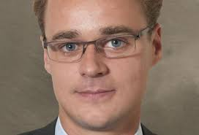
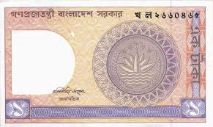
He is a European
I have a one taka note.
A is used before the sound –ইউ, ওয়া

Slide 14
Follow some examples
a one-eyed deer
a union
a university
a useful book
a unique scene

Slide 15
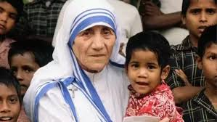
She is an honest women .
Dr. Karim is an M.B.B.S.
‘An’ is used before the sound of- অ , আ , এ

Slide 16
Follow some examples
an hour ( ‘h’ silent)
an honest ( ‘h’ silent)
an M.A.
an M.P.
an L.L.B.
an M.L.A.
an S.D.O.

Slide 18
Evaluation
Fill in the blanks with appropriate article-
Tarek is brilliant boy.
He showed excellent performance.
The tiger is ferocious animal.
Rahim is university student.
It takes hour to go there.
6.I have mobile phone.

Slide 19
Home Work
Fill in the blanks with a/an.
Osman is _____ meritorious student. He studies in ____ renowned college. There is _____ expert principal in the college. He is ____ honest man. The college has achieved ____ unique position in regard of result.

Slide 20
welcome

