Slide 1
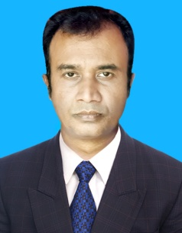
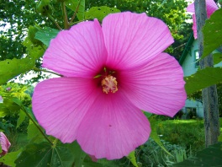
W
E
L
C
O
M
E
INTRODUCTION
CLASS: SIX
SUBJECT: ENGLISH SECOND PAPER
UNIT: ONE
LESSON: ONE
TOPIC: PARTS OF SPEECH (NOUN)
ABDUL AZIZ
ASSISTANT TEACHER ( MATH)
WEST SHRAF BHATA MIRERKHIL HIGH SCHOOL
RANGUNIA,CTG

Slide 2
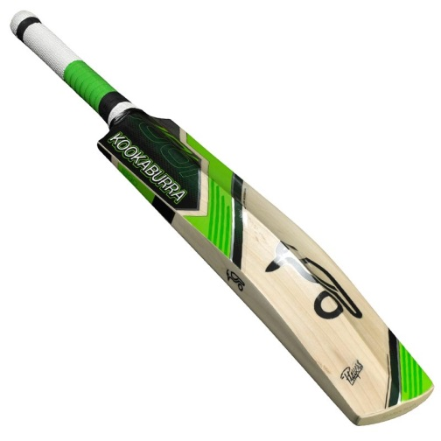
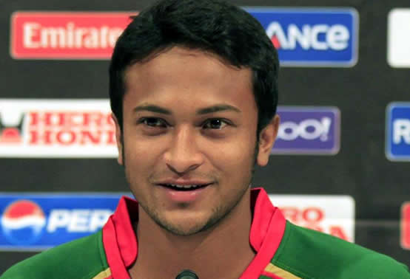
Bat
Sakib Al Hasan
What is the name of this thing?
What is his name?
Can you make sentence with this naming word?
Can you make sentence with this naming word?
Notes:
The students can make sentence orally or they can write sentences on the board. Answers can vary here.

Slide 3
1. Sakib Al Hasan is a cricket player.
2. He plays with the bat.
Nouns.
The naming words in a sentence are called
Notes:
Showing this slide The teacher can clarify what noun is.

Slide 4
LEARNING OUTCOMES OF THE LESSON
By the end of the lesson the students will be able to
say what noun is.
identify noun.
mention some nouns from real life situation.
make sentence with noun as a subject.
make sentence with noun as an object.

Slide 5
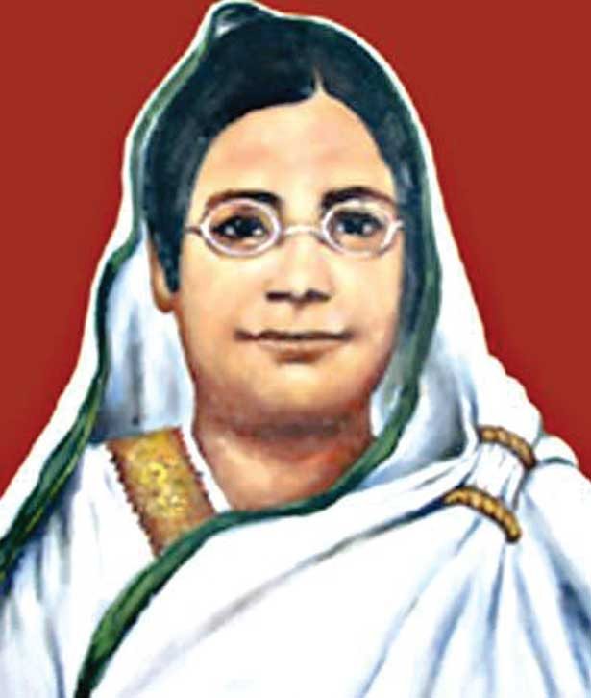
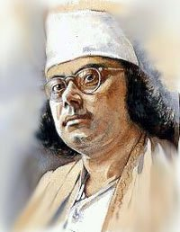
Can you tell the names of the persons?
Can you make sentences with these naming words?
1
2
Begum Rokeya
Kazi Nazrul Islam
1. Begum Rokeya is a social worker and a writer.
2. Kazi Nazrul Islam is our national poet.
Notes:
The students can make sentence orally or they can write sentences on the board. Answers can vary here. Showing the sentences The teacher can say that when the names of persons are used in a sentence they are called noun.

Slide 6
Can you tell the name of this thing?
Rose
Leaf
Can you make sentence with this naming word?
Can you make sentence with this naming word?
Notes:
The students can make sentences orally or they/teacher can write sentences on the board. Answers can vary here. The sentences will not be erased. Those will be on the board.

Slide 7
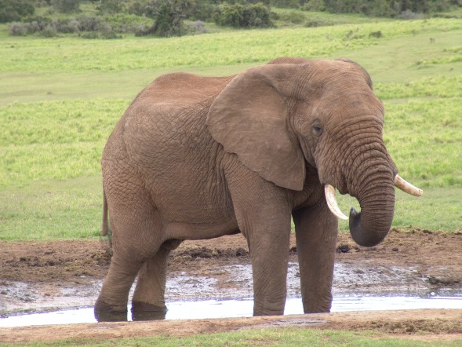
Can you tell the name of this animal?
Elephant
Can you make sentence with these naming word?
Notes:
The students can make sentences orally then they/teacher can write sentences on the board. Answers can vary here. The sentences will not be erased. Those will be on the board.

Slide 8
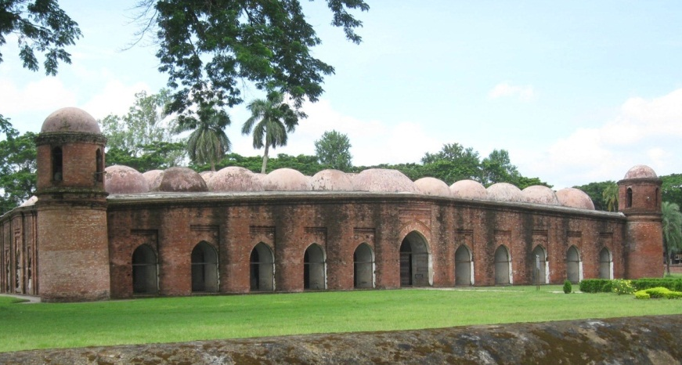
Can you tell the name of the building?
Sat Gombuj Mosque
Can you make sentence with this naming word?
Notes:
The students can make sentence orally then they/teacher can write sentences on the board. Answers can vary here. The sentences will not be erased. Those will be on the board.

Slide 9
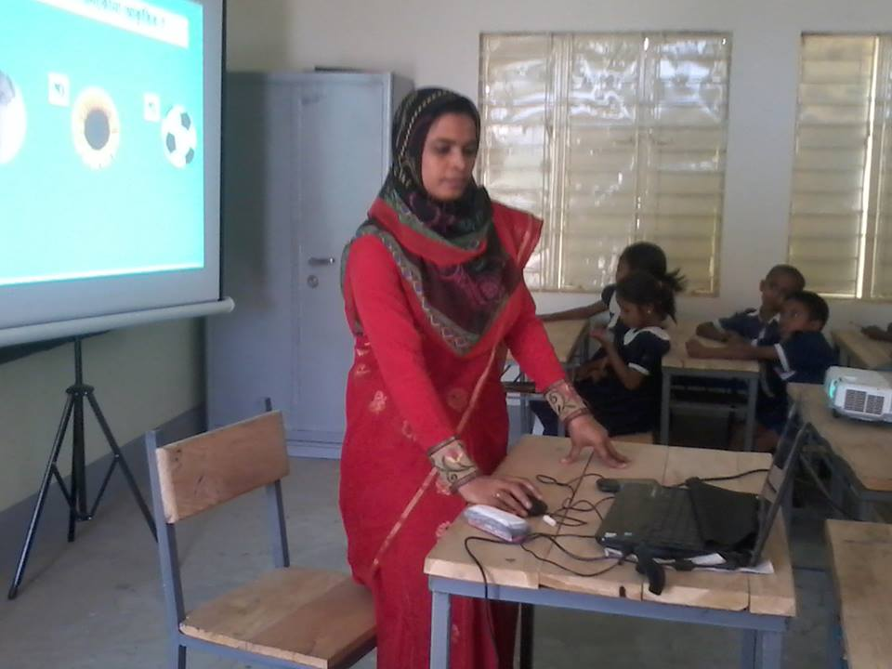
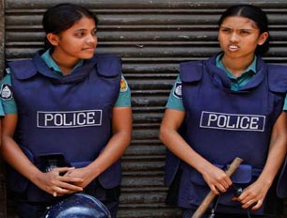
Can you tell the names of their professions?
1
2
Teacher
Police
Can you make sentences with these naming words?
Notes:
The students can make sentence orally then they/teacher can write sentences on the board. Answers can vary here. The sentences will not be erased. Those will be on the board.

Slide 10
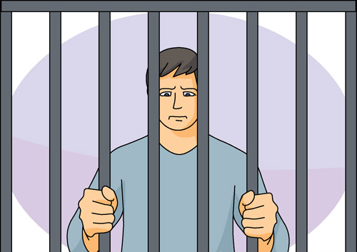
Can you make sentences with these naming words?
Can you match the names of the quality, action or state?
1
2
Happiness
Punishment
Punishment
Happiness
Knowledge
Notes:
The students can make sentence orally then they/teacher can write sentences on the board. Answers can vary here. The sentences will not be erased. Those will be on the board.

Slide 11
Look at the sentences and underlined words.
1. Kazi Nazrul Islam is our national poet.
2. The leaf is green.
3. The elephant is a big animal.
4. People like to visit Shat Gombuj Mosque.
5. The teacher is teaching.
6. Happiness keeps us healthy.
The name of any person, place, thing, idea, quality or state in a sentence is called noun.
Notes:
Showing this slide the teacher can explain again what noun is.

Slide 12
single work
Read the following passage and find out the nouns from it.
Anik Islam lives in Tongi. He is a student. His school is Mozida Govt. High School. He studies attentively. He is a singer too. He likes to sing folk song.
Answer
Anik Islam
Tongi
Student
school
Mozida Govt. High School
singer
song

Slide 13
Home work
1. What is noun?
2. Find out at least five nouns from your classroom and make sentences with those nouns.

Slide 14
THANK YOU ALL

