Slide 2
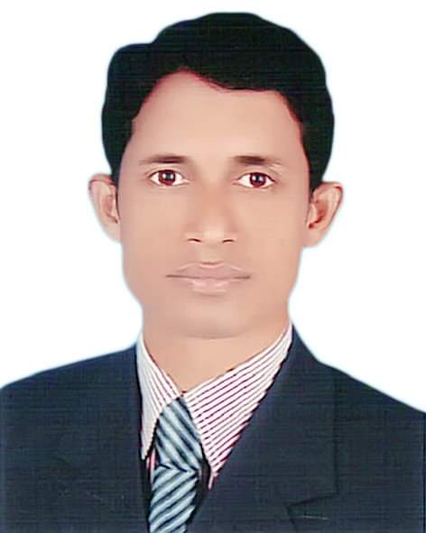
Identity of Teacher
Mohammod Abdul Hannan
Assistant Teacher
Chunghar Govt. Primary School
Kulaura, Moulvibazar.

Slide 3
Identity of lesson
English for Today
Class: one
Unit : 3, Alphabet
Lesson:4 - 6 ( A & B )
Time: 45 minutes

Slide 4
Learning outcomes
Students will be able to-
Listening: 1.1.1. become familiar with English sounds by listening to
common English words.
Speaking: 1.1.1. repeat after the teacher simple words and phrases.
1.1.2. say simple words and phrases.
Reading: 1.2.1. recognize and read the alphabet both
small and capital. (non-cursive).
Writing: 1.1.1. to practice letter shapes / simple writing
patterns, etc.

Slide 5
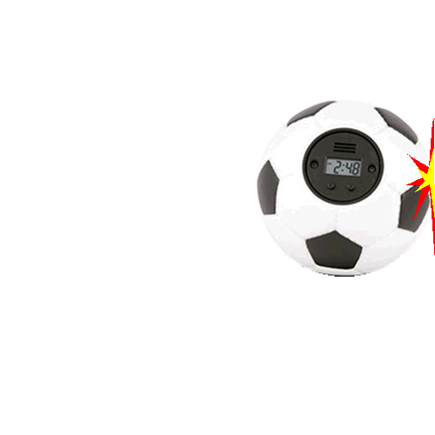
Let’s see some picture

Slide 6
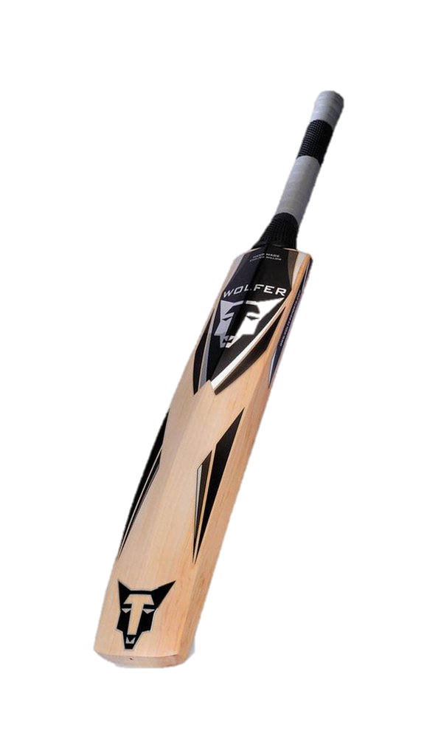
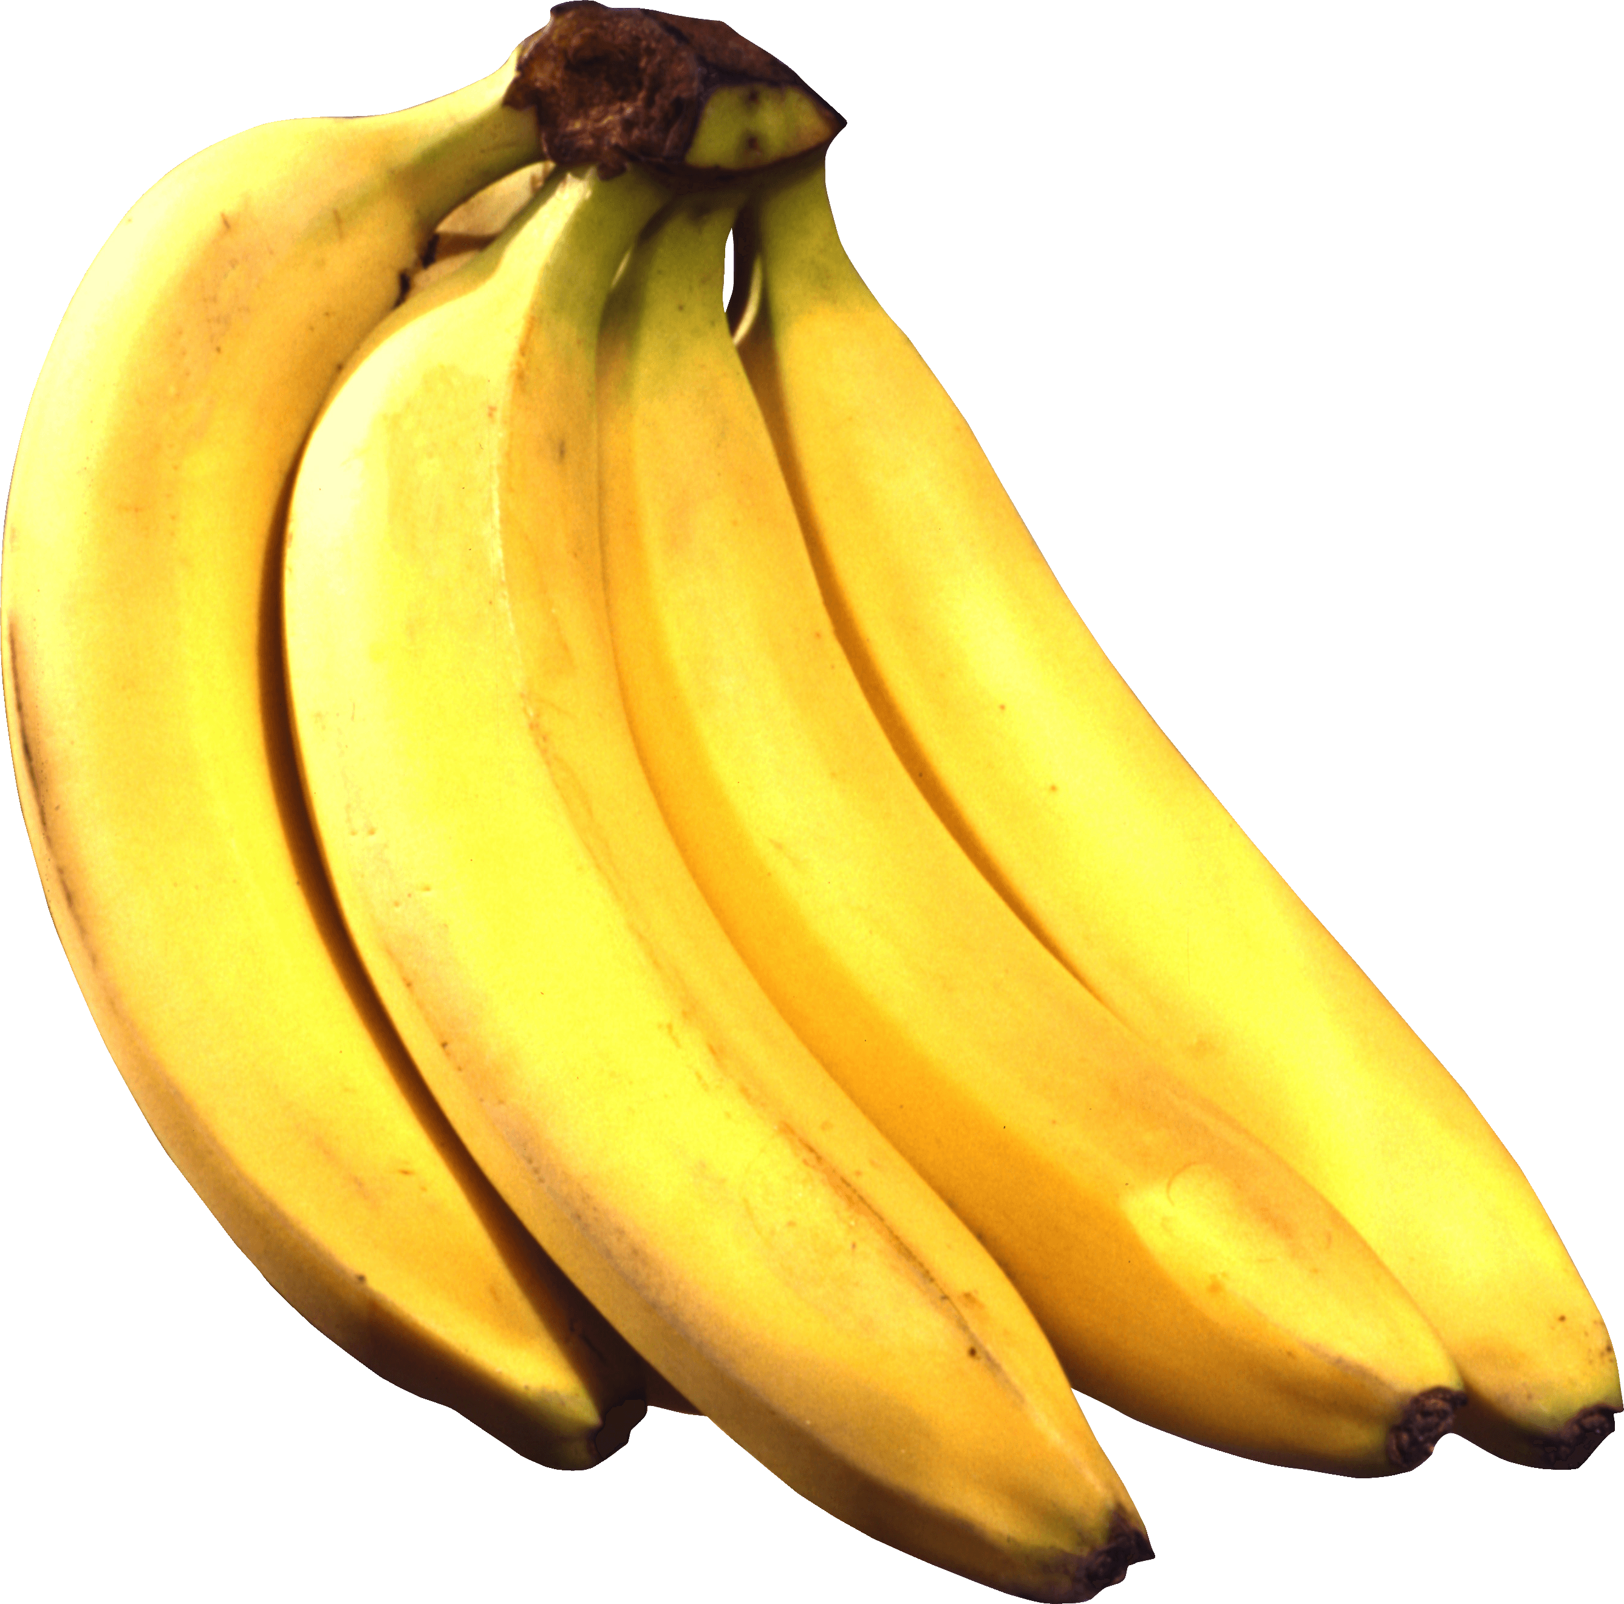
Tell the name of these pictures
Which letter is used to tell these name?

Slide 7
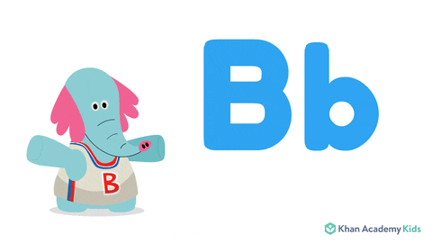
Todays lesson
Alphabet B b

Slide 8
Let’s see a video and learn the pronunciation of letter B

Slide 9
Look, listen and say, trace in the air
Input

Slide 10
Capital B
B
Ball
B

Slide 11
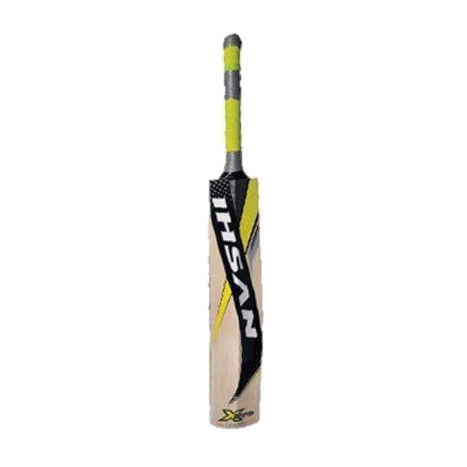
Small b
bat
b

Slide 12
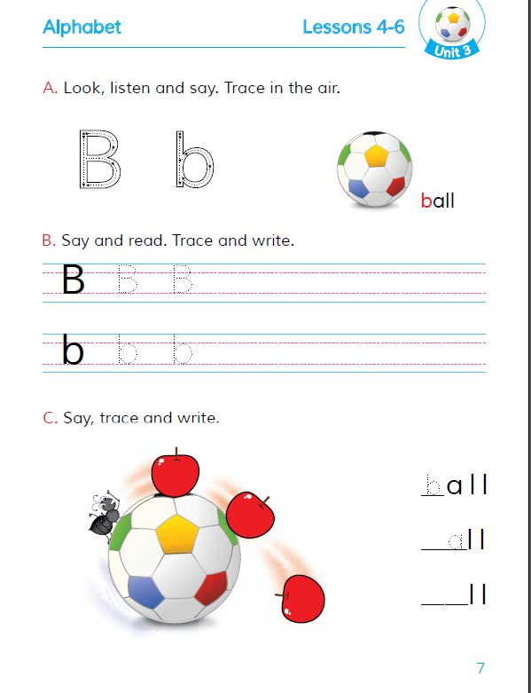
Open your book page
at 7

Slide 13
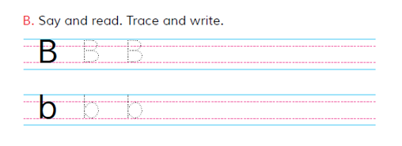
Say and read, Trace and write
B
P
R
A
C
T
I
C
e
Capital B

Slide 14
Say and read, Trace and write
Small b

Slide 15
Match the letter capital B & small b with word
E
V
A
L
U
A
T
I
O
N
b
B
bat
Ball

Slide 16
