Slide 1
Welcome To Today’s Online Class

Slide 2
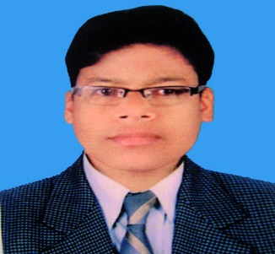
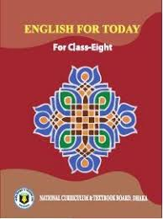
IDENTITY
Md. Abu Abdur Rahman Siddiquee
(M. A, B. Ed)
Senior Assistant Teacher (English)
Jagoroni M. L Girls’ High School
Newashi, Nageswari, Kurigram.
Master Trainer, UITRCE- BANBEIS.
E-mail: siddiquee1211@gmail.com
English for Today
Class : 8
Section: A
Total Ss: 43
Present Ss: 40
Duration: 40 Minutes
Date: 13/01/2021

Slide 3
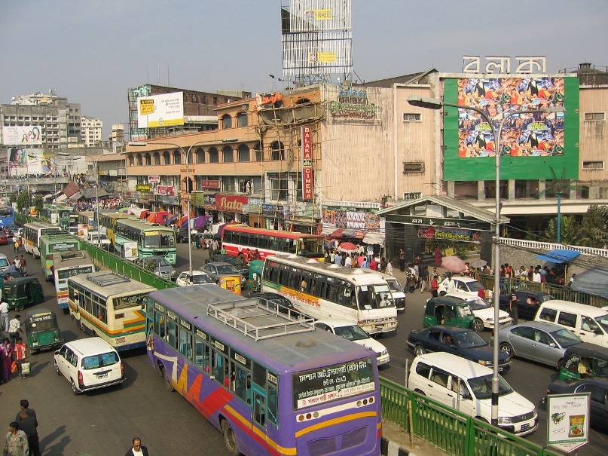
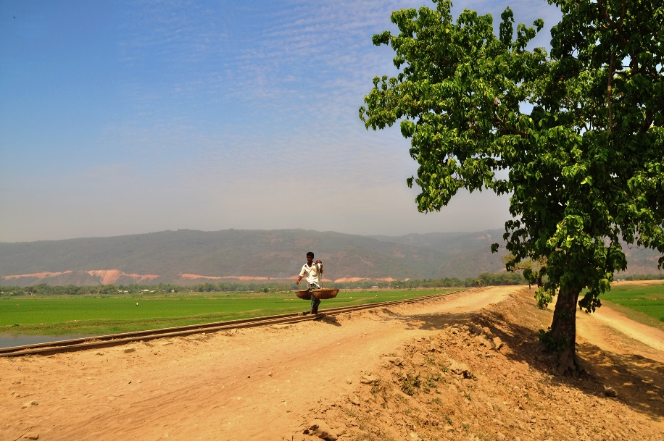
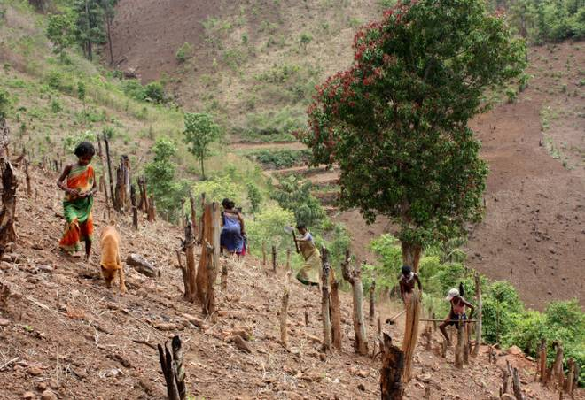
Where do you live in Bangladesh?
URBAN
RURAL
HILLY AREA

Slide 4
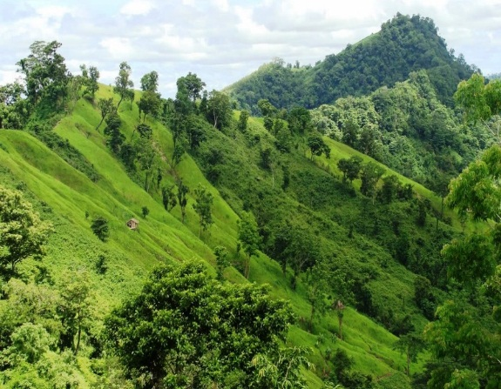
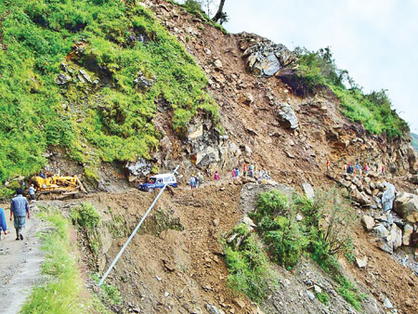
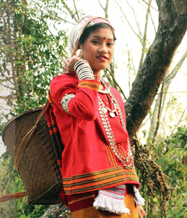
Have you visited any hilly place ?
Would you like to visit a hilly place if you have an opportunity to do so?
Do you know any people who live in a hilly place in Bangladesh?

Slide 5
If yes, tell something briefly about him/her/them.
Can you guess our today’s topic?
Our ethnic friends (1)
Unit: One
Lesson: Three

Slide 6
Learning Outcome
At the end of this lesson, students will be able to…
read and understand text,
describe the picture,
know about ethnic people’s culture, market place etc.
ask and answer questions.

Slide 7
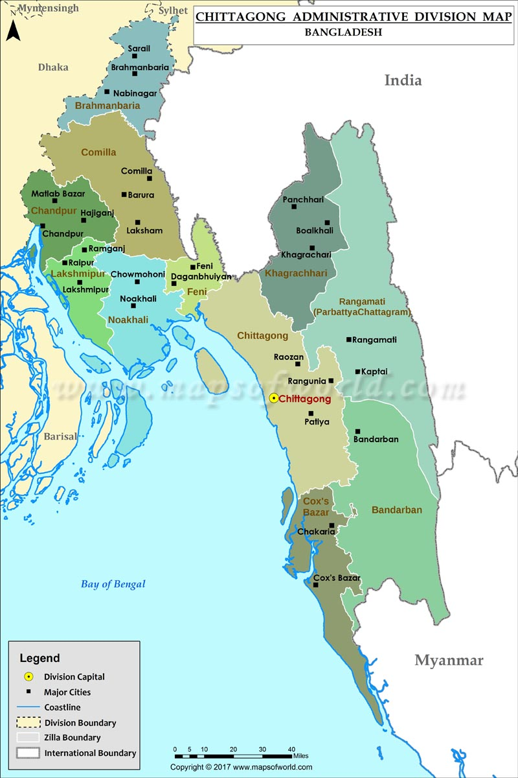
Do you know where they live?
Majority live in Chittagong Hill Tracts
Bandarban
Rangamati
Khagrachri
NB for Teachers
Click on Bandarban, Rangamati khagrachari

Slide 8
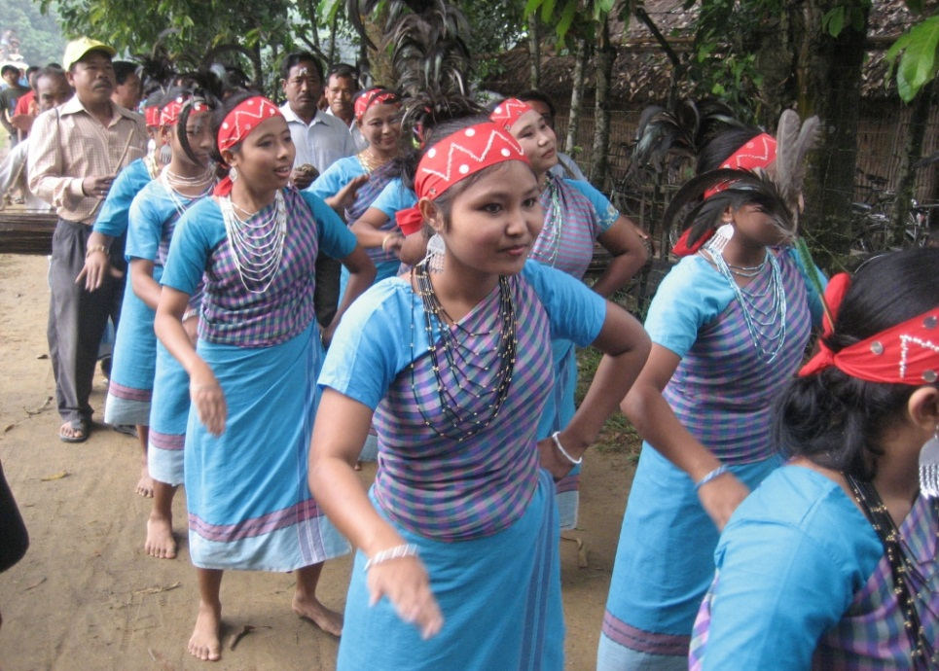
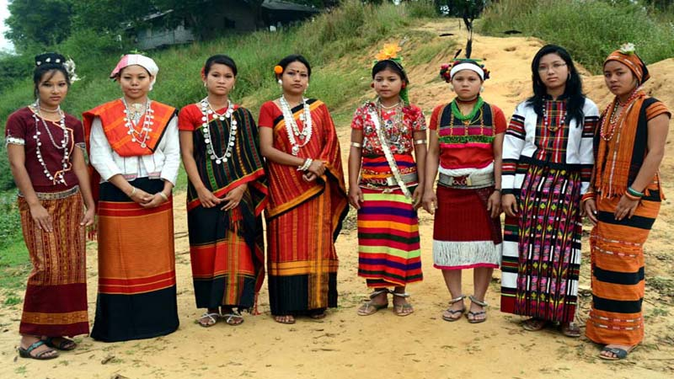
Vocabulary
Ethnic people
Meaning: relating to a population subgroup, racial.
The majority of ethnic people live in the Chittagong Hill Tracts.

Slide 9
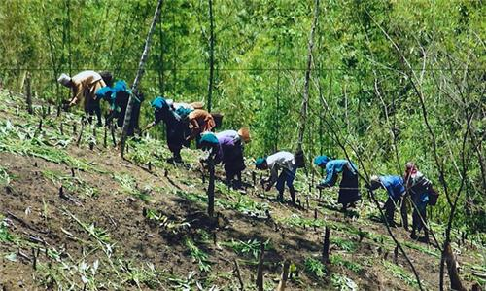
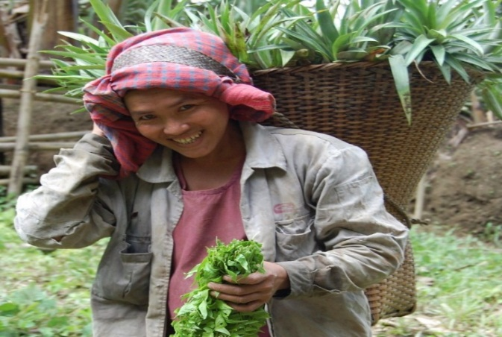
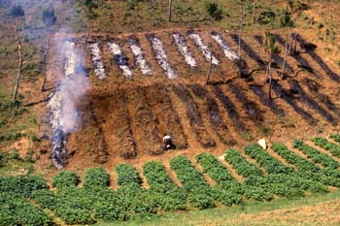
Jhum cultivation
Vocabulary
Meaning: Jhum cultivation is practiced on sloppy hills outside reserve forests. Most tribal people are well acquainted with this type of farming
Jhum cultivation is still practiced in Chittagong hill tracts..

Slide 10
Let us see a video on Jhum cultivation

Slide 11
Vocabulary
Majority
Meaning: The greater number, the number larger than half the total.
Majority
Majority people say ‘yes’.
The majority of the employees have university degrees.

Slide 12
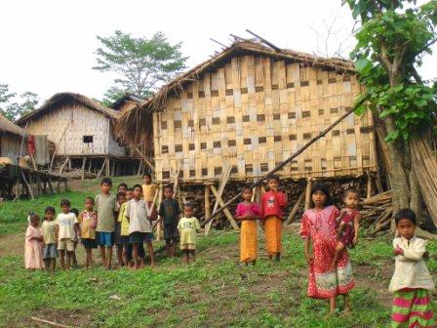
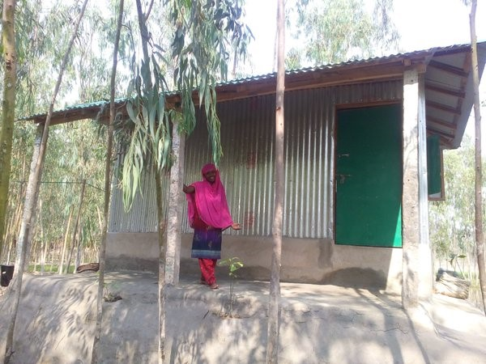
Vocabulary
Live in
Meaning: Resident is an employer's house.
Ragib’s friend Proborton Chakma lives in Rangamati.

Slide 13
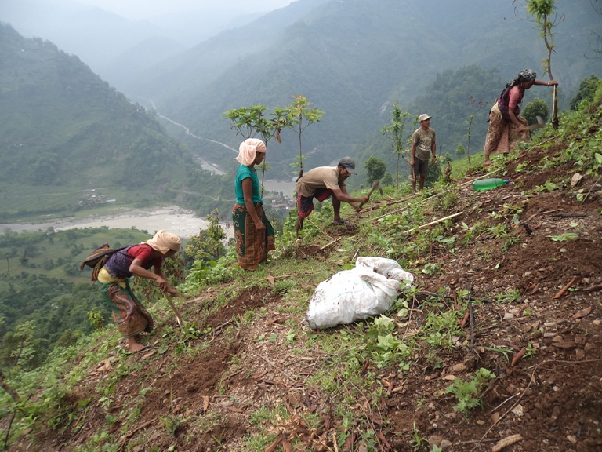
Vocabulary
Shifting
Meaning: Move or cause to move from one place to another, especially over a small distance.
Something is accepted depends upon the shifting sands of taste.

Slide 14
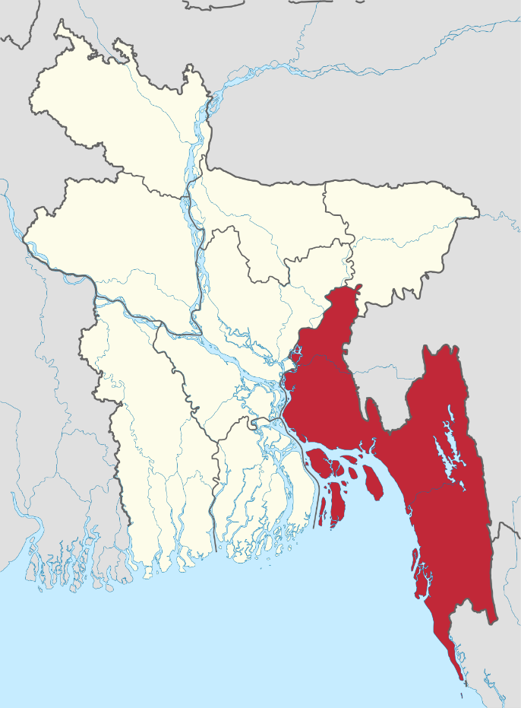
Vocabulary
Region
Meaning: An area, especially part of a country or the world having definable characteristics but not always fixed boundaries.
Something is accepted depends upon the shifting sands of taste.
Chittagong region

Slide 15
Loud Reading
Read the text carefully and identify true or false.
The ethnic people in Bangladesh hold a very important place in the culture of the country.
The majority of these people live in the Chittagong Hill Tracts. The other live in the regions of Mymensingh. Rajshahi and Sylhet . They live in the forest area, in the hills and in the rural areas. They do Jhum cultivation. For this they clear a piece of land in the forest, prepare it to sow seeds in it. They are mostly farmers. By religion they are Hindus, Christians or Buddhists. They speak their own mother tongues. Some of them are Chakmas, and Marmas, the Tripuras and the Moorangs, who live the Hill Tracts. The Santals live in Rajshahi. The Khasias and the Monipuries, live in Sylhet and the Garos in Mymensingh.

Slide 16
Individual Work
True or false? If false give the correct information
All the ethic people of our country live the Chittagong Hill Tracts.
b)Most of them are farmers.
c)By religion all of them are Buddhists.
d)The Moorangs are an ethnic group.
e)They do practice Jhum cultivation.
False, the majority ethnic people live in Chittagong Hill Tracts.
True
False, by religion they are Hindus, Christians and Buddhists
True
True

Slide 17
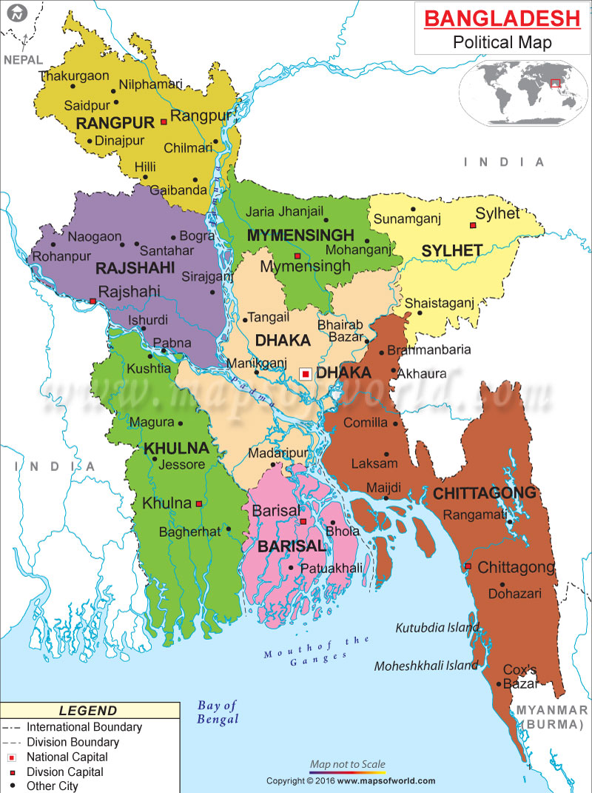
Look at the map
Santals
Hajangs
Santals
Garos
Khasias
Munipuries
Khasias
Munipuries
Hajangs
Garos

Slide 18
Group Work
GROUP A
Where do the Santals live ?Is a it plain land?
What language do they speak at home?
GROUP B
GROUP C
Where and how they do Jhum cultivation?
GROUP D
Write about their religion.

Slide 19
Learning Assessment
Fill in the blanks with using the following words given below.
Ethnic people _______ a group of people from a particular ______ or race living in a country where the ______ group of people live. They live in farmers , hills and rural areas. There are mostly farmers and ______ Jhum cultivation by clearing a piece of land in the forest. By religion they are either Hindus or Christians religion or Buddhists. They ______ their own mother tongues.
speak
practise
main
culture
mean
mean
culture
main
practise
speak

Slide 20
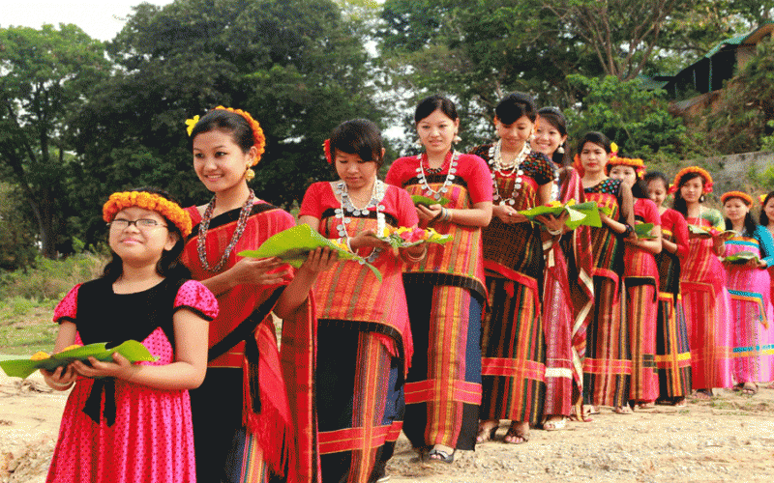
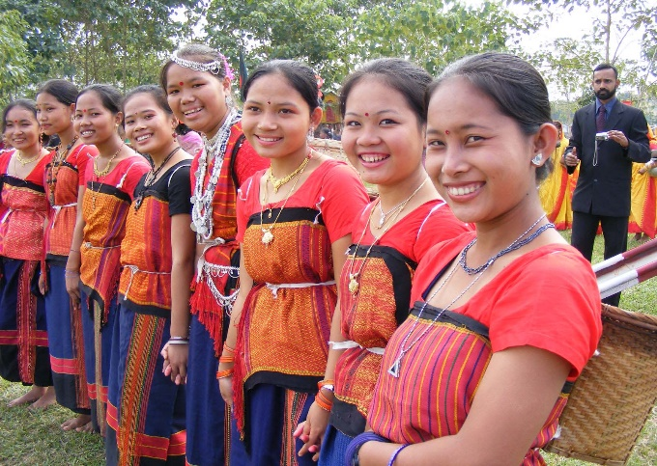
Match the synonym words
region
zone
grasp
rural
country
scatter
sow
scatter
main part
majority
main part
country
hold
grasp
zone

Slide 21
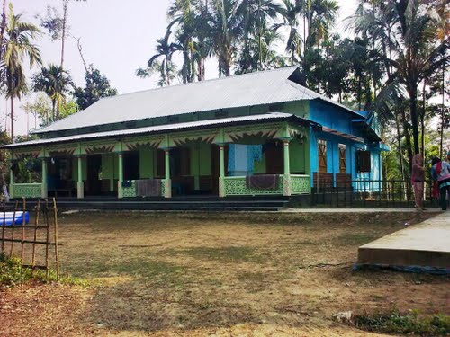
Assignment
You have to read the text again and then write the summary of it in around 50 words

Slide 22
Thank you
SEE YOU AGAIN

