Slide 1
Welcome
My dear students

Slide 2

Teacher’s info

Slide 3
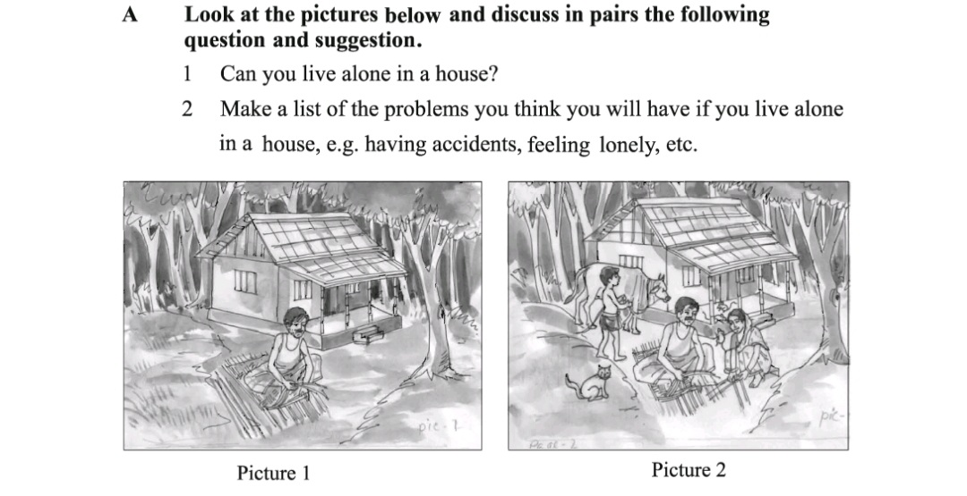

Slide 4
Can you say today’s lesson?

Slide 5
Can you live alone?
Unit: 01
Lesson: 01

Slide 6
Learning outcomes
By the end of the lesson, students will be able to ----
narrate incidents.
participate in discussion.
listen to and understand others.

Slide 7
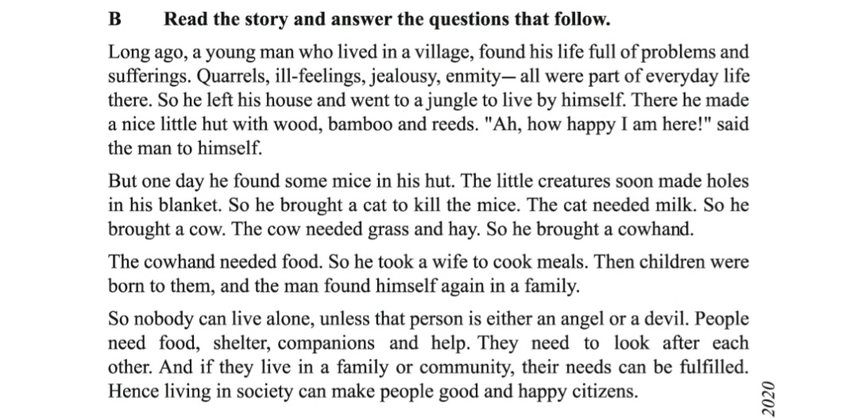

Slide 8
Group Work 12 min:
C. Close your book and answer the question. What five things did the young man do in the jungle? Now divide into groups of fives. Tell the story to the group sequentially.

Slide 9
Home Work
Answer the questions in section D from the text book .

Slide 10
Thank You

