Slide 1
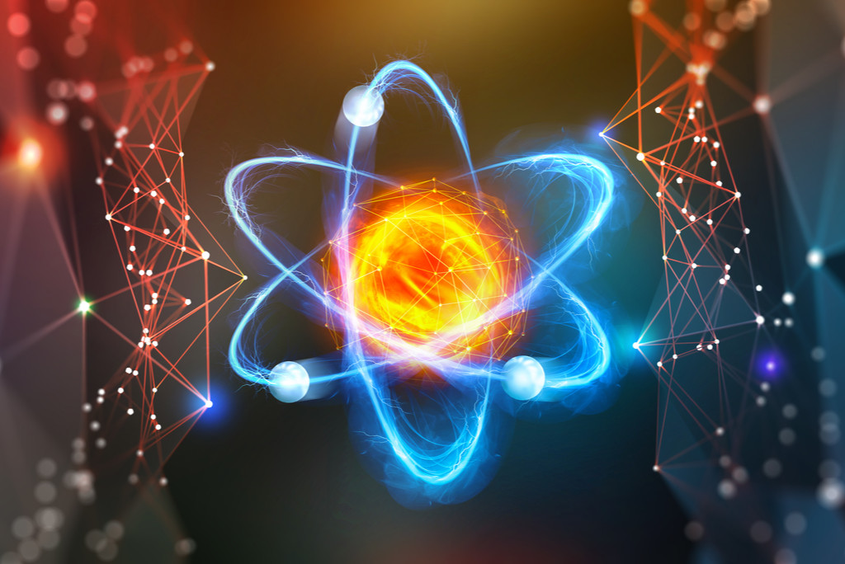
Good Morning

Slide 2
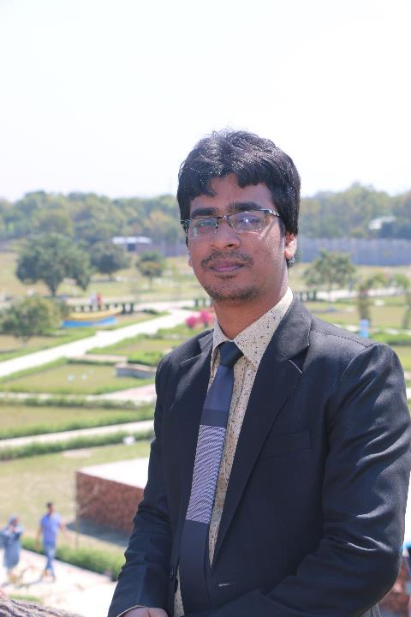
Teacher’s Identity
Md. Al Momin
B.Sc.(Hons.), M.Sc. (Physics), RU
Lecturer(Physics)
Square High School & College, Pabna.
STD-VII
Subject: Science
Chapter-7: The Use of Energy
Time: 40 min.

Slide 3
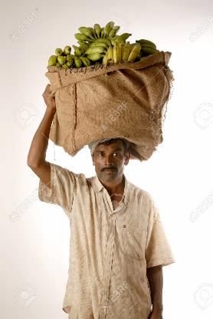
Look at the pictures…..
A girl is reading
A boy is playing football
Standing man bearing load on his head
Generally it seems, all of them doing work individually.
Are all of them doing work?
But in science, are all of them doing work?
No, only the boy playing football is doing work.

Slide 4
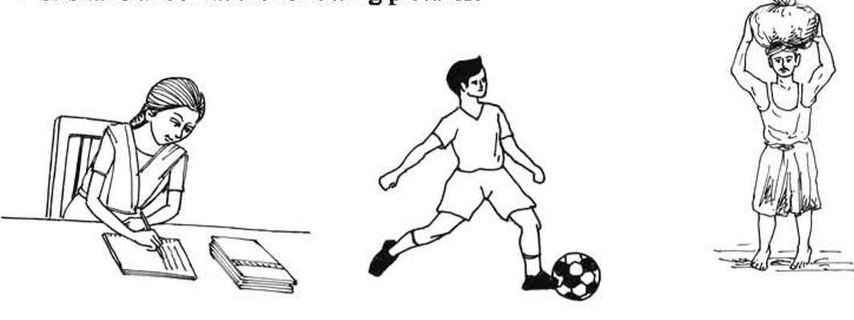
Our Today’s Topic is-
Work, Power and energy

Slide 5
Work:
When displacement is happened by applying force on an object is called work.
FORCE
Displacement
Work = Force × Displacement
The unit of work is joule (J).
Therefore, work will be done when-
There will have a force
The force will cause a displacement.

Slide 6
Now in the light of science…..
A girl is reading
A boy is playing football
Standing man bearing load on his head
Is she doing work?
Is the boy doing work?
No displacement, No Work
Yes, work has been done.
Displacement of the football is happened.
Is the man doing work?
No displacement, No Work

Slide 7
Work:
An object moves 15 meters when a force of magnitude 50 N acts on it. What is the work done?
Solution:
We know, work= Force × Displacement
= 50 N × 15 m
= 750 J (Ans.)
Here,
Force = 50 N
Displacement= 15 m
Work = ?

Slide 8
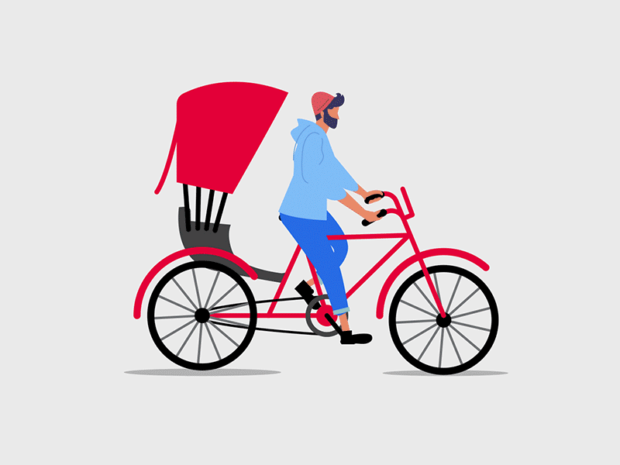
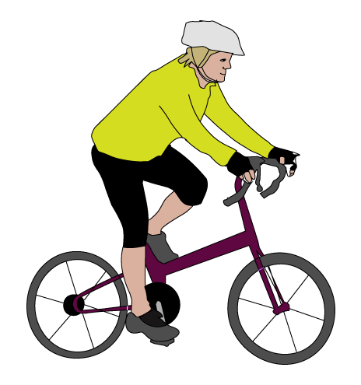
Observe the scenery…..
Power:
If we divide total work done by total time, we will get power.
That means, power =$\frac{work}{time}$
The unit of power is watt(W)
No, they are not taking same time for travelling same distance.
So their working power are not same.
The person who takes less time to go to same distance, has more power.
When someone does any work as quick as possible, it is called her/his power.
Are they taking same time for travelling same distance?
1
2

Slide 9
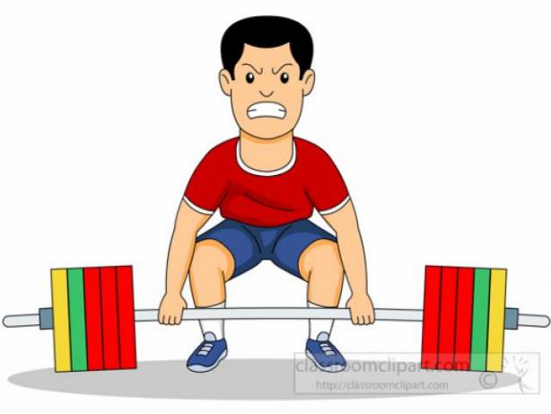
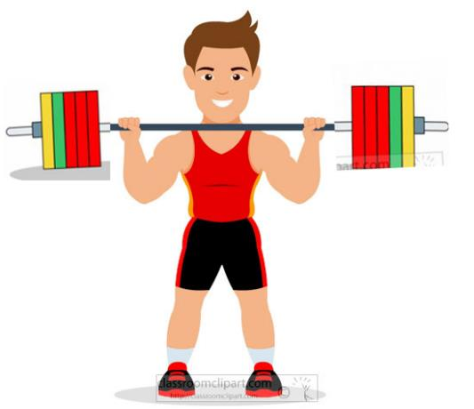
Energy:
Who has the more energy?
Toni has more energy and Joni has less energy.
Toni has the more ability to do work.
So the energy is related to ability of doing work.
Look at the pictures……..
Who has the more ability to do work?
The ability of doing work is called energy.
The unit of energy is also joule.
So energy and work are not different thing.
The person who has more energy can do more work
Toni
Joni

Slide 10
Individual Work:
An object moves 30 meters when a force of magnitude 140 N acts on it. What is the work done?

Slide 11
Evaluation:
What is work?
What is the unit of work?
What is the unit of force?
What is power?
What is energy?
What is the unit of energy?

Slide 12
H.W:
Rahim can do 80 Joule work in 16 second but Karim can do 120 Joule work in 30 second. Whose power is more?

Slide 13
THANK YOU

