Slide 1
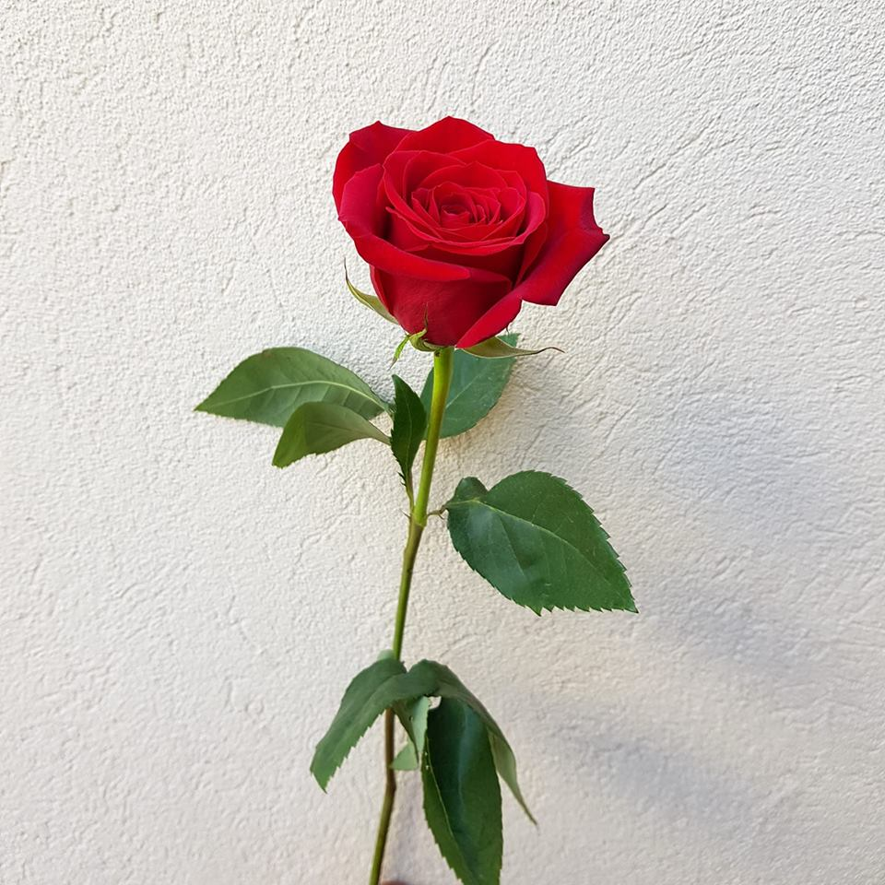
Thank you everybody

Slide 2
Identity of the teacher and the class
Shaiful Haque
Assistant Teacher
Sonargaon High School
Rangunia,chittagong
Class – Ten
Subject- English 2nd paper
Lesson- Tag question

Slide 3
It is very cold today, isn’t it ?
There rains heavily, doesn’t there ?
The mother rose in her, didn’t it ?
Can you guess what the uses of the underlined part in the above sentences are?
Ans : Yes, they are called tag questions.

Slide 4
Yes !
Our Today’s Topic is on -
Tag Questions

Slide 5
Learning outcome
Students will be able to ___
 Define of Tag
 know the use of tag questions clearly.
 use the questions in their real life.
 apply them in dialogue making.

Slide 6
Tag questions are used for justifying the whole statement whether they are true or false.
How to make tag questions generally
After the statement you should use –
a comma
auxiliary verb/operator of the statement.
pronoun form of the subject
a note of interrogation mark.
But when there is an affirmative statement, the tag question will be negative. Then short negative auxiliary form will be used such as-
You study English, don`t you?

Slide 7
A question Tag is a small question at the end of a statement.Question Tags are used when asking for agreement or confirmation.
A positive statement +
A negative question Tag
You are a student, aren`t you?
A negative statement +
A positive question Tag
Marry isn`t a teacher, is she?

Slide 8
positive sentence → negative tag
She is american, isn`t she?
You study english, don’t you?
You were at home, weren`t you?
He can read this book, can`t he?
negative sentence → positive tag
She isn`t american, is she?
You don`t study english, do you?
You weren`t at home, were you?
He can`t read this book, can he?

Slide 9
Group Work
Try to add tag questions on the following statements :
I am a student,...................?
Fire burns,.....................?
Everybody believes him,......?
The father rose in him,.......?
He will explain it,......?
Something happened,.........?
The moon shines at night,....?
What a nice bird it is,...?
To tell a lie is a great sin,......?
Walking is a good exercise,..?

Slide 10
Let`s see the answer
I am a student, aren’t I?
Fire burns, doesn’t it?
Everybody believes him, don’t they?
The father rose in him, didn’t it?
He will explain it, won’t he?
Something happened, didn’t it?
The moon shines at night, doesn’t she?
What a nice bird it is, isn’t it ?
To tell a lie is a great sin, isn’t it?
Walking is a good exercise, isn’t it?

Slide 11
Pair work
Now, add tag questions on the following imperative statements :
Follow the examples.............?
Change the voices,.........?
Don’t tell a lie,.............?
Please , go to your seat,..............?
Let me go now,.............?
Let’s discuss us,..............?
Work hard,.............?

Slide 12
Match your answers :
Follow the examples, won’t you?
Change the voices, won’t you?
Don’t tell a lie, will you?
Please , go to your seat, will you?
Let me go now, will you?
Let’s discuss us, shall we?
Work hard, won’t you?

Slide 13
Single work
Now, add tag questions on the following imperative statements :
Sit down.............?
Let`s go to the party,.........?
Somebody sit at the door,.............?
Nobody called me yesterday,..............?
Sultan never drinks beer,..............?

Slide 14
Match your answers :
Sit down,will you?
Let`s go to the party, shall we?
Somebody sit at the door, aren`t they?
Nobody called me yesterday, did they?
Sultan never drinks beer, does he?

Slide 15
HOME WORK
Write 20 sentences on assertive, exclamatory & imperative sentences and add tag questions on them properly.

Slide 16
welcome

