Slide 1
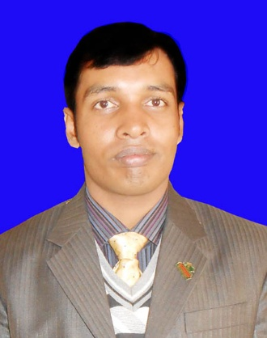
Welcome my dear Students
Class:8
Sub:English 2nd Paper
Date:16.01.2021
Md. Akhtarul Islam
Assistant Teacher English
Boalia Bl High School
Gomastapur Chapai Nawabganj
Cell: 01716472413

Slide 2
Active Voice – Passive Voice
Active voice – Passive voice

Slide 3
Kannan likes apples.
Apples
are liked
by Kannan
He employs a servant.
A servant
is employed
by him

Slide 4
My mother washes my clothes.
My clothes are washed by my mother
Kannan beats Ravi.
Ravi is beaten by Kannan.
We celebrate the Golden Jubilee of our school.
The Golden Jubilee of our school is celebrated by us.

Slide 5
I greet the student.
The student is greeted by me.
The cat kills the rats.
The rats are killed by the cat.
He writes a letter.
A letter is written by him.

Slide 6
Ravi Varma teaches us grammar.
Grammar is taught by Ravi Varma to us.
She helps the poor.
The poor are helped by her.

Slide 7
They killed the enemies.
The enemies
by them
were killed
He wrote a letter.
A letter
was written
by him

Slide 8
were discovered
Thomson discovered the electrons.
The electrons
by Thomson
A car knocked down the child
The child
was knocked down
by a car.
The people gave a grand welcome to the president.
The president was given a grand welcome by the people.

Slide 9
Raja rajan built the Big temple of Tanjore.
The Big temple of Tanjore was built by Raja rajan
My uncle painted this picture.
This picture was painted by my uncle.

Slide 10
Thank you Everyone

