Slide 1
welcome

Slide 2
Identity
Md. Jahangir Alam
Assistant Head Teacher.
Durgapur High School,
Aditmari Lalmonirhat.
E-mail: jahangir7385@gmail.com
Class: Nine
Subject: English 1st paper
Unit: 4 Lesson: 3
Date: 16/01/2021

Slide 3
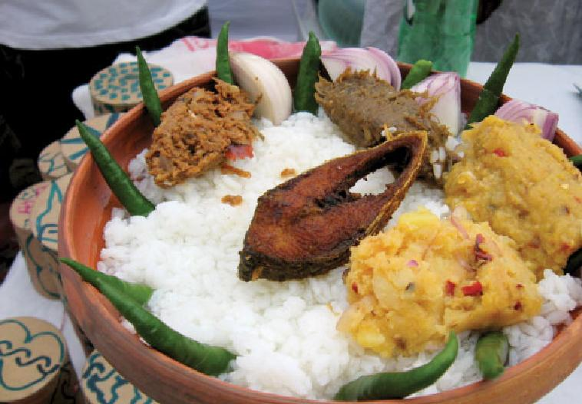

Slide 4
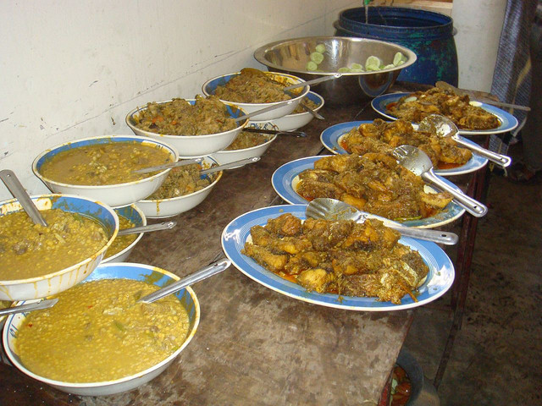

Slide 5
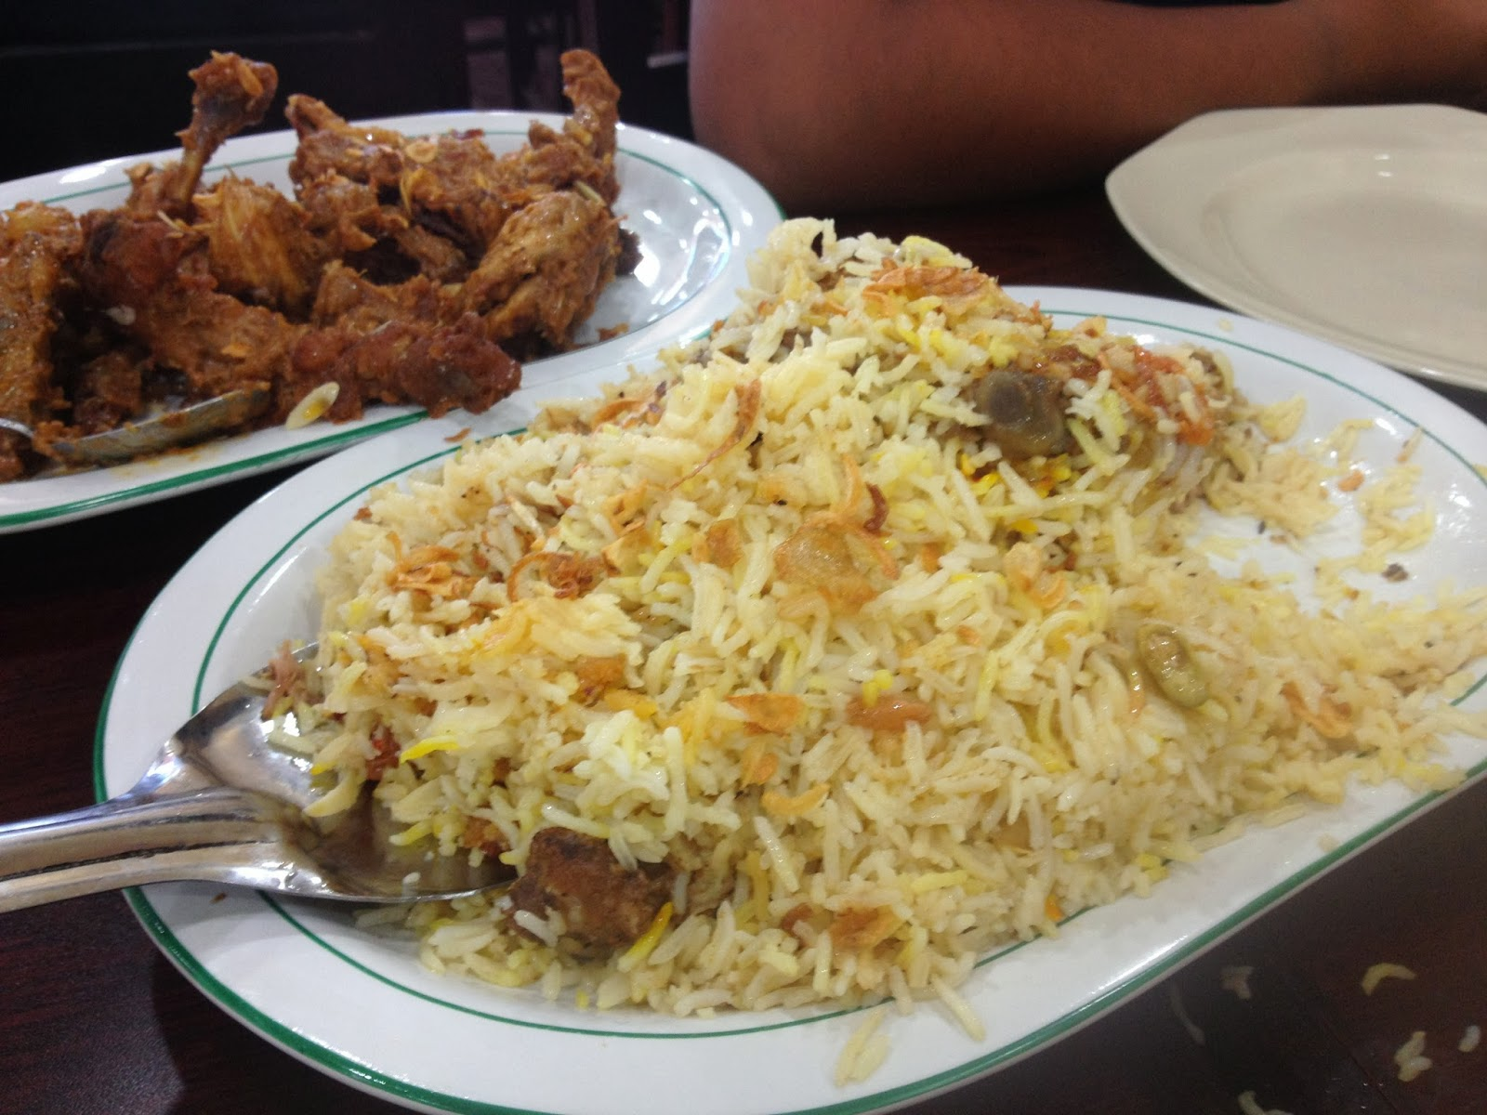

Slide 6
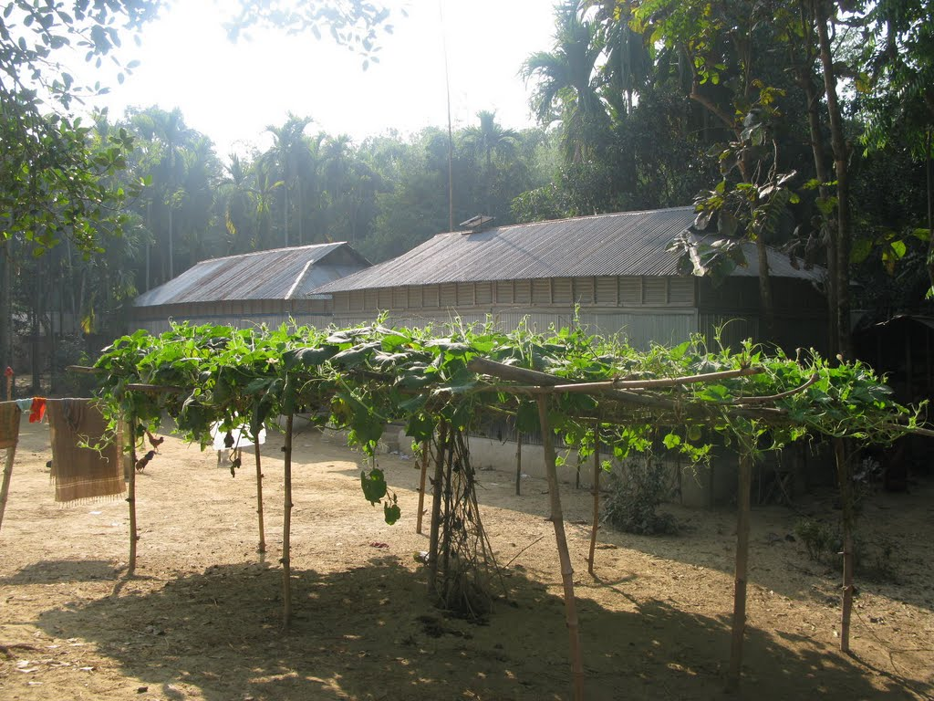

Slide 7
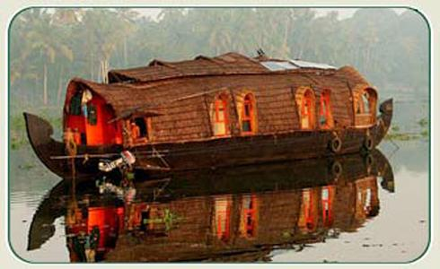

Slide 8
Our food and shelter
Unit: 4 Lesson: 3 Page: 55

Slide 9
By the end of the lesson students will be able to -
describe some pictures.
infer meaning of some new words.
read the passage and answer the questions.
tick the best answer.
write a short paragraph.

Slide 10
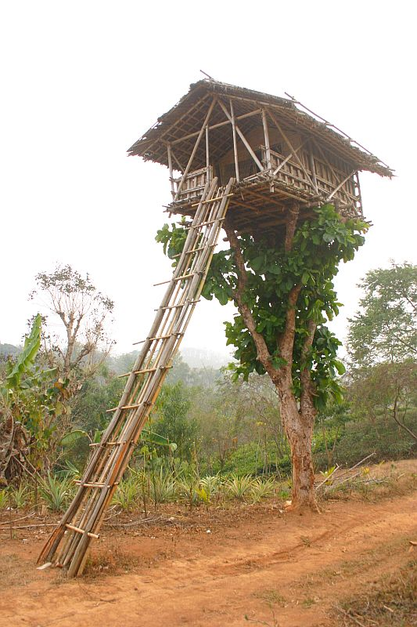
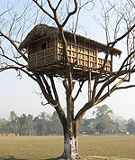
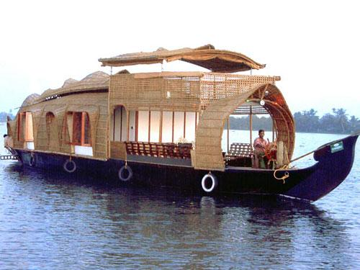
1. What do the people do in the trees and the boats?
2. Why do they do so?

Slide 11
Now discuss what will be our problems if our population becomes double the number we have now.

Slide 12
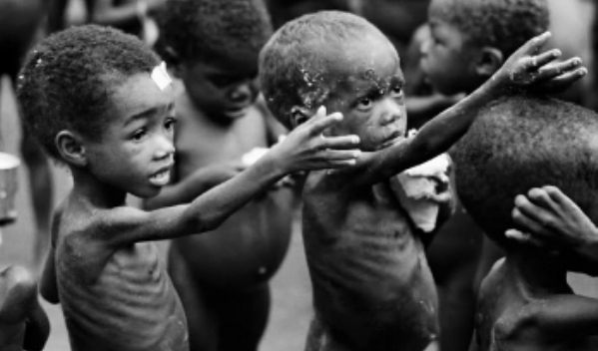
Scarcity
S c a r c i t y
Want of anything/ not easy to get.
The farmers could not plant seedlings in many fields for the scarcity of rain last month.

Slide 13
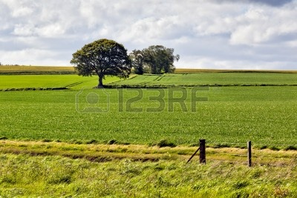
Arable
A r a b l e
cultivable/ suitable for growing crops.
We are building houses in the arable fields.

Slide 14
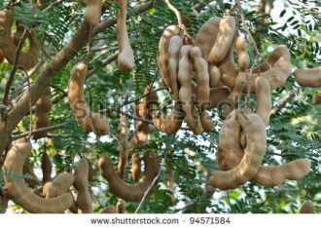
Tamarind
T a m a r i n d
A kind of sour fruits
The girls are fond of eating tamarind.

Slide 15
Now read the passage silently and answer the questions below.
a) About which problems has the first group leader said?
b) About which problems has the second group leader said?
c) What has Ms Choudhury said about?
d) Where would Ms Choudhury often have picnic with her age –mates?

Slide 16
D. Tick the best answer.
E. Make a list of things Ms. Choudhury saw as a child in the village. How do you know from the text that she liked them?

Slide 17
Home Task
F. Write a composition about your village or locality. Describe any change in the things you have noticed over the years such as houses, fields, trees, plants etc.

Slide 18
Thank you

